Slide 1

Lecture 3
Symmetric Encryption II
Stefan Dziembowski
www.crypto.edu.pl/Dziembowski
University of Warsaw
17.11.18
version 1.1

Slide 2
Plan
Pseudorandom functions
Block cipher modes of operation
Block ciphers – popular construction paradigms
Feistel ciphers

Slide 3
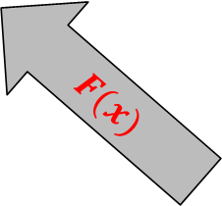
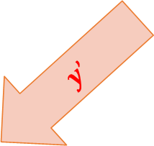
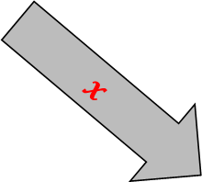
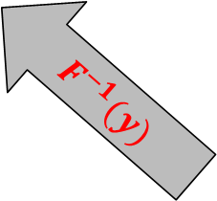
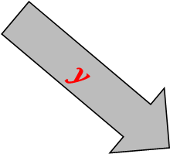
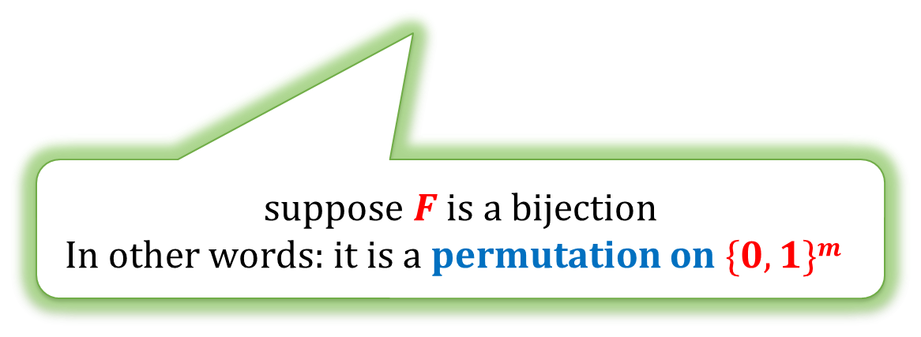
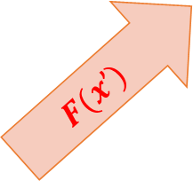
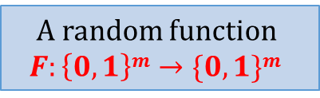
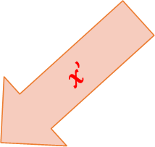
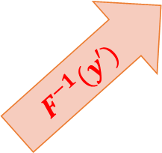
Random permutations
Suppose we have a box with a “random function”
that Alice and Bob can query
$$x$$
$$x’$$
$$F(x)$$
$$F(x’)$$
$$y$$
A random function
$$F:\left\{0,1\right\}m→\{0,1\}m$$
$$y’$$
$$F^{−1}(y)$$
$$F^{−1}(y′)$$
. . .
. . .
suppose $F$ is a bijection
In other words: it is a permutation on $\{0,1\}m$

Slide 4
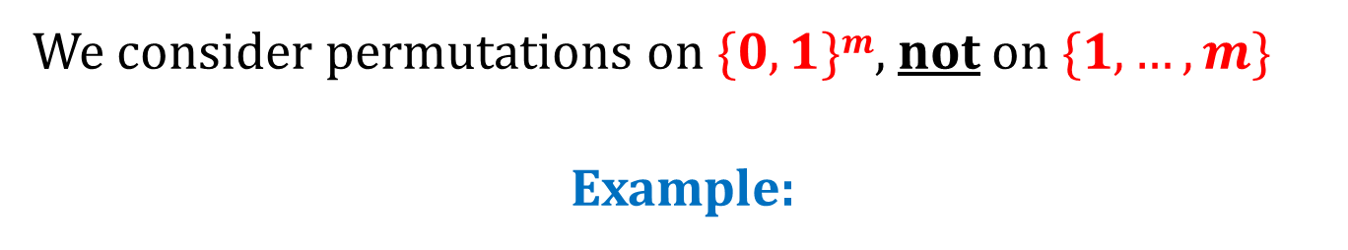
Note
We consider permutations on $\{0,1\}m$, not on $\{1,…,m\}$
Example:
0 | 0 | 0
0 | 0 | 0
0 | 0 | 1
0 | 0 | 1
0 | 1 | 0
0 | 1 | 0
0 | 1 | 1
0 | 1 | 1
1 | 0 | 0
1 | 0 | 0
1 | 0 | 1
1 | 0 | 1
1 | 1 | 0
1 | 1 | 0
1 | 1 | 1
1 | 1 | 1

Slide 5
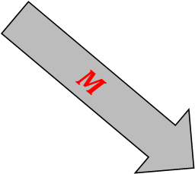
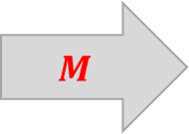
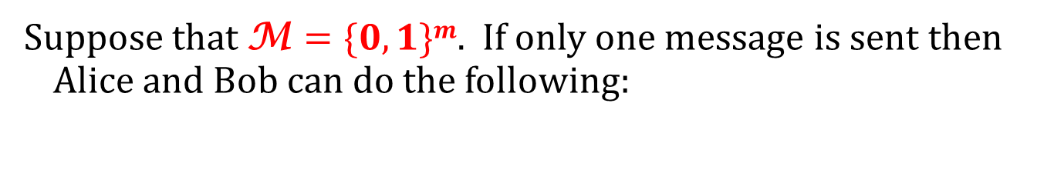

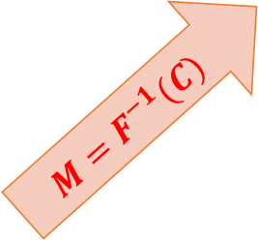
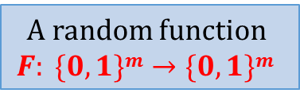
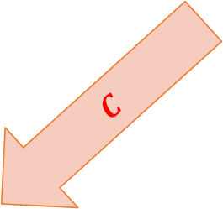
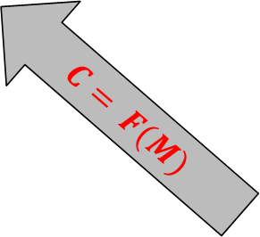
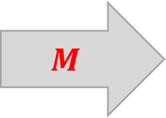
Example of an application: “encryption”
Suppose that M $=\{0,1\}m$. If only one message is sent then Alice and Bob can do the following:
$$M$$
$$C$$
$$M$$
$$C$$
$$M$$
$$C= F(M)$$
$$M=F^{−1}(C)$$
A random function
$$F: \{0,1\}m→\{0,1\}m$$
this requries secure communication, so in practice this “method” doesn’t make sense...

Slide 6

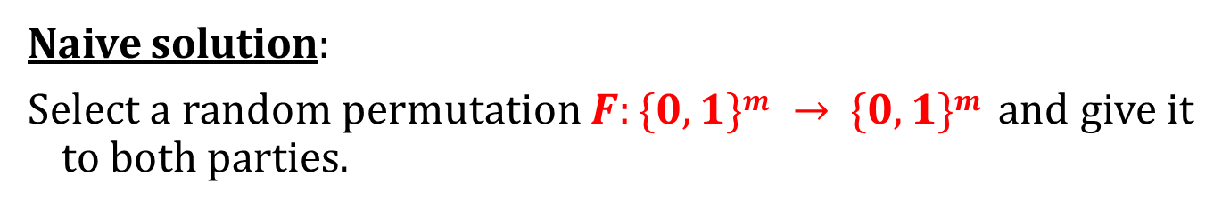

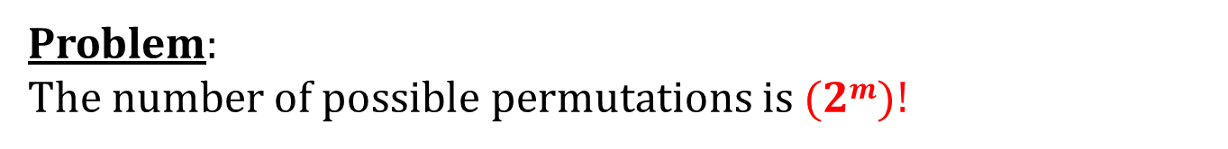
Can this box be simulated in real life?
Naive solution:
Select a random permutation $F:\{0,1\}m → \{0,1\}m$and give it to both parties.
$$F: \{0,1\}m → \{0,1\}m$$
$$F: \{0,1\}m → \{0,1\}m$$
Problem:
The number of possible permutations is $(2m)!$

Slide 7
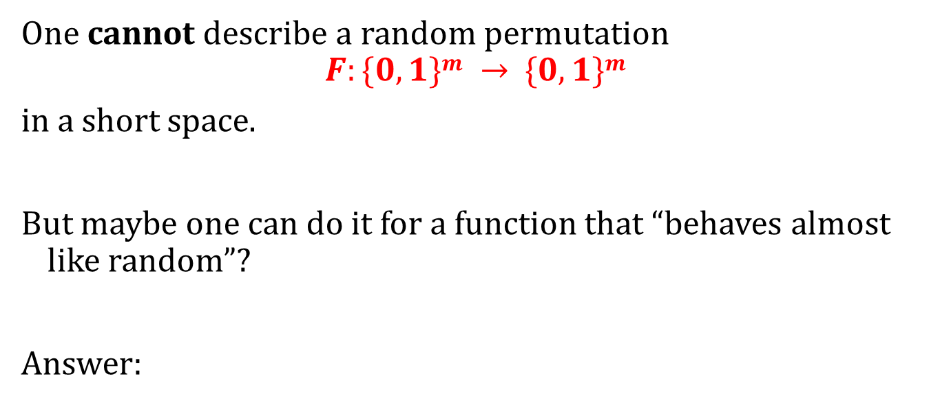
An idea
One cannot describe a random permutation
$$F:\{0,1\}m → \{0,1\}m$$
in a short space.
But maybe one can do it for a function that “behaves almost like random”?
Answer:
YES, it is possible! (under certain assumptions)
objects like these are called
pseudorandom permutations (by the theoreticians)
block ciphers (by the practitioners)

Slide 8

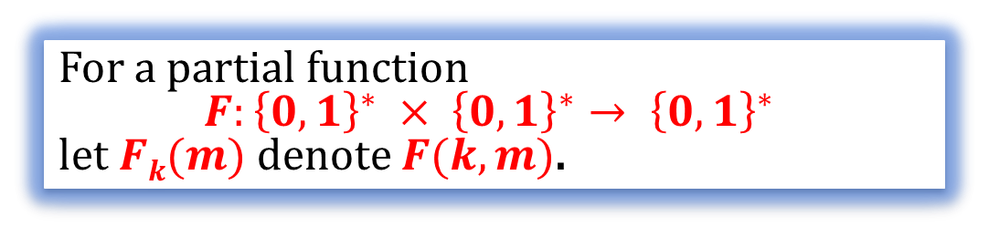

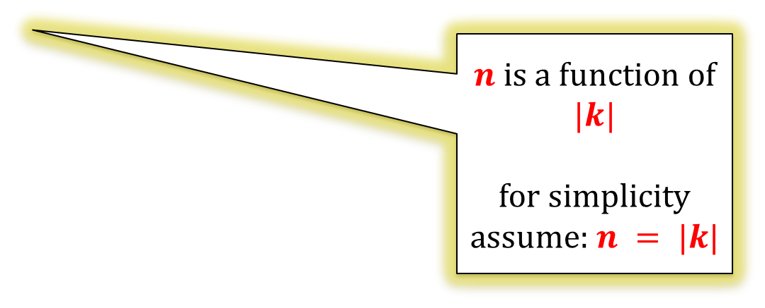
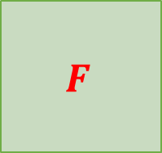
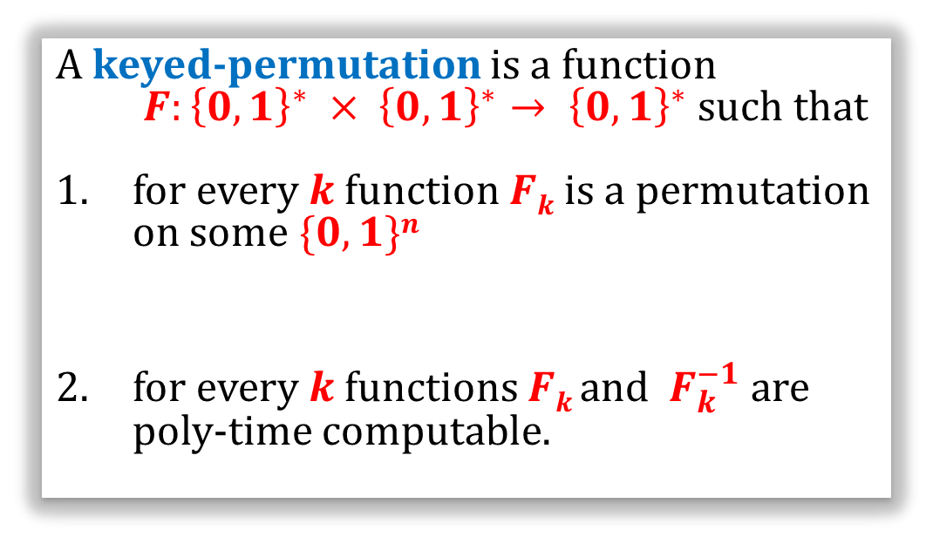

Keyed permutations
For a partial function
$$F:{\left\{0,1\right\}}^{∗} × {\left\{0,1\right\}}^{∗}→ {\left\{0,1\right\}}^{∗}$$
let $Fk(m)$ denote $F(k,m)$.
$$F_{k}(m)$$
$$k$$
$$F$$
A keyed-permutation is a function
$F:{\left\{0,1\right\}}^{∗} × {\left\{0,1\right\}}^{∗}→ {\left\{0,1\right\}}^{∗}$ such that
for every $k$function $Fk$is a permutation on some $\{0,1\}n$
for every $k$ functions $Fk$ and $F_{k}^{−1}$ are poly-time computable.
$$m$$
$n$ is a function of $|k|$
for simplicity assume: $n = |k|$

Slide 9
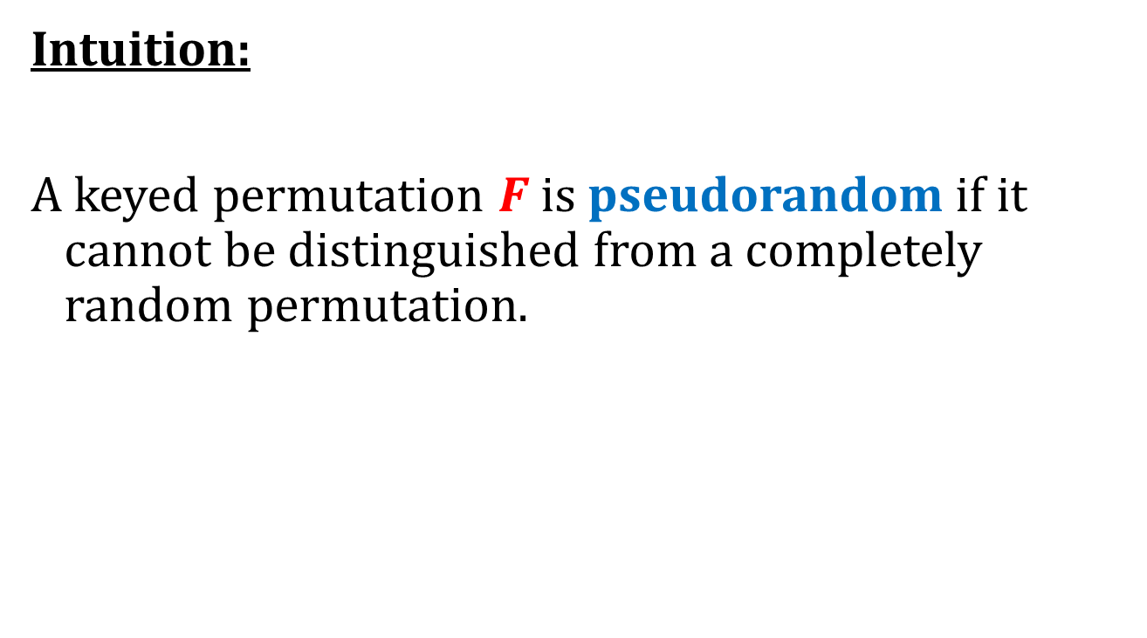
Pseudorandom permutations
Intuition:
A keyed permutation $F$ is pseudorandom if it cannot be distinguished from a completely random permutation.
This has to be formalized

Slide 10



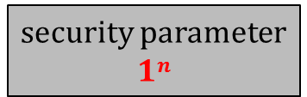


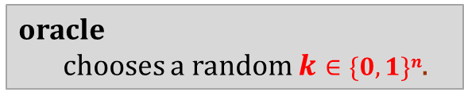

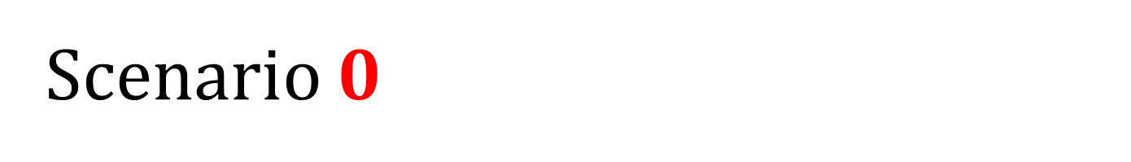


Scenario $0$
security parameter
$$1n$$
distinguisher $D$
oracle
chooses a random $k∈\{0,1\}n$.
$$m1∈\{0,1\}n$$
$$Fk(m1)$$
$$m_{2}∈\{0,1\}n$$
$$Fk(m2)$$
. . .
$$mt∈\{0,1\}n$$
$$Fk(mt)$$
outputs $b∈\{0,1\}$

Slide 11



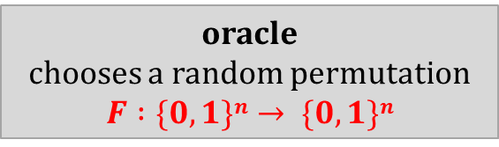

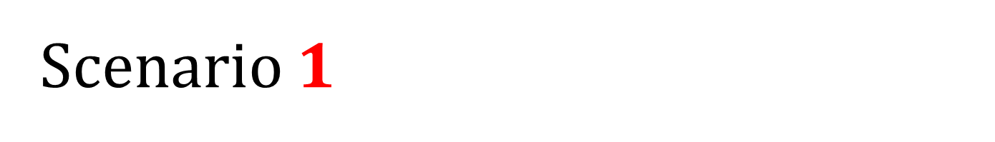
Scenario $1$
security parameter
$$1n$$
oracle
chooses a random permutation
$$F :\{0,1\}n→ \{0,1\}n$$
distinguisher $D$
$$m1∈\{0,1\}n$$
$$F(m1)$$
$$m_{2}∈\{0,1\}n$$
$$F(m2)$$
. . .
$$mt∈\{0,1\}n$$
This of course cannot be done efficiently, but it doesn’t matter
$$F(mt)$$
outputs $b∈\{0,1\}$

Slide 12
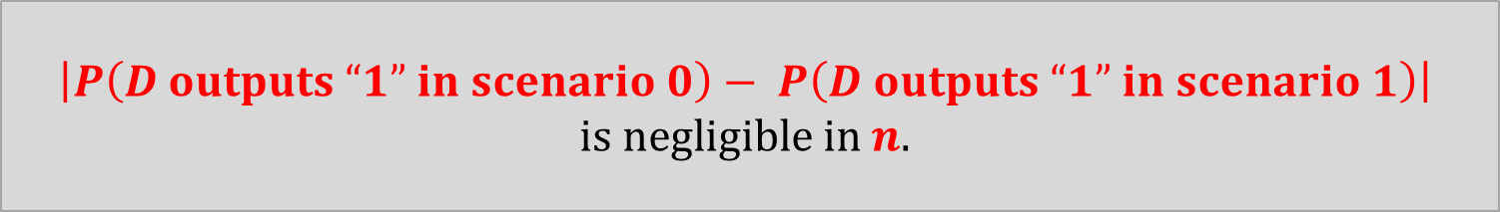
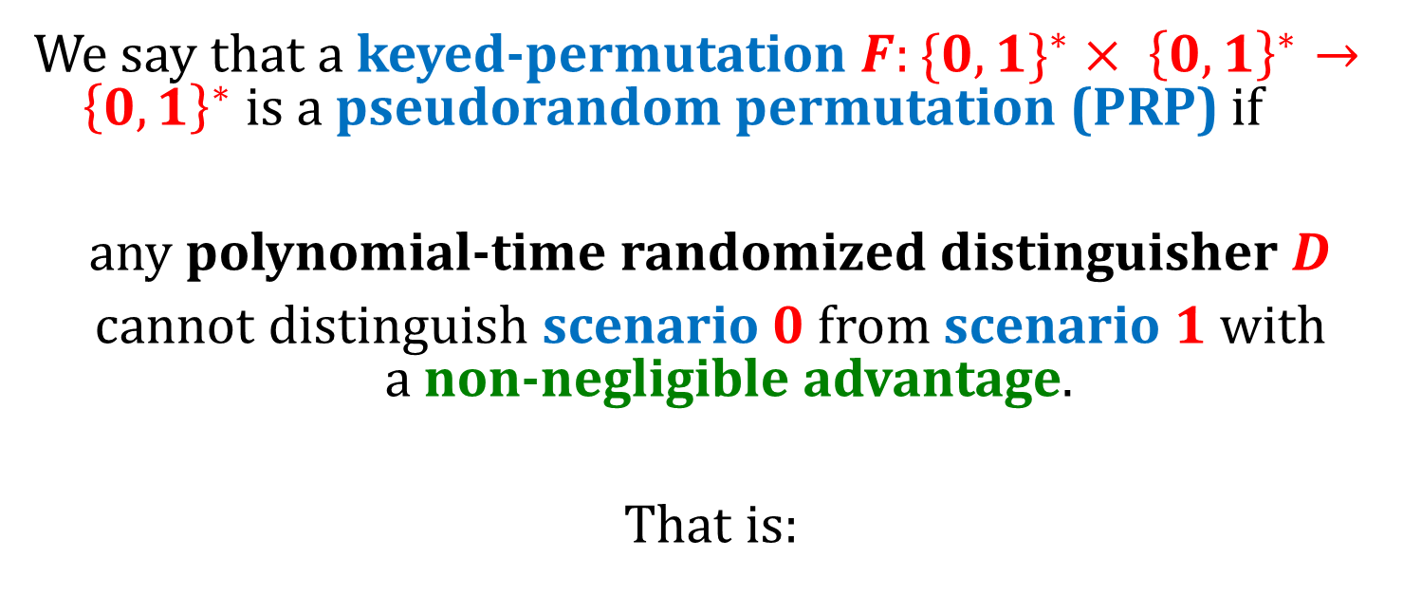
Pseudorandom permutations – the definition
We say that a keyed-permutation $F:\{0,{1\}}^{∗}× {\left\{0,1\right\}}^{∗}→ {\left\{0,1\right\}}^{∗}$is a pseudorandom permutation (PRP) if
any polynomial-time randomized distinguisher $D$
cannot distinguish scenario $0$ from scenario $1$ with
a non-negligible advantage.
That is:
$$\left|P\left(D outputs “1” in scenario 0\right)− P\left(D outputs “1” in scenario 1\right)\right|$$
is negligible in $n$.

Slide 13



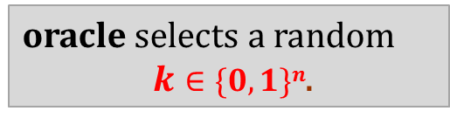
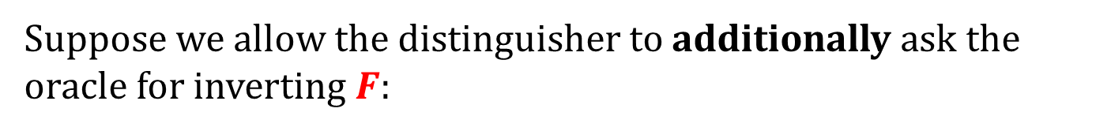
Strong pseudorandom permutations
Suppose we allow the distinguisher to additionally ask the oracle for inverting $F$:
distinguisher $D$
$$ci∈\{0,1\}n$$
oracle selects a random
$k∈\{0,1\}n$.
$$F_{k}^{−1}(ci)$$
Then we get a definition of a strong pseudorandom permutation.

Slide 14
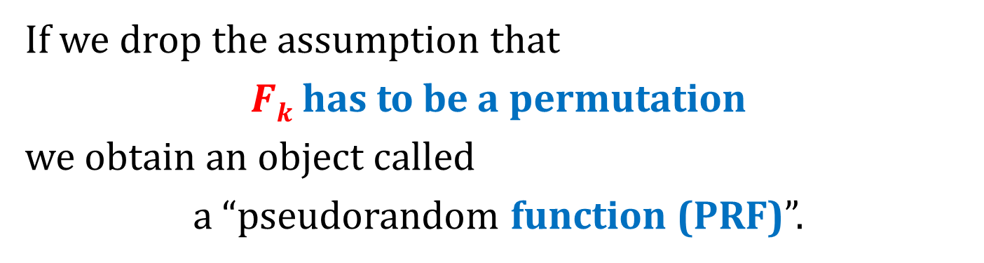
PRFs vs PRP
If we drop the assumption that
$Fk$has to be a permutation
we obtain an object called
a “pseudorandom function (PRF)”.
The security definition doesn’t change.
In fact those two objects are indistinguishable for a polynomial-time adversary.

Slide 15
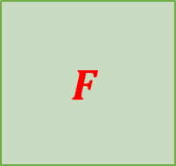



Terminology
Before we had:
stream ciphers ≈ pseudorandom generators
Similarly:
block ciphers ≈ pseudorandom permutations
“ciphertext”
$$F(m)$$
this terminology is a bit confusing
$$k$$
$$F$$
“block”
“plaintext”
$$m$$

Slide 16


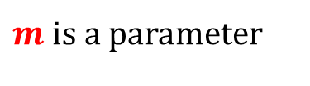






Another way to look at the stream ciphers :
$m$ is a parameter
give me block $1$
$$GK(1)∈\{0,1\}m$$
give me block $2$
$$GK$$
$$GK(2)∈\{0,1\}m$$
give me block $3$
$$GK(3)∈ \{0,1\}m$$
. . .
. . .
Requiremenent:
$$G_{K}\left(1\right),G_{K}\left(2\right),G_{K}\left(3\right),…$$
has to “look random” if is $K$ random and secret.

Slide 17

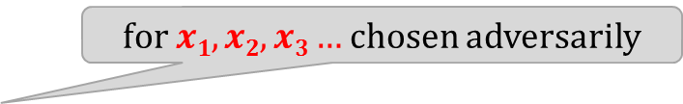


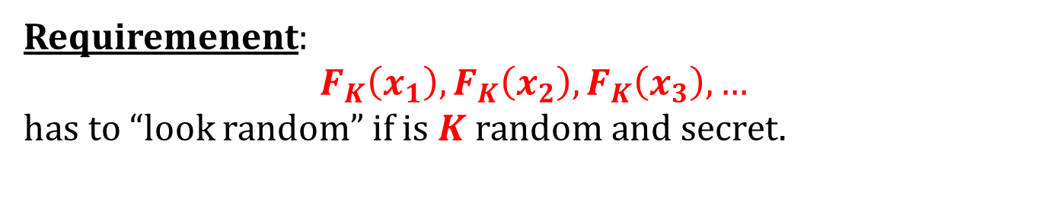




Block ciphers:
$m$ is a parameter
give me block $x1  \{0,1\}m$
$$FK(x1)  \{0,1\}m$$
give me block $x2  \{0,1\}m$
$$FK$$
$$FK(x2)  \{0,1\}m$$
give me block $x3  \{0,1\}m$
$$FK(x3)  \{0,1\}m$$
. . .
. . .
for $x1,x2,x3…$chosen adversarily
Requiremenent:
$$F_{K}\left(x_{1}\right),F_{K}\left(x_{2}\right),F_{K}\left(x_{3}\right),…$$
has to “look random” if is $K$ random and secret.

Slide 18














An additional property of the block ciphers
give me block $x1$
$$FK(x1)$$
give me block $x2$
$$FK$$
$$FK(x2)$$
give me block $x3$
$$FK(x3)$$
invert $FK(x1)$
$$x1$$
invert $FK(x2)$
$$FK$$
$$x2$$
invert $FK(x3)$
$$x3$$

Slide 19
Popular block ciphers
A great design.
The only practical weakness: short key.
Can be broken by a brute-force attack.
 | key length | block length
DES (1976) (Data Encryption Standard) | 56 | 64
IDEA (1991) (International Data Encryption Algorithm) | 128 | 64
AES (1998) (Advanced Encryption Standard) | 128, 192 or 256 | 128
Other: Blowfish, Twofish, Serpent,...

Slide 20






How to encrypt using the block ciphers?
A naive (wrong) idea: Encrypt short blocks:
plaintext $m$
key $k$
encryption $Fk$
ciphertext $c$
key $k$
decryption $F_{k}^{−1}$
plaintext $m$
Problems:
the messages have to be short
it is deterministic and has no state, so it cannot be CPA-secure.

Slide 21
Plan
Pseudorandom functions
Block cipher modes of operation
Block ciphers – popular construction paradigms
Feistel ciphers

Slide 22
Block cipher modes of operation
Block ciphers cannot be used directly for encryption.
They are always used in some “modes of operation”
Electronic Codebook (ECB) mode ← not secure,
Cipher-Block Chaining (CBC) mode,
Output Feedback (OFB) mode,
Counter (CTR) mode,
. . .

Slide 23





















Electronic Codebook mode
plaintext
encryption:
. . .
block 1
block 2
block 3
block $t$
$$Fk$$
$$Fk$$
$$Fk$$
$$Fk$$
block $1$
block $2$
block $3$
block $t$
ciphertext
decryption:
block $1$
block $2$
block $3$
block $t$
. . .
$$F_{k}^{−1}$$
$$F_{k}^{−1}$$
$$F_{k}^{−1}$$
$$F_{k}^{−1}$$
block $1$
block $2$
block $2$
block $t$
plaintext

Slide 24
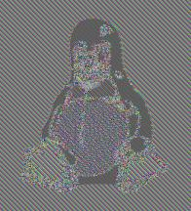
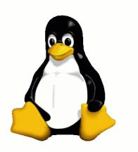
This mode was used in the past.
It is not secure, and should not be used.
Example:
ECB
© wikipedia

Slide 25










Cipher-Block Chaining (CBC)
encryption:
plaintext
block $1$
block $2$
block $3$
. . .
block $t$
xor
xor
xor
xor
$$Fk$$
$$Fk$$
$$Fk$$
$$Fk$$
random
initial
value
block $1$
block $2$
block $3$
block $t$
ciphertext

Slide 26











Cipher-Block Chaining (CBC)
decryption:
ciphertext
initial
value
block $1$
block $2$
block $3$
. . .
block $t$
$$F_{k}^{−1}$$
$$F_{k}^{−1}$$
$$F_{k}^{−1}$$
$$F_{k}^{−1}$$
xor
xor
xor
xor
block $1$
block $2$
block $3$
block $t$
plaintext

Slide 27
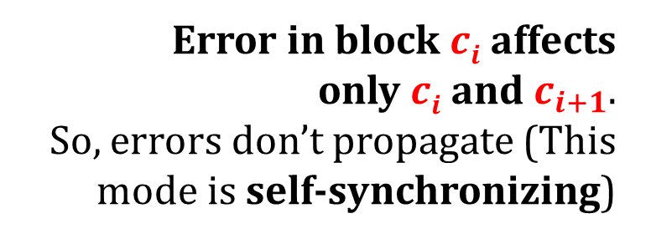
CBC mode – properties
Error in block $ci$ affects
only $ci$ and $c_{i+1}$.
So, errors don’t propagate (This mode is self-synchronizing)
Error propagation?
Can encryption be parallelized?
No
Can decryption be parallelized?
Yes
What if one bit of plaintext is changed?
Everything needs to be recomputed
(not so good e.g. for disc encryption)

Slide 28


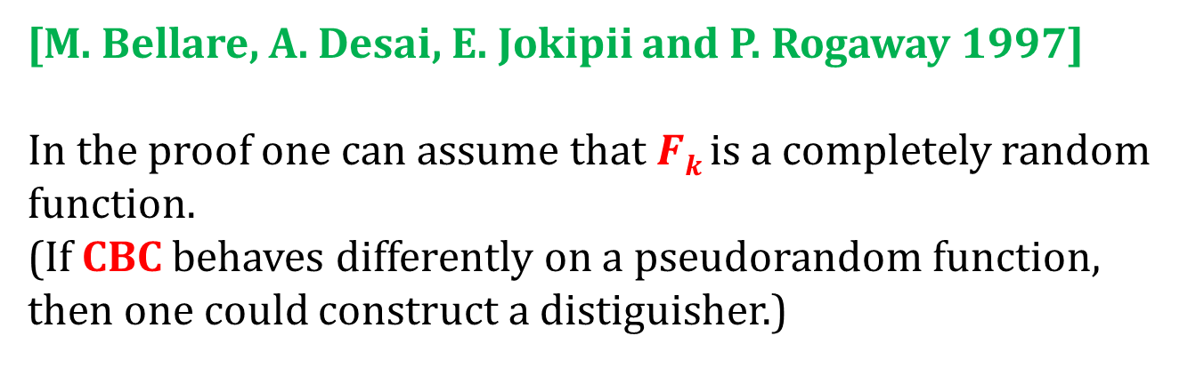
CBC mode is secure
Theorem. If $F$ is a PRP then $F$-CBC is secure.
[M. Bellare, A. Desai, E. Jokipii and P. Rogaway 1997]
In the proof one can assume that $Fk$ is a completely random function.
(If CBC behaves differently on a pseudorandom function, then one could construct a distiguisher.)
plaintext
plaintext
CBC
CBC
. . .
. . .
$$Fk$$
$$Fk$$
random
random
ciphertext
ciphertext

Slide 29












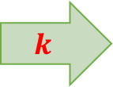
How to convert a pseudorandom permutation into a pseudorandom generator?
0000001
$$0000002$$
$$0000003$$
$$0000004$$
a seed
$$k$$
$$Fk$$
. . .
$$Fk$$
$$Fk$$
$$Fk$$
block $1$
block $2$
block $3$
block $4$
a pseudorandom stream
$$G(k) := Fk(1) || Fk(2) || Fk(3) || ···$$
Essentially, this is called a “counter mode” (CTR).

Slide 30

How to “randomize” this?
take some random IV
IV+1
IV+2
IV+3
IV+4
a seed
$$k$$
$$Fk$$
. . .
$$Fk$$
$$Fk$$
$$Fk$$
block 1
block 2
block 3
block 4
a pseudorandom stream
$$G(k,IV) := Fk(IV + 1) || Fk(IV + 2) || Fk(IV + 3) || ···$$
Note:
We have to be sure that IV + i never repeats.
This is why it is bad if the block length is too small (like in DES).

Slide 31
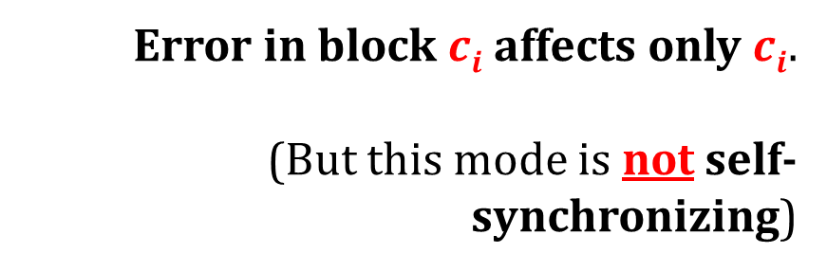
CTR mode – properties
Error in block $ci$ affects only $ci$.
(But this mode is not self-synchronizing)
Error propagation?
Can encryption be parallelized?
Yes
Can decryption be parallelized?
Yes
What if one bit of plaintext is changed?
Only one block needs to be recomputed

Slide 32
One more member of minicrypt!
pseudorandom
functions/permutations
exist
using “modes of operation”
this can also be proven
secure encryption
exist
this we already knew
one-way functions
exist

Slide 33


There are many constructions of block ciphers that are believed to be secure
Why do we believe it?
Someone important say “it is secure”.
(But is he honest?)
Many people tried to break it and they failed...

Slide 34
Plan
Pseudorandom functions
Block cipher modes of operation
Block ciphers – popular construction paradigms
Feistel ciphers

Slide 35
Block ciphers – typical requirements
security: ideally the best attack should be the brute force key search.
efficiency when implemented on:
  8 bit microcontrollers and smart cards with limited memory
  tablets, phones, palmtops,
  PCs, workstations, servers,
  dedicated hardware (ASICs, FPGAs) – here we might require speeds up to gigabits/second
key agility – changing the key can be done very efficiently

Slide 36
Block ciphers – more “informal” requirements
simplicity – advantages:
  easier to implement
  more confidence that there is no backdoor
symmetry (repeating patterns):
  smaller circuits (in hardware)
  easier to program (in software).

Slide 37
Block ciphers –advanced security requirements
resistance to the side-channel attacks,
resistance to the key-related attacks.

Slide 38









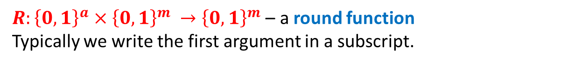


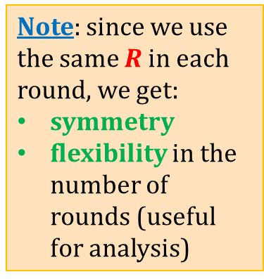
A very popular paradigm: iterated ciphers
$R:{\left\{0,1\right\}}^{a}×{\left\{0,1\right\}}^{m }→{\left\{0,1\right\}}^{m}$ – a round function
Typically we write the first argument in a subscript.
$$m$$
subkeys:
input $M_{0}$
$$a$$
key $k$
rounds
$$k1$$
$$M_{1}=R_{k_{1}}\left(M_{0}\right)$$
$$k2$$
$$M_{2}=R_{k_{2}}\left(M_{1}\right)$$
Note: since we use the same $R$ in each round, we get:
symmetry
flexibility in the number of rounds (useful for analysis)
key
schedule
. . .
. . .
$$kn$$
$$M_{n}=R_{k_{n}}\left(M_{n−1}\right)$$
output $M_{n}$

Slide 39
Popular types of iterated ciphers
Feistel ciphers
Substitution-permutation networks
Lai-Massey ciphers

Slide 40
Plan
Pseudorandom functions
Block cipher modes of operation
Block ciphers – popular construction paradigms
Feistel ciphers

Slide 41
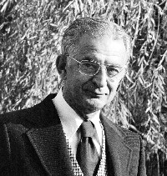
Feistel ciphers
Invented by Horst Feistel (1915-1990) in 1970s while working at IBM.
First used in Lucifer. Most famous use: Data Encryption Standard (DES).
Other ciphers that use it:
Blowfish, Camellia, CAST-128, FEAL, GOST 28147-89, ICE, KASUMI, LOKI97, MARS, MAGENTA, MISTY1, RC5, Simon, TEA, Twofish, XTEA,...

Slide 42
DES (Digital Encryption Standard)
Key length:
  effective: 56 bits
  formally: 64 bits (8 bits for checking parity).
Block length: 64 bits

Slide 43
History of DES
First version designed by IBM in 1973-74, based on a Lucifer cipher (by Horst Feistel).
National Security Agency (NSA) played some role in the design of DES.
Made public in 1975.
Approved as a US federal standard in November 1976.

Slide 44

Criticism of DES
The key is to short (only 56 bits).
Unclear role of NSA in the design
  hidden backdoor?
  $256$ : feasible for NSA, infeasible for the others
  (in the 1970s)?

Slide 45
Security of DES
The main weakness is the short key (brute-force attacks are possible).
Also the block length is too small.
Apart from this – a very secure design:
after 4 decades still the most practical attack is brute-force!
The only attacks so far:
differential cryptanalysis
linear cryptanalysis
are rather theoretical

Slide 46
The role of NSA
The United States Senate Select Committee on Intelligence (1978):
"In the development of DES, NSA convinced IBM that a reduced key size was sufficient; indirectly assisted in the development of the S-box structures; and certified that the final DES algorithm was, to the best of their knowledge, free from any statistical or mathematical weakness.”
"NSA did not tamper with the design of the algorithm in any way. IBM invented and designed the algorithm, made all pertinent decisions regarding it, and concurred that the agreed upon key size was more than adequate for all commercial applications for which the DES was intended."

Slide 47
Brute-force attacks on DES
1977
Diffie and Hellman proposed a machine costing 20 million $ breaking DES in 1 day.
1993
Wiener proposed a machine costing 1 million $ breaking DES in 7 hours.
1997
DESCHALL Project broke a “DES Challenge” (published by RSA) in 96 days using idle cycles of thousands of computers across the Internet.
1998
a DES-cracker was built by the Electronic Frontier Foundation (EFF), at the cost of approximately 250,000$
2000s
COPACOBANA (the Cost-Optimized Parallel COde Breaker) breaks DES in 1 week and costs 10,000$

Slide 48


DES-cracker
COPACOBANA

Slide 49




Theoretical attacks on DES – differential cryptoanalysis
Biham and Shamir (late 1980s):
differential cryptoanalysis
They show how to break DES using a chosen-plaintext attack.
$247$ times
plaintext
DES_{k}
ciphertext
$$k$$
Not very practical...

Slide 50
Differential cryptoanalysis – an interesting observation
A small change in the design of DES would make the differential cryptanalysis much more sucesfull.
Moral
NSA and IBM knew it!

Slide 51

"After discussions with NSA, it was decided that disclosure of the design considerations would reveal the technique of differential cryptanalysis, a powerful technique that could be used against many ciphers. This in turn would weaken the competitive advantage the United States enjoyed over other countries in the field of cryptography.”
Don Coppersmith, IBM
see: Coppersmith, Don (May 1994). "The Data Encryption Standard (DES) and its strength against attacks" (PDF). IBM Journal of Research and Development 38 (3): 243. http://www.research.ibm.com/journal/rd/383/coppersmith.pdf.

Slide 52

Theoretical attacks on DES – linear cryptoanalysis
Matsui (early 1990s):
linear cryptoanalysis
uses a known-plaintext attack
$243$ (plaintext, ciphertext) pairs
this means:
the adversary doesn’t need to choose the plaintexts
Let’s now discuss in detail how DES is built.

Slide 53
















subkeys:
$$m/2$$
$$m/2$$
Feistel
network
$$L0$$
$$R0$$
$$k1$$
$$f$$
$$k$$
$$L1$$
$$R1$$
$$k2$$
$$f$$
$n$ “Feistel rounds”
key
schedule
. . .
. . .
$$kn$$
$$f$$
here no twist
$$Ln$$
$$Rn$$

Slide 54








A nice propery of Feistel rounds
Even if $f$is not easily invertible, each round can be easily inverted!
$$Li$$
$$Ri$$
$$f$$
$$L_{i+1}:= Ri$$
$$R_{i+1}:= L_{i} xor f(Ri)$$
inversion:
$$f$$
$$(L_{i} xor f (Ri)) xor f(L_{i+1})$$
$$Ri$$
=
$$Li$$

Slide 55






















Hence: the Feistel network can be “inverted”!
Example: 3 round Feistel network
$$L0$$
$$R0$$
$$L3$$
$$R3$$
$$f1$$
$$f3$$
$$L1$$
$$R1$$
$$L2$$
$$R2$$
$$f2$$
$$f2$$
$$L2$$
$$R2$$
$$L1$$
$$R1$$
$$f3$$
$$f1$$
$$L3$$
$$R3$$
$$L0$$
$$R0$$

Slide 56



Without a “twist” in the last round:
$$L0$$
$$R0$$
$$L3$$
$$R3$$
$$f1$$
$$f3$$
$$L1$$
$$R1$$
$$L2$$
$$R2$$
$$f2$$
$$f2$$
$$L2$$
$$R2$$
$$L1$$
$$R1$$
$$f3$$
$$f1$$
$$L3$$
$$R3$$
$$L0$$
$$R0$$

Slide 57






How to decrypt?
Reverse the key schedule (note: symmetry)!
$$L0$$
$$R0$$
$$kn$$
$$f$$
key $k$
$$L1$$
$$R1$$
$k_{n−1}$
$$f$$
key
schedule
$$. . .$$
$$. . .$$
$$k1$$
$$f$$
$$Ln$$
$$Rn$$

Slide 58

Feistel networks are also studied by the theoreticians
Suppose $f$is a pseudorandom function, and we use it to construct a Feistel network.
Then:
the $3$-round Feistel network is a pseudorandom permutation,
the $4$-round Feistel network is a strong pseudorandom permutation.
see M. Luby and C. Rackoff. "How to Construct Pseudorandom Permutations and Pseudorandom Functions." In SIAM J. Comput., vol. 17, 1988, pp. 373-386.

Slide 59

How is the Feistel network used in DES?
The following needs to be described:
The concrete parameters
The key schedule algorithm.
The functions $f$.

Slide 60


DES:
$64$ bits
input
initial permutation (IP)
key $k$
“Feistel network”
16 rounds
56 bits
final permutation (IP⁻¹)
output

Slide 61







DES key schedule
$48$ bits
$$k1$$
$56$ bits
$$k$$
$$k2$$
$$. . .$$
key
schedule
$$k16$$
each subkey $ki$ consists of some bits of $k$ (we skip the details)

Slide 62








function $f$:
$32$bits
48 bits
half-block $X$
subkey $Ki$
expansion
half-block $Y$
48 bits
$$Y xor K_{i}$$
“confusion”
“S – boxes”
$$Si: \{0,1\}6 → \{0,1\}4$$
S₁
S₂
S₃
S₄
S₅
S₆
S₇
S₈
“diffusion”
permutation $P$
$32$ bits

Slide 63

The expansion function
32 | 1 | 2 | 3 | 4 | 5
4 | 5 | 6 | 7 | 8 | 9
8 | 9 | 10 | 11 | 12 | 13
12 | 13 | 14 | 15 | 16 | 17
16 | 17 | 18 | 19 | 20 | 21
20 | 21 | 22 | 23 | 24 | 25
24 | 25 | 26 | 27 | 28 | 29
28 | 29 | 30 | 31 | 32 | 1

Slide 64


Permutation $P$
16 | 7 | 20 | 21
29 | 12 | 28 | 17
1 | 15 | 23 | 26
5 | 18 | 31 | 10
2 | 8 | 24 | 14
32 | 27 | 3 | 9
19 | 13 | 30 | 6
22 | 11 | 4 | 25

Slide 65


Properties of $P$
The construction of $P$ looks a bit ad-hoc.
Still, some properties of it are known:
The four bits output from an S-box are distributed so that they affect six different S-boxes in the following round.
If an output bit from S-box $i$ affects one of the two middle input bits to S-box $j$ (in the next round), then an output bit from S-box $i$ cannot affect a middle bit of S-box $i$.
The middle six inputs to two neighbouring S-boxes (those not shared by any other S-boxes) are constructed from the outputs from six different S-boxes in the previous round.
The middle ten input bits to three neighbouring S-boxes, four bits from the two outer S-boxes and six from the middle S-box, are constructed from the outputs from all S-boxes in the previous round.

Slide 66
The substitution boxes
(S-boxes)
Example of an S-box
S₅ |  | Middle 4 bits of input
 |  | 0000 | 0001 | 0010 | 0011 | 0100 | 0101 | 0110 | 0111 | 1000 | 1001 | 1010 | 1011 | 1100 | 1101 | 1110 | 1111
Outer bits | 00 | 0010 | 1100 | 0100 | 0001 | 0111 | 1010 | 1011 | 0110 | 1000 | 0101 | 0011 | 1111 | 1101 | 0000 | 1110 | 1001
 | 01 | 1110 | 1011 | 0010 | 1100 | 0100 | 0111 | 1101 | 0001 | 0101 | 0000 | 1111 | 1010 | 0011 | 1001 | 1000 | 0110
 | 10 | 0100 | 0010 | 0001 | 1011 | 1010 | 1101 | 0111 | 1000 | 1111 | 1001 | 1100 | 0101 | 0110 | 0011 | 0000 | 1110
 | 11 | 1011 | 1000 | 1100 | 0111 | 0001 | 1110 | 0010 | 1101 | 0110 | 1111 | 0000 | 1001 | 1010 | 0100 | 0101 | 0011
G

Slide 67
Properties of S-boxes [1/2]
The design of S-boxes was controversial from the beginning (we discussed it before).
Responding to this the designers of DES published the criteria that they were using in this design:
No S-box is a linear or afﬁne function of the input.
Changing one bit in the input to an S-box results in changing at least two output bits.
The S-boxes were chosen to minimise the difference between the number of 1’s and 0’s when any single input bit is held constant.

Slide 68

Properties of S-boxes [2/2]
For any S-box $S$, it holds that
$S[x]$ and $S[x⊕001100]$
differ in at least two bits.
For any S-box $S$, it holds that
$S\left[x\right]≠S[x⊕11rs00]$
for any binary values $r$ and $s$.
If two different $48$-bit inputs to the ensemble of eight S-boxes result in equal outputs, then there must be different inputs to at least three neighbouring S-boxes.
For any S-box it holds that for any nonzero $6$-bit value α, and for any 4-bit value $β$, that the number of solutions (for $x$) to the equation
$S\left[x\right]⊕S\left[x⊕α\right]=β$
is at most 16.
makes the differential cryptanalysis harder

Slide 69
DES – the conclusion
The design of DES is extremally good.
The only weaknesses: short key and block.
Enormous impact on research in cryptography!

Slide 70
One practical weakness of Feistel networks
Only half of the message is processed at one time.
Question: Is there any alternative construction that does not have this problem?
Yes! (substitution-permutation networks)

Slide 71
©2018 by Stefan Dziembowski. Permission to make digital or hard copies of part or all of this material is currently granted without fee provided that copies are made only for personal or classroom use, are not distributed for profit or commercial advantage, and that new copies bear this notice and the full citation.

