Slide 1



MPC-hardness and applications
Mathematics for the Real World
Kyiv/Odense
August 28, 2026
Stefan Dziembowski

Slide 2
This talk is based on my recent work
W. Ciszewski, S. Dziembowski, T. Lizurej, and M. Mielniczuk: On the Pitfalls of Modeling Individual Knowledge, ACM CCS 2026
S.D., S. Faust, P. Kedzior, M. Mielniczuk, S. K. Mohanty, and K. Pietrzak: Beholder Signatures, CRYPTO 2026
J. Bormet, S. D., S. Faust, T. Lizurej, and M. Mielniczuk: Strong Secret Sharing with Snitching, CRYPTO 2025
S. D., S. Faust, T. Lizurej, and M. Mielniczuk: Secret Sharing with Snitching, ACM CCS 2024
S. D., S. Faust, and T. Lizurej:
Individual Cryptography, CRYPTO 2023
Independent work:
M. Kelkar, K. Babel, P. Daian, J. Austgen, V. Buterin, A. Juels: Complete Knowledge: Preventing Encumbrance of Cryptographic Secrets, ACM CCS 2024

Slide 3

Plan
Introduction to different models in distributed cryptography
Secret Sharing with Snitching
Other applications of MPC-hardness
Extensions and research problems

Slide 4







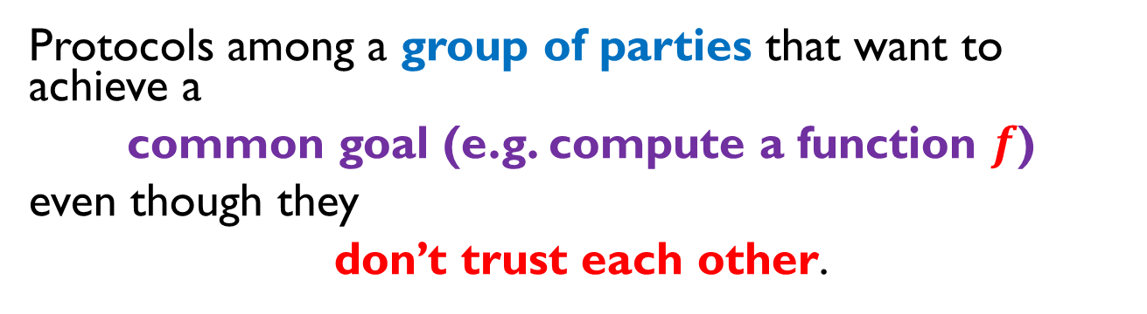
Distributed cryptography
Protocols among a group of parties that want to achieve a
common goal (e.g. compute a function $f$)
even though they
don’t trust each other.
This is called a secure multiparty computation protocol
(MPC)

Slide 5
Two approaches
classical cryptographic approach
(MPCs, consensus, broadcast,…)
– an active area since the 1980s.
blockchain – introduced in 2008 by an pseudonymous author
slightly different models

Slide 6



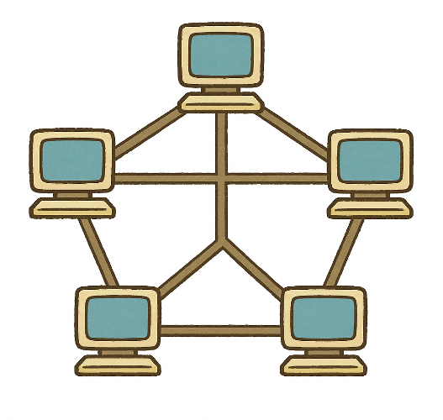




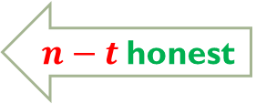
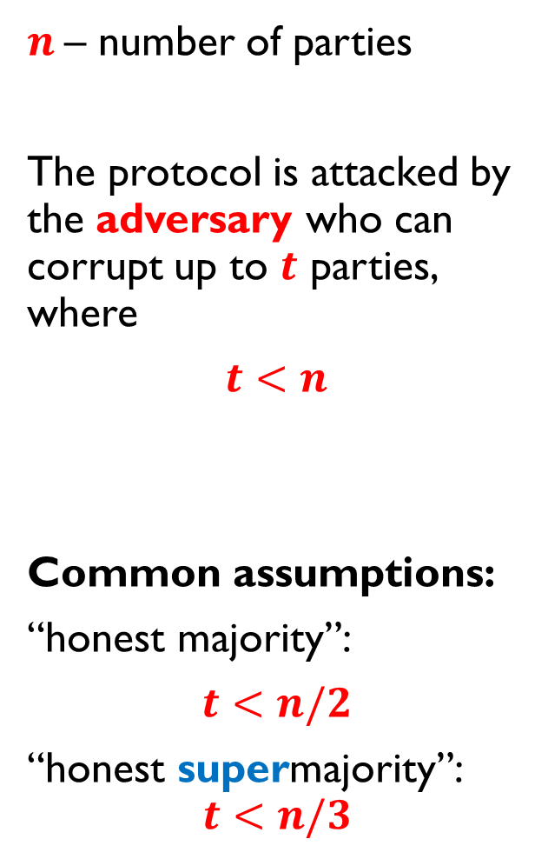
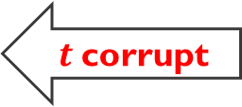
Typical settings
$n$– number of parties
The protocol is attacked by the adversary who can corrupt up to $t$ parties, where
$t<n$
Common assumptions:
“honest majority”:
$t<n/2$
“honest supermajority”:
$$t<n/3$$
$n−t$honest
$t$corrupt
adversary

Slide 7
“Secure evaluation”?
Typical requirements:
correctness – the output is correct
privacy – the inputs remain private
The only way the adversary can influence the output is to manipulate the inputs of the corrupt parties.
The adversary does not learn more than she can infer from the input and output of corrupt parties.

Slide 8
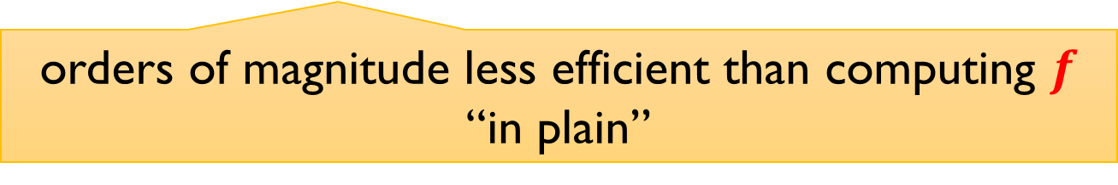
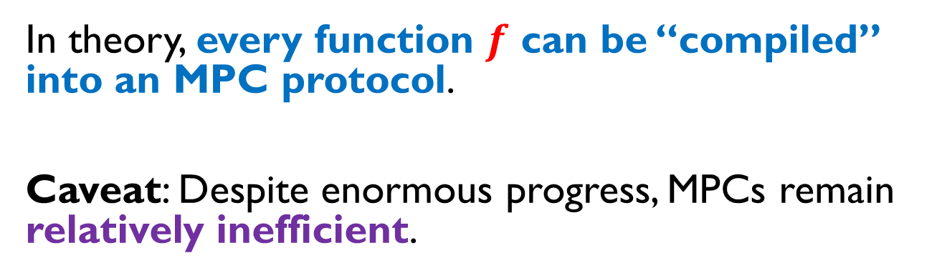
State of the art
maximal corruption threshold depends on the settings (computational/unconditional security, etc.)
In theory, every function $f$ can be “compiled” into an MPC protocol.
Caveat: Despite enormous progress, MPCs remain relatively inefficient.
orders of magnitude less efficient than computing $f$ “in plain”

Slide 9
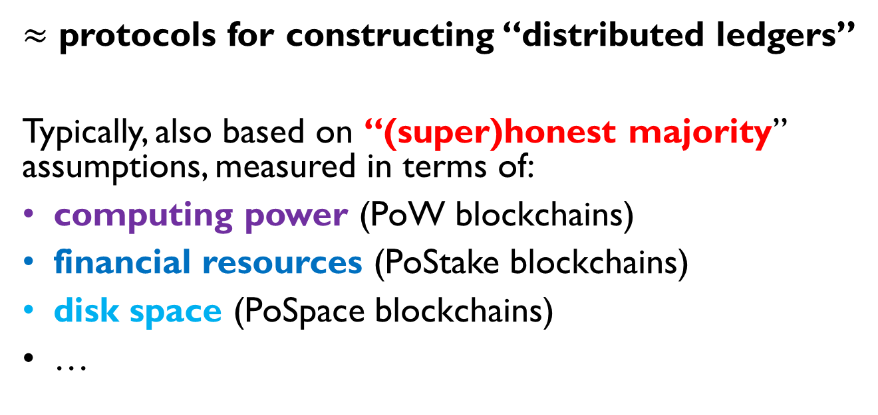
Blockchains
$≈$ protocols for constructing “distributed ledgers”
Typically, also based on “(super)honest majority” assumptions, measured in terms of:
computing power (PoW blockchains)
financial resources (PoStake blockchains)
disk space (PoSpace blockchains)
…
Turns out:
The lockchain literature usually interprets “honest majority” differently from the MPC literature.

Slide 10









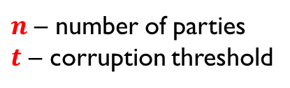
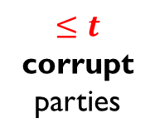
“Honest behavior” in MPC
$n$ – number of parties
$t$ – corruption threshold
honest
$≤t$ corrupt
parties

Slide 11




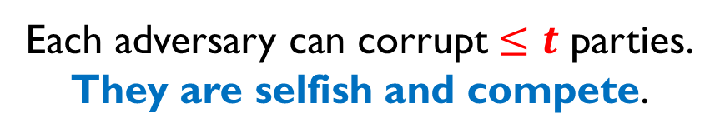
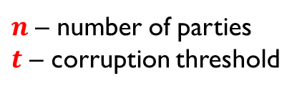
In blockchains
$n$ – number of parties
$t$ – corruption threshold
There are multiple adversaries
Each adversary can corrupt $≤t$ parties.
They are selfish and compete.

Slide 12
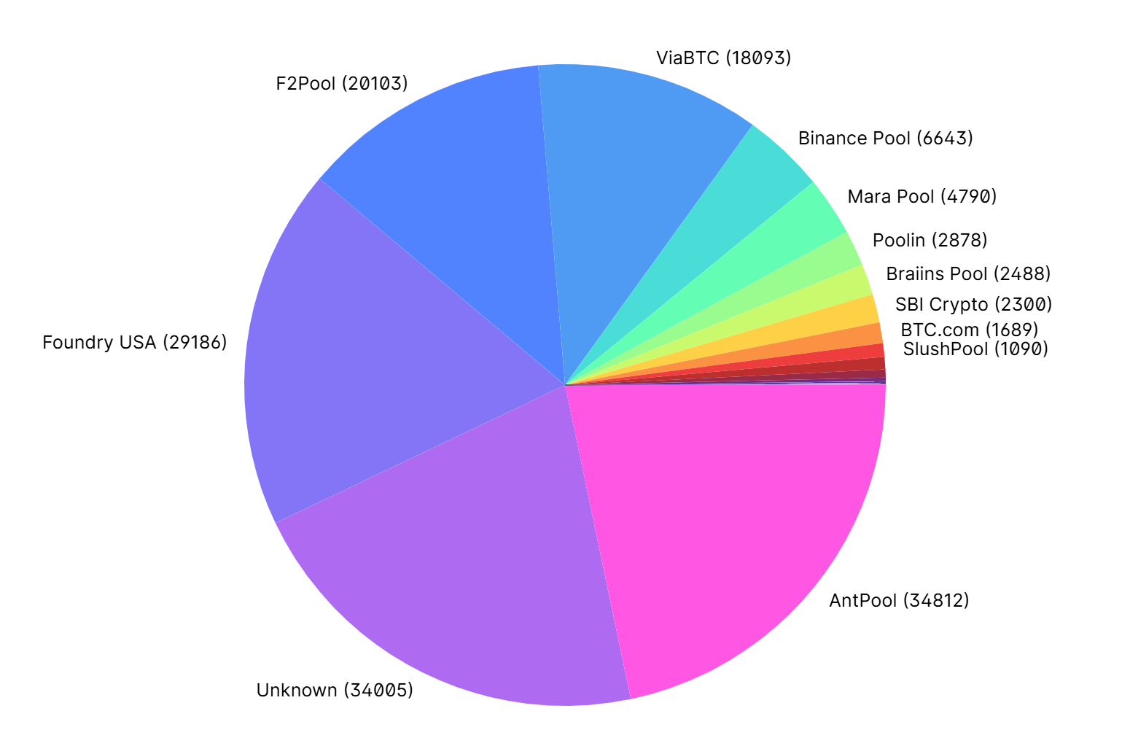
Example: Bitcoin’s blockchain

Slide 13

In blockchains, all parties are corrupt, but by different adversaries.
Question: Can we adapt “traditional MPCs” to these settings?
Correctness – can be addressed, e.g., by using an incentive mechanism and punishments to ensure that the output is computed correctly.
(out of scope of this talk)
Secrecy – less clear…
For general MPCs, see, e.g., [ADMM14] and the follow-up work
our topic today

Slide 14

Plan
Introduction to different models in distributed cryptography
Secret Sharing with Snitching
Other applications of MPC-hardness
Extensions and research problems

Slide 15
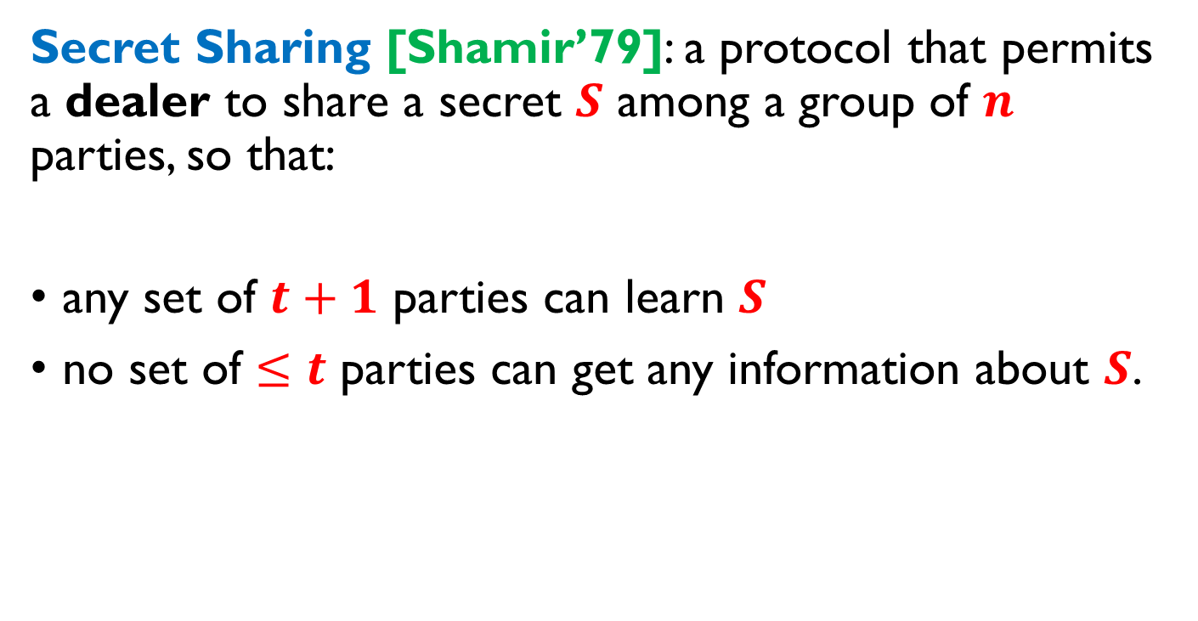
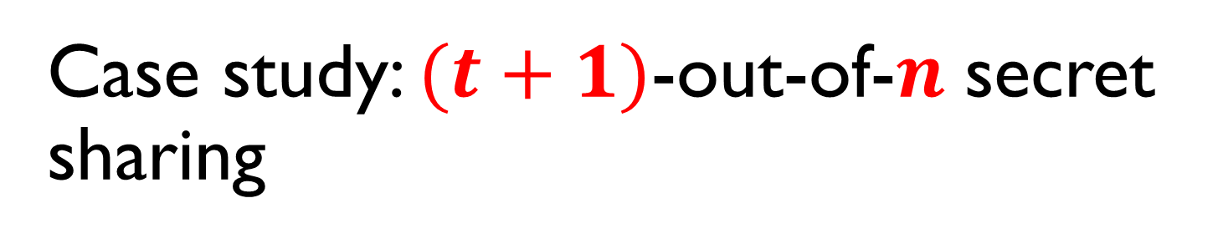
Case study: $(t+1)$-out-of-$n$ secret sharing
Secret Sharing [Shamir’79]: a protocol that permits a dealer to share a secret $S$ among a group of $n$ parties, so that:
any set of $t+1$ parties can learn $S$
no set of $≤t$ parties can get any information about $S$.

Slide 16


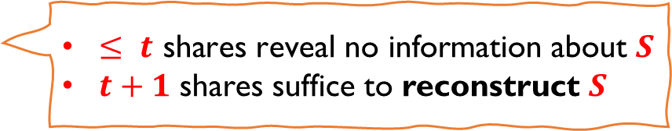










Pictorially
$n$ – number of parties
$t$ – corruption threshold
dealer $D$
secret $S$
$$share\left(S\right)$$
$$S_{1}$$
$$S_{2}$$
$$S_{3}$$
$$S_{4}$$
$$S_{5}$$
$$S_{6}$$
$$S_{7}$$
“shares”
$≤ t \text{shares} \text{reveal} \text{no} \text{information} \text{about} S$
$t+1$ shares suffice to reconstruct $S$

Slide 17










Example $t=3$
know $S$
$$S_{1}$$
$$S_{2}$$
$$S_{3}$$
$$S_{4}$$
$$S_{5}$$
$$S_{6}$$
$$S_{7}$$
doesn’t know $S$

Slide 18
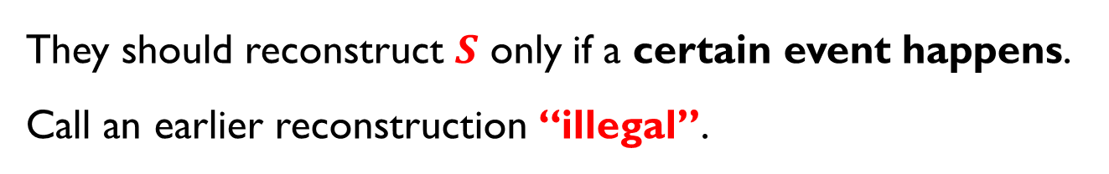

Example of use
secret $S$
They should reconstruct $S$ only if a certain event happens.
Call an earlier reconstruction “illegal”.

Slide 19
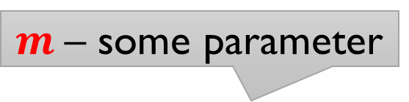
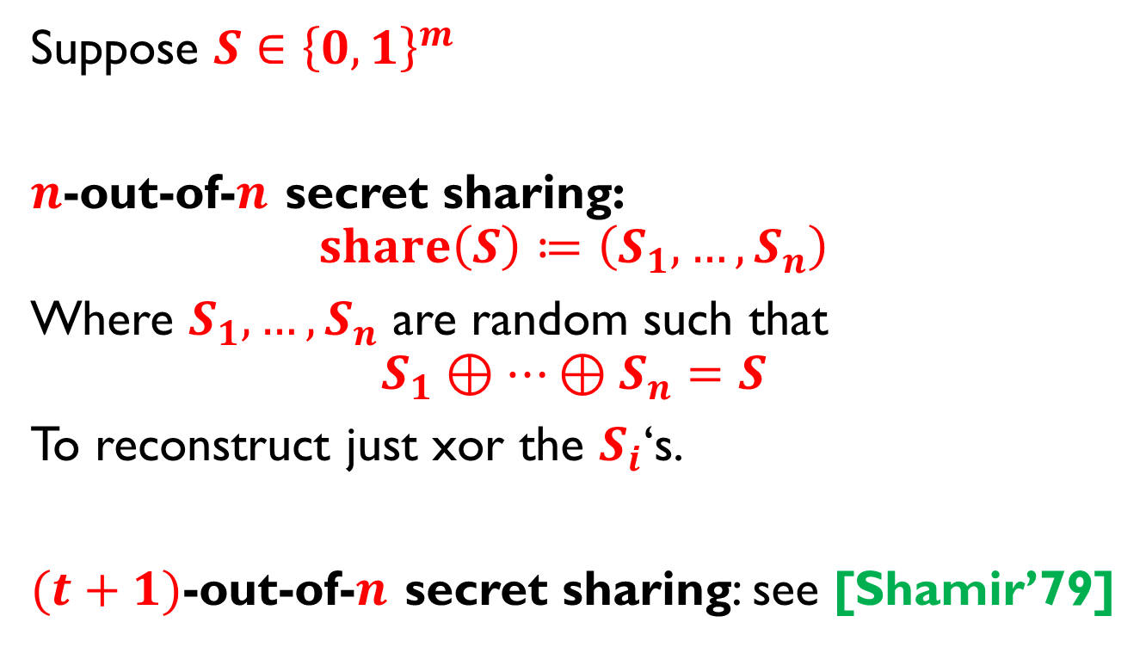
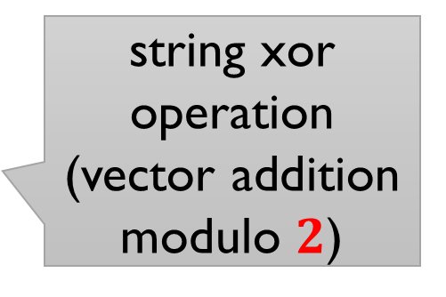
How to implement it?
$m$– some parameter
Suppose $S∈{\left\{0,1\right\}}^{m}$
$n$-out-of-$n$ secret sharing:
$$share\left(S\right)≔\left(S_{1},…,S_{n}\right)$$
Where $S_{1},…,S_{n}$ are random such that
$$S_{1}⊕…⊕S_{n}=S$$
To reconstruct just xor the $S_{i}$‘s.
$(t+1)$-out-of-$n$ secret sharing: see [Shamir’79]
call it “xor secret sharing”
string xor operation
(vector addition modulo $2$)

Slide 20


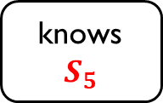


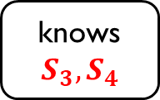

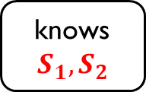

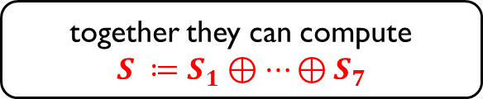


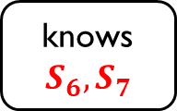
Problem
Learning a secret is a “passive attack” and can be done entirely “outside the protocol”.
$$S_{1}$$
$$S_{2}$$
$$S_{3}$$
$$S_{4}$$
$$S_{5}$$
$$S_{6}$$
$$S_{7}$$
knows
$$S_{1},S_{2}$$
knows
$$S_{3},S_{4}$$
knows
$$S_{5}$$
knows
$$S_{6},S_{7}$$
together they can compute
$${S ≔S}_{1}⊕⋯⊕S_{7}$$
Preventing this looks impossible…

Slide 21


Our idea
Since illegal reconstruction cannot be prevented, at least make it provable and punishable.
In other words, create a mechanism for economically disincentivizing illegal reconstruction.
Recall that the adversaries are competing.
So: create a system for reporting “illegal reconstruction” to some judge.

Slide 22


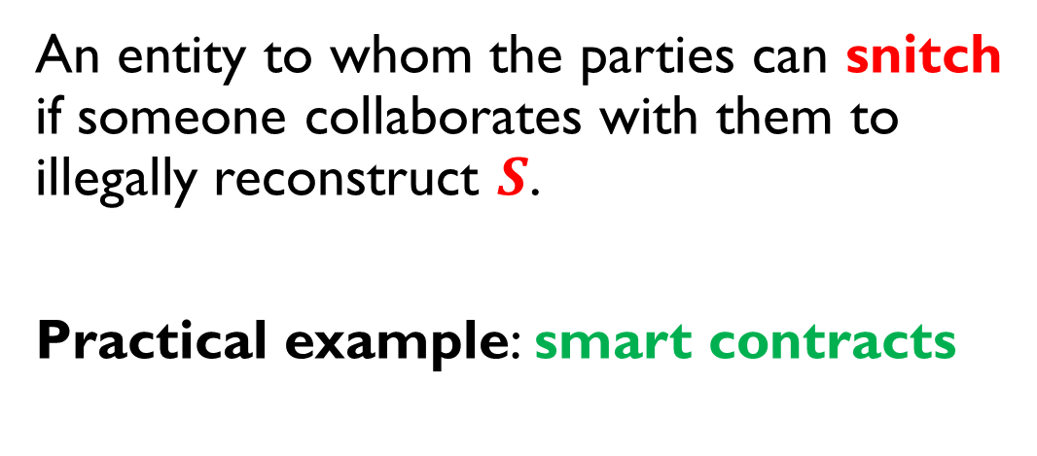
The judge
An entity to whom the parties can snitch if someone collaborates with them to illegally reconstruct $S$.
Practical example: smart contracts
Agreements on a blockchain that are:
enforceable by the blockchain mechanics,
public-state
can own coins
available, e.g., on Ethereum

Slide 23













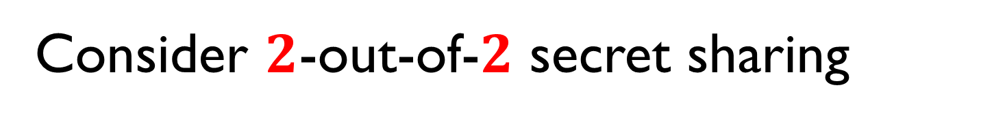
Consider $2$-out-of-$2$ secret sharing
Each party (except for the judge) can be “selfish”
the dealer
Bob
Alice
can be confiscated and shared between the other participants
the judge
trusted
public-state
can own coins

Slide 24

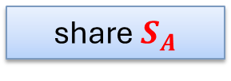

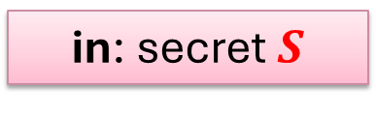
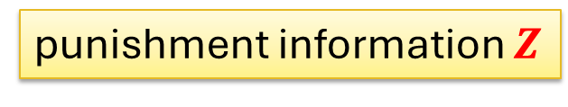
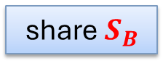
Sharing and reconstructing
not needed for the reconstruction
in: secret $S$
reconstruction
share
share $S_{A}$
share $S_{B}$
$$S$$
punishment information $Z$
$$S$$

Slide 25


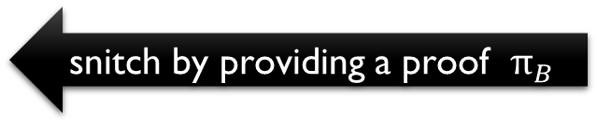
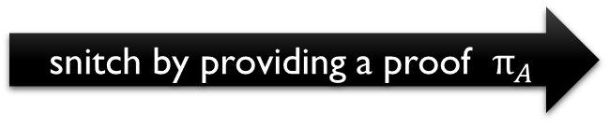

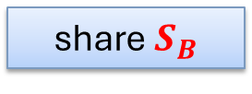
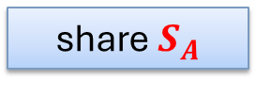
Snitching
Suppose Alice and Bob illegally reconstruct the secret.
malicious Alice
malicious Bob
share $S_{A}$
share $S_{B}$
snitch by providing a proof $π_{A}$
snitch by providing a proof $π_{B}$
punish Alice
$$Z$$
punish Bob
can be incentivized to snitch by getting part of Alice’s deposit

Slide 26
Note
We are interested in deterring “illegal reconstruction”.
So, if they can both snitch on each other, it’s even better.
I can snitch on you
I can snitch on you

Slide 27
Construction?

Slide 28
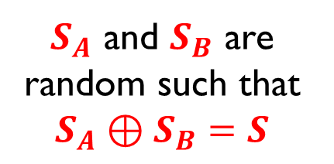

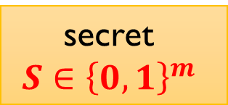

Secret Sharing without Snitching
Recall:
secret
$$S∈{\left\{0,1\right\}}^{m}$$
$$S_{A}$$
$$S_{B}$$
$S_{A}$ and $S_{B}$ are random such that $S_{A}⊕S_{B}=S$

Slide 29










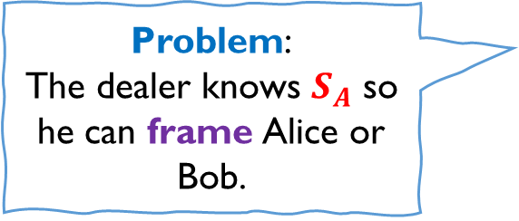
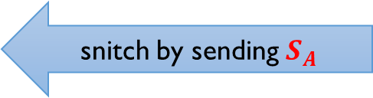
A straw-man proposal
Use standard secret sharing
secret $S$
Assumption: illegal reconstruction is done by sending shares
$$S_{A}$$
share $S_{A}$
share $S_{B}$
snitch by sending $S_{A}$
Problem:
The dealer knows $S_{A}$ so he can frame Alice or Bob.
Note: adding signatures to the shares does not help, since they can always be stripped off.

Slide 30

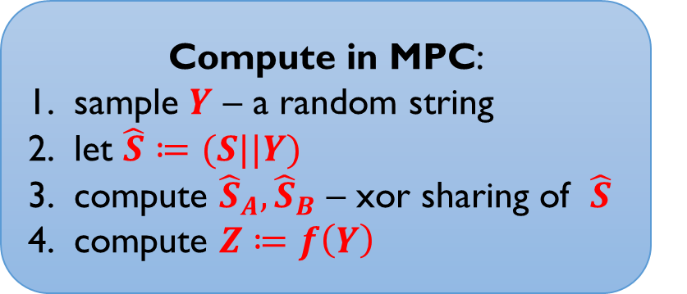
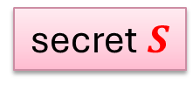


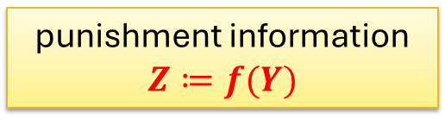

A better idea
$f$ – a one-way function
secret $S$
Compute in MPC:
sample $Y$ – a random string
let $\hat{S}≔(S||Y)$
compute ${\hat{S}}_{A},{\hat{S}}_{B}$ – xor sharing of $\hat{S}$
compute $Z≔f\left(Y\right)$
share ${\hat{S}}_{A}$
share ${\hat{S}}_{B}$
xor shares of $\hat{S}$
punishment information $Z≔f(Y)$

Slide 31
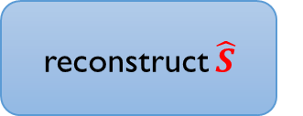





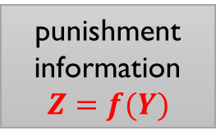

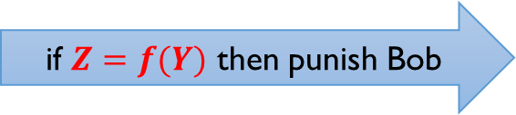

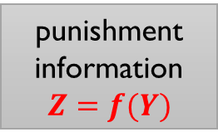
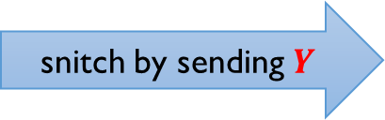

Snitching and punishment
$f$ – a one-way function
secret $S$
$Y$ – a random string
punishment information
$$Z=f(Y)$$
punishment information
$$Z=f(Y)$$
$$\hat{S}≔(S||Y)$$
reconstruct $\hat{S}$
$$\hat{S}$$
$$\hat{S}$$
parse $\hat{S}$ as $(S||Y)$
snitch by sending $Y$
punishment information $Z≔ f(Y)$
if $Z=f(Y)$ then punish Bob

Slide 32





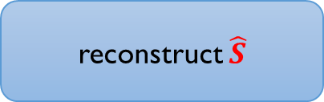




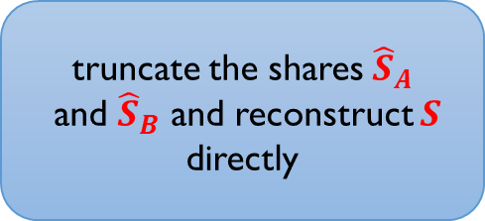

Problem
Instead of doing this:
$${\hat{S}}_{A}$$
$${\hat{S}}_{B}$$
reconstruct $\hat{S}$
$$\hat{S}$$
$$\hat{S}$$
parse $\hat{S}$ as $(S||Y)$
They can do this:
$${\hat{S}}_{A}$$
truncate the shares ${\hat{S}}_{A}$
and ${\hat{S}}_{B}$ and reconstruct $S$ directly
$${\hat{S}}_{B}$$
$$S$$
$$S$$
So: snitching is prevented!

Slide 33

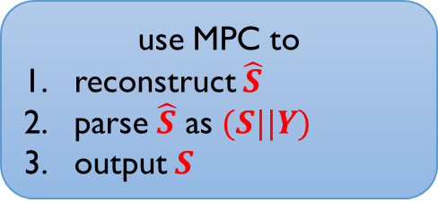



More generally
Even if they use some other secret sharing, they can do the following:
$${\hat{S}}_{A}$$
use MPC to
reconstruct $\hat{S}$
parse $\hat{S}$ as $(S||Y)$
output $S$
$${\hat{S}}_{B}$$
$$S$$
$$S$$

Slide 34





Moral
We need secret sharing, in which reconstruction is “hard in MPC”.
hard in MPC
reconstruct $\hat{S}$
parse $\hat{S}$ as $(S||Y)$
output $S$
$$S$$
$$S$$
Hence:
knows $\hat{S}=(S||Y)$
and can snitch on Bob using $Y$
knows $\hat{S}=(S||Y)$
and can snitch on Alice using $Y$
or

Slide 35



How to model it?
functions that “behave randomly” and take some non-trivial amount of time to compute
Main building block: hash functions
to avoid attacks that exploit the structure of $H$
we only use fixed-input length functions.
$$H$$
modeled as a “random oracle”
$$x$$
Two types of queries:
slow (computed in MPC) – the hash input is not known to any individual party
fast – the input needs to be known to some individual party
The budget for slow queries is bounded.

Slide 36
More formally
used for snitching on Bob
transcript of corrupt Alice
slow queries
$$x_{1}$$ | $$x_{2}$$ | $$x_{3}$$ | $$x_{4}$$ | $$x_{5}$$ | $$x_{6}$$ | $$x_{7}$$ | $$x_{8}$$ | $$x_{9}$$ | $$x_{10}$$ | $$x_{11}$$ | $$x_{12}$$ | $$x_{13}$$ | $$x_{14}$$ | $$x_{15}$$
used for snitching on Alice
transcript of corrupt Bob
Generalizes easily to multiparty settings

Slide 37

Our construction
Main idea: to reconstruct the secret, the parties need to compute a massive number of hashes $H$.
More precisely:
Sharing requires a small number of MPC computations of $H$.
Reconstructing requires inverting $H$ by brute-forcing it.

Slide 38








Sharing (simplified)
$k$ – security parameter
$d$ – “moderate hardness” parameter
$H,G$ – hash functions
secret $S$
compute in MPC:
sample $Y ←{\left\{0,1\right\}}^{d}$
let $C ≔G\left(X_{A}⊕X_{B} || Y\right)⊕S$
let $Z ≔H(X_{A}⊕X_{B} |\left| Y\right)$
$$X_{A}←{\left\{0,1\right\}}^{k}$$
$$X_{B}←{\left\{0,1\right\}}^{k}$$
$$(C,Z)$$
$$Z$$

Slide 39





Reconstruction
$$Z ≔H(X_{A}⊕X_{B} |\left| Y\right)$$
$$C ≔G\left(X_{A}⊕X_{B} || Y\right)⊕S$$
$$X_{B}$$
$$X_{A}$$
$$C$$
$$X_{B}$$
compute ${X ≔X}_{A}⊕X_{B}$
find $Y$ such that $Z =H(X |\left| Y\right)$
output $S≔G\left(X || Y\right)⊕C$
brute force

Slide 40



Snitching
compute ${X ≔X}_{A}⊕X_{B}$
find $Y$ such that $Z=H(X |\left| Y\right)$
output $S≔G\left(X||Y\right)⊕C$
brute force
$X$ and $Y$ such that $H(X ||Y)=Z$
$$Z$$

Slide 41

Full version
We need $k$ variables $Y_{1},…,Y_{k}$ instead of one.
We generalize the definition to $t$-out-of-$n$ SSS
We use $2$-out-of-$2$ SSS to build $t$-out-of-$n$ SSS
For the details, see our ACM CCS 2024 paper.

Slide 42

An example of an application
“Maximal Extractable Value”
MEV protection
Instead of posting a transaction $S$ directly on a blockchain, a user secret-shares it with some consortium.
The consortium reconstructs $S$ after some time has passed.
Note: no long-term protection is needed.

Slide 43
Alternative solutions
Collusion-free protocols make physical assumptions that prevent communication between the parties.
Traceable secret sharing (based on traitor tracing techniques) assumes that reconstruction is done by physical boxes that are given to the adversary.
(See our ACM CCS 2024 paper for more on this related work.)

Slide 44
Bonus question
What if the adversaries can also use a judge whom they all fully trust?
For example, they can deploy their own smart contract on the blockchain.
Our new notion: Strong Secret Sharing with Snitching

Slide 45

Strong Secret Sharing with Snitching
honest
honest parties
judge
adversarial
adversaries
“adversarial” judge

Slide 46






Example of an attack: insurance
Consider again $2$-out-of-$2$ secret sharing.
Compensates Alice if she is punished
(The parties first deposit coins that will be used for such compensation)
If Bob snitches, then Alice gets compensated by the adversarial judge
$$S_{A}$$
share $S_{A}$
share $S_{B}$
Alice
Bob
“adversarial” judge
computes
$$S≔S_{A}⊕S_{B}$$
locally

Slide 47
Our contribution
A new model that captures such attacks.
A construction that is secure in this model.
based on the idea of self-snitching
“everybody can punish itself”
(requires the use of Non-Interactive Zero Knowledge to make the self-snitching undistinguishable from the real snitching)

Slide 48
Plan
Introduction to different models in distributed cryptography
Secret Sharing with Snitching
Other applications of MPC-hardness
Extensions and research problems

Slide 49




(Zero-Knowledge) Proofs of Individual Knowledge (PIK)
[D. et al., CRYPTO 2023]
a similar notion: Proofs of Complete Knowledge
[Kelkar, et al., ACM CCS 2024]
knows $M$
or
(in the ZK variant)
has some information about $M$
prover proves that a message $M$ is stored entirely on a single machine
verifier verifies this claim

Slide 50
Applications of PIK
preventing account sharing
deniable messaging
preventing vote selling in online voting
See: [D. et al., CRYPTO 2023, Kelkar, et al., ACM CCS 2024]

Slide 51
Another recent paper in this model
J. Hsin-yu Chiang, B. David, T. K. Frederiksen, A. Mondal, E. Yeniaras:
Detecting Rogue Decryption in (Threshold) Encryption via Self-Incriminating Proofs
ePrint 2024

Slide 52
Plan
Introduction to different models in distributed cryptography
Secret Sharing with Snitching
Other applications of MPC-hardness
Extensions and research problems

Slide 53
Extensions
Weaker modeling of fast queries
Making it compatible with Bitcoin mining rigs (hope: better security against TEEs)
Building protocols on top of SSS
Research questions:
Study MPC-hard primitives
Combine individual cryptography with timed cryptograpy

Slide 54

Thanks!

