Slide 1

Lecture 2
Symmetric Encryption I
Stefan Dziembowski
www.crypto.edu.pl/Dziembowski
University of Warsaw
10.10.18
version 1.0

Slide 2
Plan
Computational definitions of security
If semantically-secure encryption exists then P ≠ NP
A proof that “the PRGs imply secure encryption”
Theoretical constructions of PRGs
Stream ciphers

Slide 3
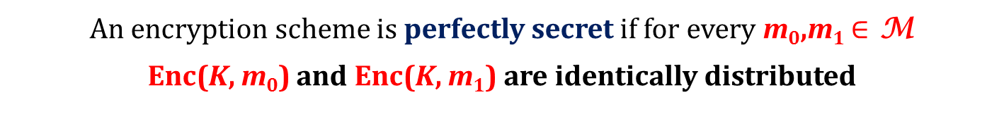
How to change the security definition?
we will require that m₀,m₁ are chosen by a poly-time adversary
An encryption scheme is perfectly secret if for every m₀,m₁ $∈$ M
Enc(K, m₀) and Enc(K, m₁) are identically distributed
we will require that no poly-time adversary can distinguish
Enc(K, m₀) from Enc(K, m₁)

Slide 4
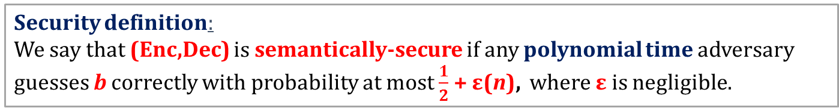
A game
(Enc,Dec) – an encryption scheme
security parameter
1^{n}
adversary
(polynomial-time probabilistic Turing machine)
oracle
chooses m₀,m₁ such that
|m₀|=|m₁|
m₀,m₁
selects k randomly from {0,1}^{n}
chooses a random b = 0,1
calculates
c := Enc(k,m_{b})
has to guess b
c
Alternative name: has indistinguishable encryptions
Security definition:
We say that (Enc,Dec) is semantically-secure if any polynomial time adversary guesses b correctly with probability at most $\frac{1}{2}$ + ε(n), where ε is negligible.

Slide 5
Testing the definition
Suppose the adversary can compute k from Enc(k,m). Can he win the game?
YES!
Suppose the adversary can compute some bit of m from Enc(k,m). Can he win the game?
YES!

Slide 6
Multiple messages
In real-life applications we need to encrypt multiple messages with one key.
The adversary may learn something about the key by looking at
ciphertexts c₁,...,c_{t} of
some messages m₁,...,m_{t}.
How are these messages chosen?
let’s say: the adversary can choose them!
(good tradition: be as pessimistic as possible)

Slide 7



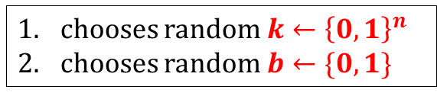



A chosen-plaintext attack (CPA)
security parameter
1^{n}
chooses random $k←{\left\{0,1\right\}}^{n}$
chooses random $b←\{0,1\}$
chooses $m_{1}^{′}$
$$m_{1}^{′}$$
c₁ = Enc(k,$m_{1}^{′}$)
oracle
. . .
chooses $m_{t}^{′}$
$$m_{t}^{′}$$
challenge phase:
c_{t} = Enc($m_{t}^{′}$)
chooses m₀,m₁
m₀,m₁
c = Enc(k,m_{b})
the interaction continues . . .
has to guess b

Slide 8
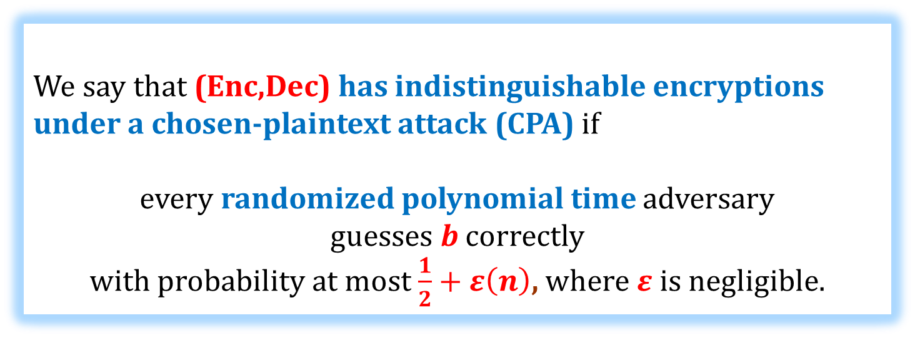
CPA-security
Alternative name: CPA-secure
Security definition
We say that (Enc,Dec) has indistinguishable encryptions under a chosen-plaintext attack (CPA) if
every randomized polynomial time adversary
guesses b correctly
with probability at most $\frac{1}{2}+ε\left(n\right)$, where $ε$ is negligible.

Slide 9
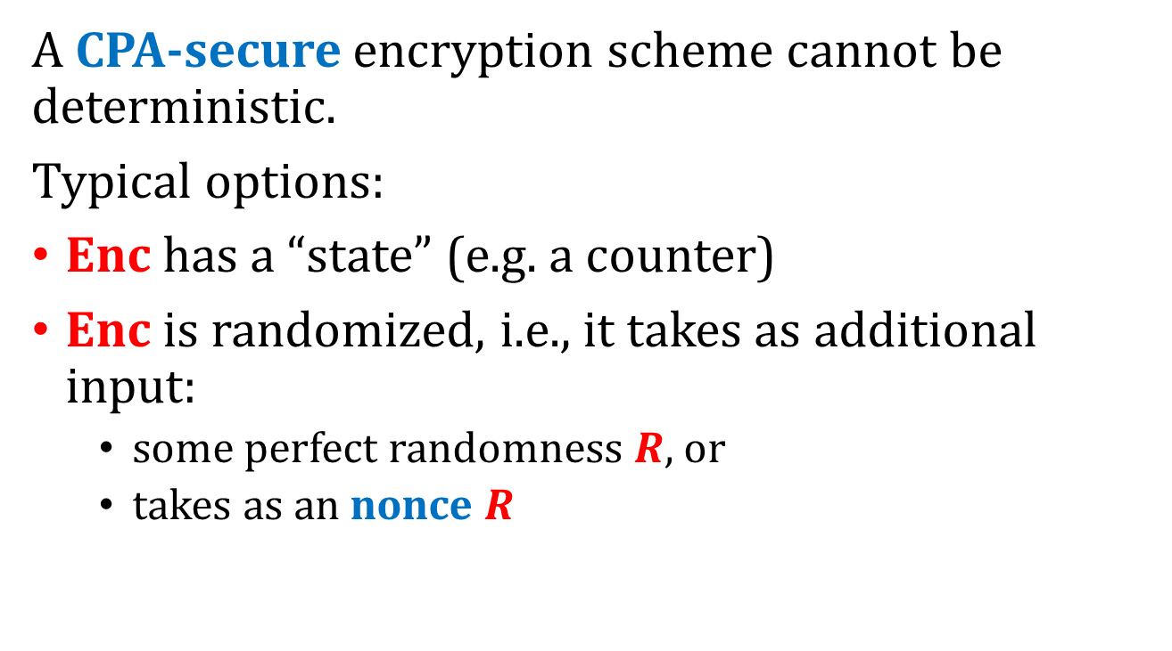
Observation
A CPA-secure encryption scheme cannot be deterministic.
Typical options:
Enc has a “state” (e.g. a counter)
Enc is randomized, i.e., it takes as additional input:
  some perfect randomness $R$, or
  takes as an nonce $R$
weaker requirement
nonce = “number used once”

Slide 10
CPA in real-life
Q: Aren’t we too pessimistic?
A: No! CPA can be implemented in practice.
Example: routing
k
Enc_{k}(m)
k
m

Slide 11
Other attacks known in the literature
strong weak
ciphertext-only attack – the adversary has no information about the plaintext
known plaintext attack – the plaintext are drawn from some distribution that the adversary does not control
batch chosen-plaintext attack – like the CPA attack, but the adversary has to choose m₁,...,m_{t} at once.
chosen ciphertext attack – we will discuss it later…
(“our” CPA-attack is also called the “adaptive CPA-attack”)

Slide 12
Plan
Computational definitions of security
If semantically-secure encryption exists then P ≠ NP
A proof that “the PRGs imply secure encryption”
Theoretical constructions of PRGs
Stream ciphers

Slide 13
Is it possible to prove security?
Bad news:
Theorem
If semantically-secure encryption exists
(with |k| < |m| )
then
P ≠ NP
Intuition: if P = NP then the adversary can guess the key...
(formal proof – exercises)

Slide 14
Moral:
“If P=NP, then the semantically-secure encryption is broken”
Is it 100% true?
Not really...
This is because even if P=NP we do not know what are the constants.
Maybe P=NP in a very “inefficient way”...

Slide 15
To prove security of a cryptographic scheme we need to show
a lower bound on the computational complexity of some problem.
In the “asymptotic setting” that would mean that
at least
we show that P ≠ NP.
Does the implication in the other direction hold?
(that is: does P ≠ NP imply anything for cryptography?)
No! (at least as far as we know)
Therefore
proving that an encryption scheme is secure is probably much harder than proving that P ≠ NP.

Slide 16
What can we prove?
We can prove conditional results.
That is, we can show theorems of a type:
Suppose that some “computational
assumption A”
holds
Suppose that some
scheme Y is secure
then scheme X is secure.
then scheme X is secure.

Slide 17
A natural question
What is “the minimal assumption” needed for cryptography?
Answer: existence one-way functions.
We introduce them now.

Slide 18
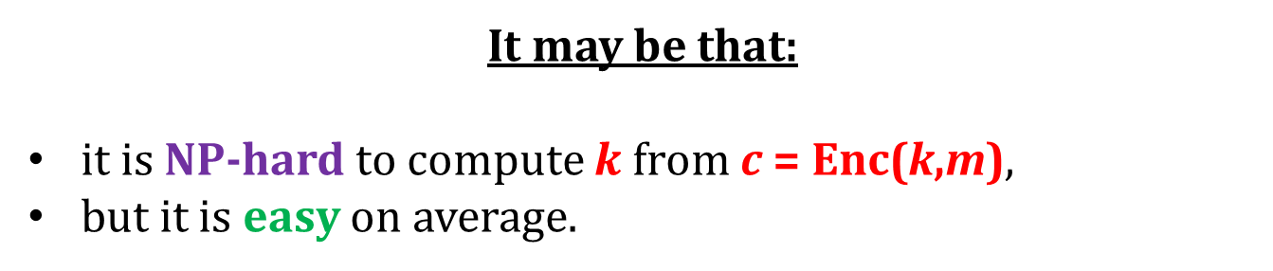



Why P ≠ NP is not enough?
Intuition:
$$m$$
$$k←{\left\{0,1\right\}}^{n}$$
chooses $m$
c = Enc(k,m)
oracle
It may be that:
it is NP-hard to compute $k$ from c = Enc(k,m),
but it is easy on average.

Slide 19
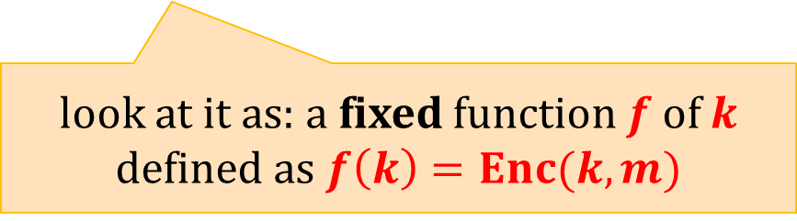
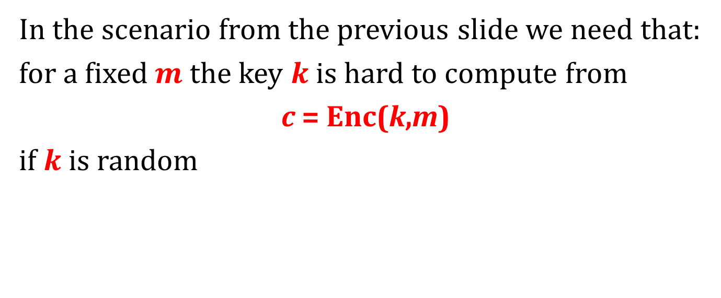
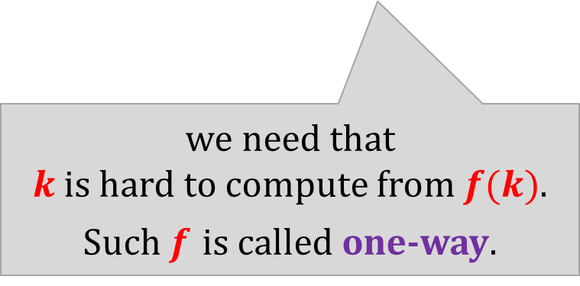
The “minimal assumption for cryptography”?
In the scenario from the previous slide we need that:
for a fixed $m$ the key $k$ is hard to compute from
c = Enc(k,m)
if $k$ is random
look at it as: a fixed function $f$ of $k$ defined as $f\left(k\right)=Enc(k,m)$
we need that
$k$is hard to compute from $f(k)$.
Such $f$ is called one-way.

Slide 20
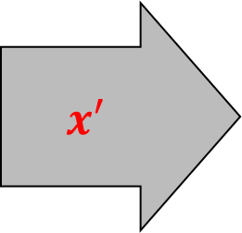
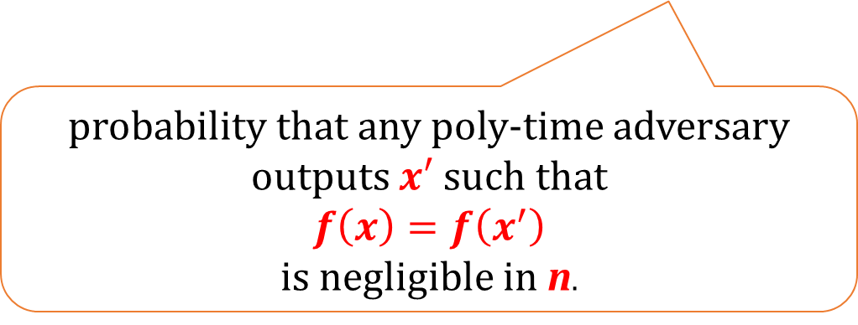
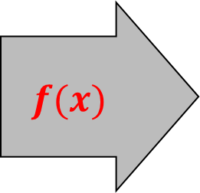
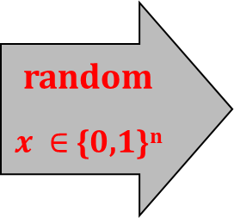
One-way functions
A function
f : {0,1}* → {0,1} *
is one-way if it is: (1) poly-time computable, and (2) “hard to invert it”.
random
$x ∈$ {0,1}^{n}
f
$$f(x)$$
$$x′$$
probability that any poly-time adversary
outputs $x′$ such that
$$f\left(x\right)=f\left(x^{′}\right)$$
is negligible in n.

Slide 21
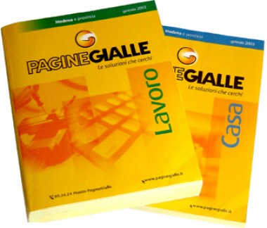
A real-life analogue: phone book
A function:
people → numbers
is “one way”.

Slide 22
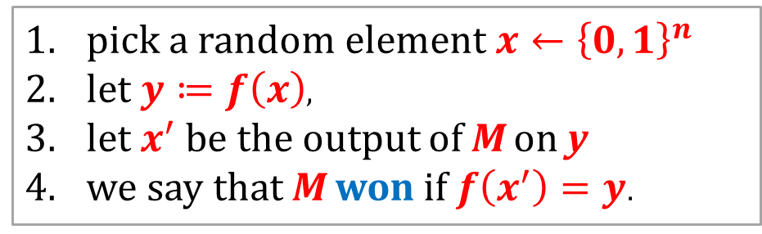

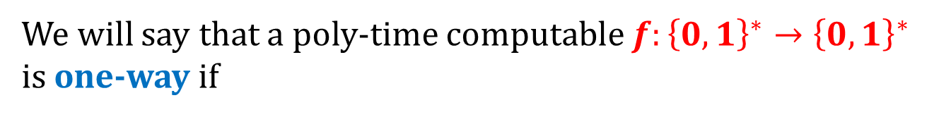
More formally...
experiment (machine M, function f)
pick a random element $x←{\left\{0,1\right\}}^{n}$
let $y≔f\left(x\right)$,
let $x^{′}$ be the output of M on y
we say that M won if $f\left(x^{′}\right)=y$.
We will say that a poly-time computable $f:{\left\{0,1\right\}}^{∗}→{\left\{0,1\right\}}^{∗}$ is one-way if
$$∀$$
P (M wins) is negligible
polynomial-time
Turing Machine M

Slide 23
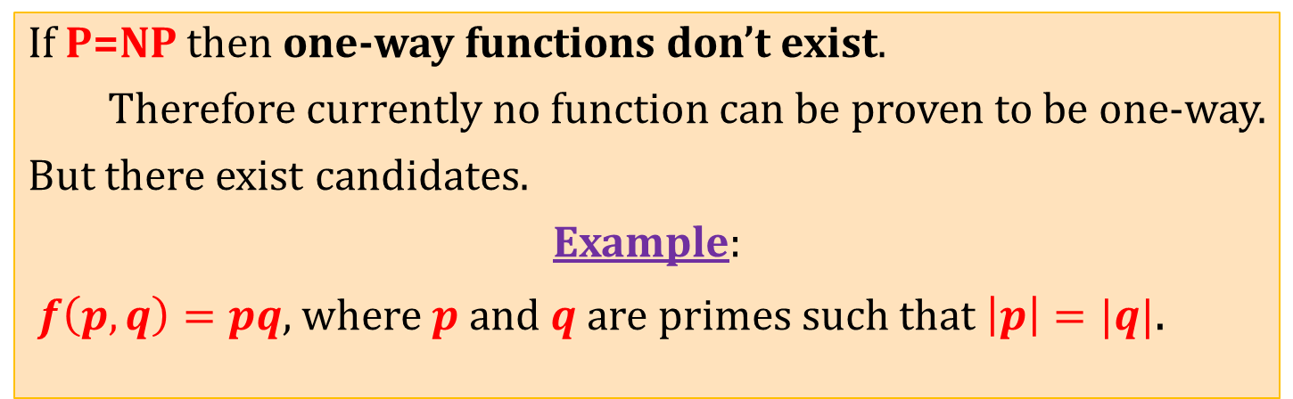
Example of a (candidate for) a one-way function
If P=NP then one-way functions don’t exist.
Therefore currently no function can be proven to be one-way.
But there exist candidates.
Example:
$f\left(p,q\right)=pq$, where $p$ and $q$are primes such that $\left|p\right|=|q|$.
this function is defined on
primes × primes,
not on
{0,1}*
but it’s just a technicality

Slide 24
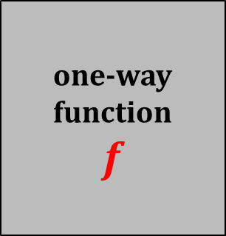


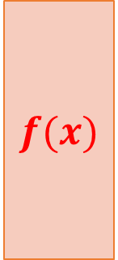
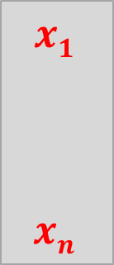
One way functions do not “hide all the input”
Example:
$$x1$$
$$xn$$
one-way function
$$f$$
$$f(x)$$
$$x_{n+1}$$
$$x_{n+1}$$
$f’(x1,…,x_{n+1}) := f(x1,…,xn) || x_{n+1 }$is also a one-way function

Slide 25
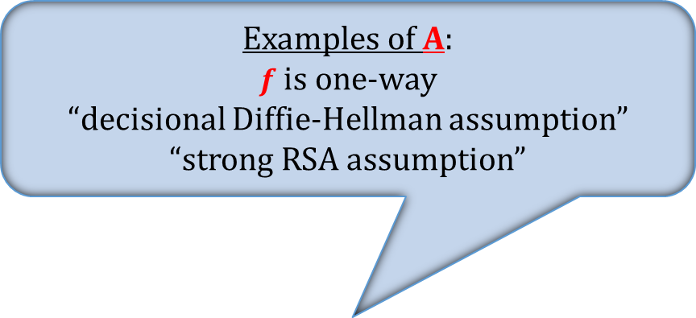
Research program in cryptography
Base the security of cryptographic schemes on a small number of well-specified “computational assumptions”.
Examples of A:
$f$ is one-way
“decisional Diffie-Hellman assumption”
“strong RSA assumption”
in this we
have to
“believe”
Some “computational
assumption A”
holds
interesting only if this is “far from trivial”
the rest is
provable
then scheme X is secure.

Slide 26
Example
Suppose that G is a “cryptographic pseudorandom generator”
we can construct a secure encryption scheme based on G

Slide 27
Plan
Computational definitions of security
If semantically-secure encryption exists then P ≠ NP
A proof that “the PRGs imply secure encryption”
Theoretical constructions of PRGs
Stream ciphers

Slide 28

Pseudorandom generators
“seed”
G(s)
s
n
$$ℓ(n)$$
“expansion
factor”
Definition
l – polynomial such that always l(n) > n
An algorithm G : {0,1}* → {0,1}* is called a pseudorandom generator (PRG) if
for every n
and for every s such that |s| = n
we have
|G(s)| = l(n).
and for a random s the value G(s) “looks random”.
this has to be formalized

Slide 29
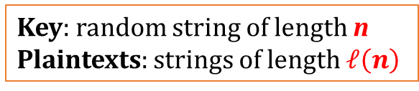
Idea
for a moment just consider a single message case
Use PRGs to “shorten” the key in the one time pad
Key: random string of length n
Plaintexts: strings of length $ℓ\left(n\right)$
xor
G(s)
m
m
xor
G(s)
Enc(s,m)
s
G(s)
c
c
xor
G(s)
s
Dec(s,m)
If we use a “normal PRG” – this idea doesn’t work
We have to use the cryptographic PRGs.

Slide 30
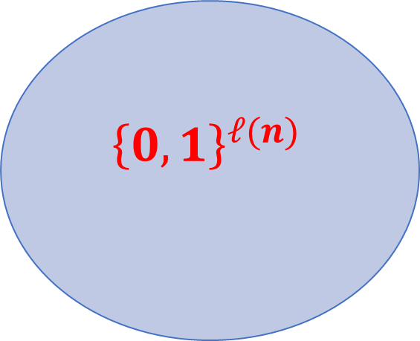
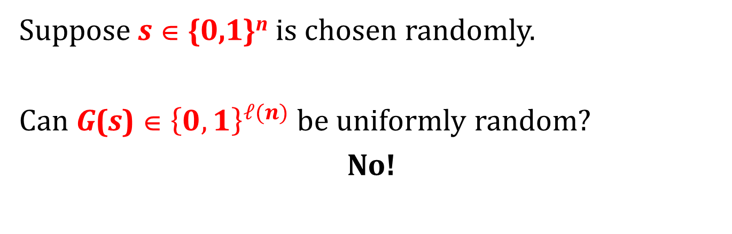
“Looks random”
Suppose s ∈ {0,1}^{n} is chosen randomly.
Can G(s) ∈ ${\left\{0,1\right\}}^{ℓ(n)}$ be uniformly random?
No!
$${\left\{0,1\right\}}^{ℓ(n)}$$
{0,1}^{n}
G({0,1}^{n})

Slide 31
“Looks random”
What does it mean?
Non-cryptographic applications:
should pass some statistical tests.
Cryptography:
should pass all polynomial-time tests.

Slide 32
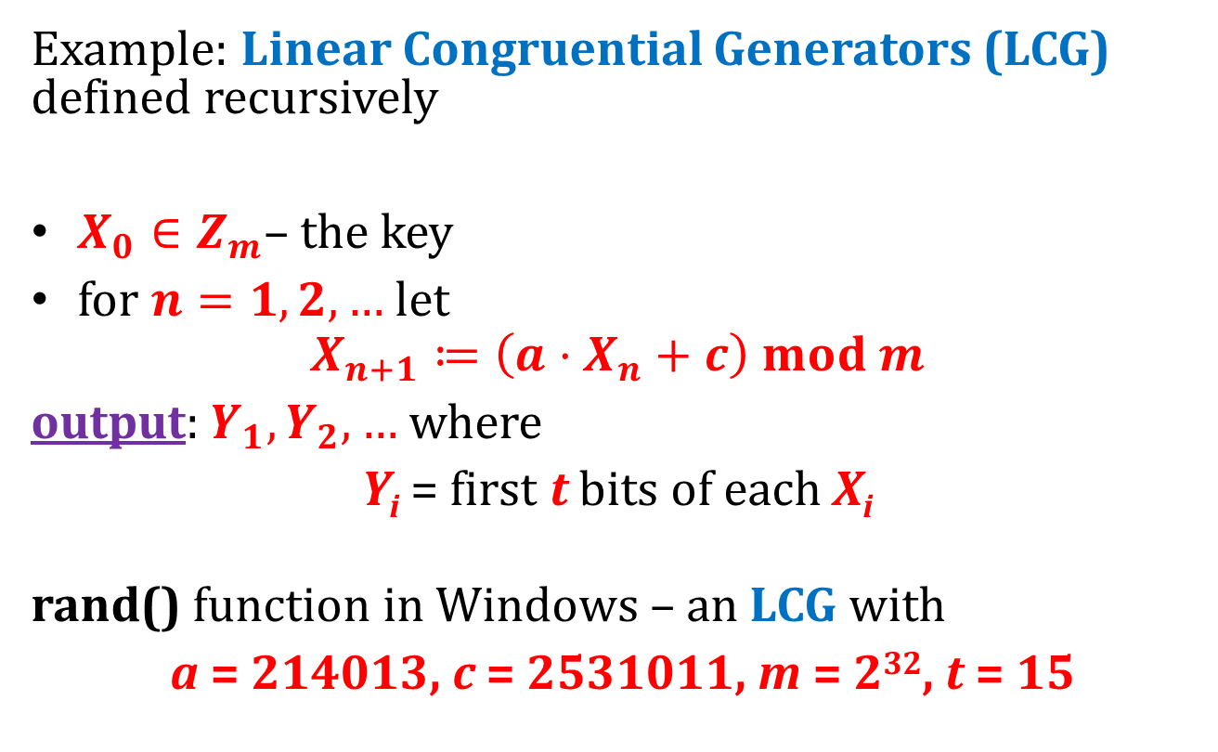
Non-cryptographic PRGs
Example: Linear Congruential Generators (LCG) defined recursively
$X_{0}∈Z_{m}$– the key
for $n=1,2,…$let
$$X_{n+1}≔\left(a⋅X_{n}+c\right) mod m$$
output: $Y_{1},Y_{2},…$ where
Y_{i} = first t bits of each X_{i}
rand() function in Windows – an LCG with
a = 214013, c = 2531011, m = 2³², t = 15

Slide 33
How to break an LRS
Y₁
Y₂
…
Y_{n}
X₀
Solve linear equations with “partial knowledge” (because you only know only first t bits)
See:
G. Argyros and A. Kiayias: I Forgot Your Password: Randomness Attacks Against PHP Applications, USENIX Security '12
(successful attacks on password-recovery mechanisms in PHP)

Slide 34
PRG – main idea of the definition
scenario 0
a random string R
outputs:
b ∈{0,1}
should not be able to distinguish...
scenario 1
a probabilistic polynomial-time distinguisher D
G(S)
Notes:
hardness vs. randomness

Slide 35
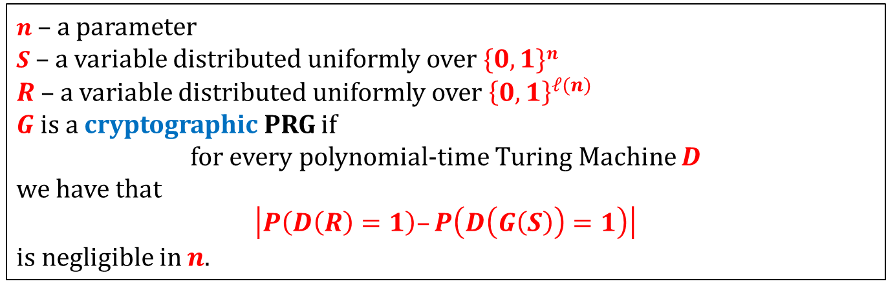



Cryptographic PRG
outputs:
a random string R
$0$ if he thinks it’s R
or
$G(S)$ (where $S$ random)
1 if he thinks it’s $G(S)$
Should not be able to distinguish...
Definition
$n$ – a parameter
$S$ – a variable distributed uniformly over $\{0,1\}n$
$R$ – a variable distributed uniformly over ${\left\{0,1\right\}}^{ℓ(n)}$
$G$is a cryptographic PRG if
for every polynomial-time Turing Machine $D$
we have that
$\left|P\left(D\left(R\right)=1\right)–P\left(D\left(G\left(S\right)\right)=1\right)\right|$
is negligible in $n$.

Slide 36
Constructions
There exists constructions of cryptographic pseudorandom-generators, that are conjectured to be secure.
We will discuss them later...

Slide 37
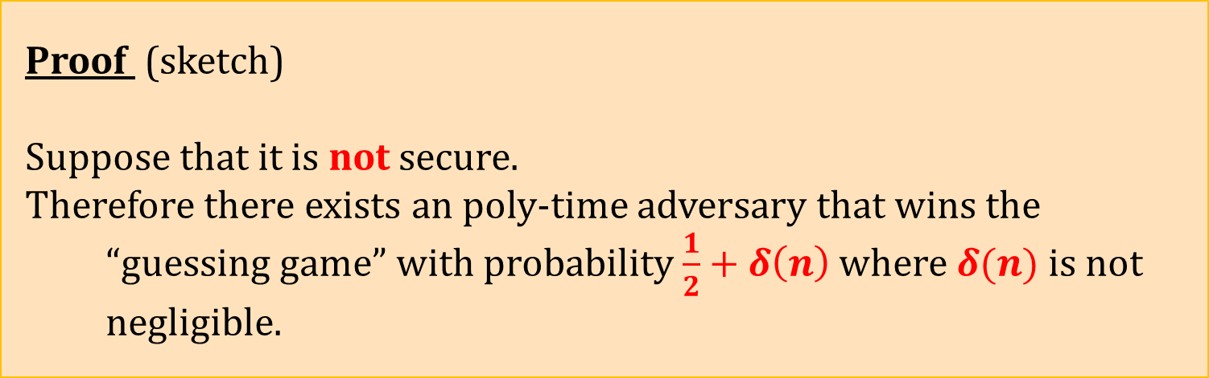
Theorem
(for simplicity consider only the single message case)
xor
If G is a cryptographic PRG then the encryption scheme constructed before is semantically secure.
G(s)
m
m
xor
G(s)
s
cryptographic PRGs
exist
CPA-secure encryption
exists
Proof (sketch)
Suppose that it is not secure.
Therefore there exists an poly-time adversary that wins the “guessing game” with probability $\frac{1}{2}+δ\left(n\right)$ where $δ(n)$ is not negligible.

Slide 38


x
simulates
chooses $m_{0},m_{1}$
$$m_{0},m_{1}$$
b = 0,1 random
c := x xor m_{b}
tries to guess b
c
If the adversary guessed b correctly
otherwise
output 1:
“x is pseudorandom”.
output 0:
“x is random”.

Slide 39


“scenario 0”: x is a random string
x
simulates
chooses $m_{0},m_{1}$
$$m_{0},m_{1}$$
b = 0,1 random
c := x xor m_{b}
tries to guess b
c
If the adversary guessed b correctly
otherwise
prob. $\frac{1}{2}$
prob. $\frac{1}{2}$
output 1:
“x is pseudorandom”.
output 0:
“x is random”.

Slide 40


“scenario 1”: x = G(S)
x
simulates
chooses $m_{0},m_{1}$
$$m_{0},m_{1}$$
b = 0,1 random
c := x xor m_{b}
tries to guess b
c
If the adversary guessed b correctly
otherwise
prob. $\frac{1}{2}+δ(n)$
prob. $\frac{1}{2}−δ(n)$
output 1:
“x is pseudorandom”.
output 0:
“x is random”.

Slide 41

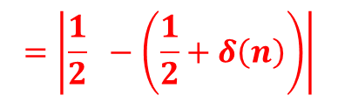



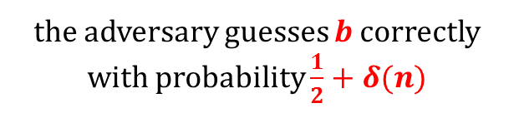
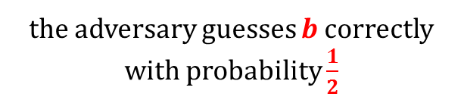




Hence
$x$ is a random string $R$
$x=G(S)$
the adversary guesses b correctly with probability $\frac{1}{2}$
the adversary guesses b correctly with probability $\frac{1}{2}+δ(n)$
prob.$\frac{1}{2}$
prob.$\frac{1}{2}$
prob.$\frac{1}{2}+δ(n)$
prob.$\frac{1}{2}−δ(n)$
outputs:
1
0
1
0
$$=\left|\frac{1}{2} −\left(\frac{1}{2}+δ\left(n\right)\right)\right|$$
$$|P\left(D\left(R\right)=1\right)−P(D\left(G\left(S\right)\right)=1|$$
$$= δ(n)$$
Since δ is not negligible G cannot be a cryptographic PRG.

Slide 42
The complexity
The distinguisher
simply simulated
one execution of the adversary
against the oracle .
Hence he works in polynomial time.
QED

Slide 43
Moral
it can be extended to CPA-security
cryptographic PRGs
exist
semantically-secure encryption
exists
To construct secure encryption it suffices to construct a secure PRG.
Moreover, we can also state the following:
Informal remark. The reduction is tight.

Slide 44
A question
What if the distinguisher
needed to simulate
1000 executions of the adversary
?
An (informal) answer
Then, the encryption scheme would be “1000 times less secure” than the pseudorandom generator.
Why?
To achieve the same result
needs to work 1000 times
more than
.

Slide 45
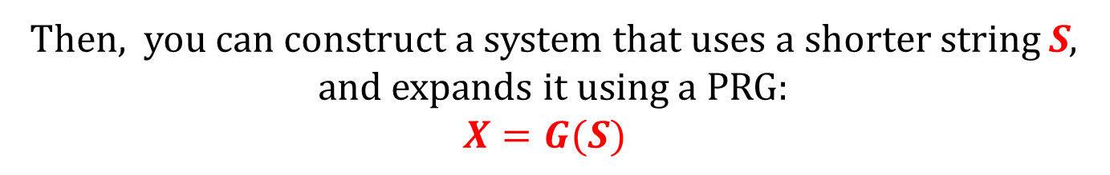
General rule
Take a secure system that uses some long secret string X.
secret string X
Then, you can construct a system that uses a shorter string S,
and expands it using a PRG:
$$X=G(S)$$
secret string S
G
“pseudorandom” string X

Slide 46
Constructions of PRGs
A theoretical result
a PRG can be constructed from any one-way function
(very elegant, impractical, inefficient)
Based on hardness of some
particular computational problems
For example
[Blum, Blum, Shub. A Simple Unpredictable Pseudo-Random Number Generator]
(elegant, more efficient, still rather impractical)
“Stream ciphers”
ugly, very efficient, widely used in practice
Examples: RC4, Trivium, SOSEMANUK,...

Slide 47
Plan
Computational definitions of security
If semantically-secure encryption exists then P ≠ NP
A proof that “the PRGs imply secure encryption”
Theoretical constructions of PRGs
Stream ciphers

Slide 48
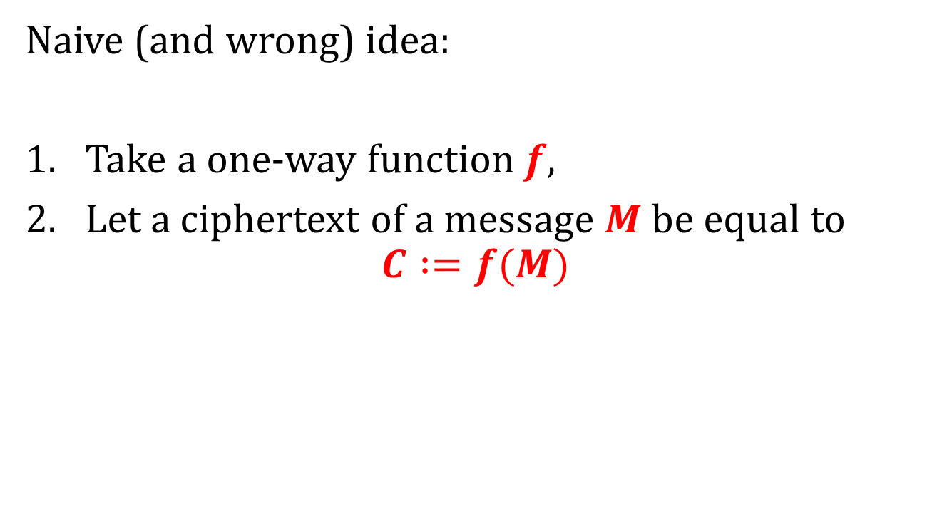
How to encrypt with one-way functions?
Naive (and wrong) idea:
Take a one-way function $f$,
Let a ciphertext of a message $M$ be equal to
$$C :=f(M)$$
where is the key?
not all the input is hidden...
how to decrypt?

Slide 49
One of the most fundamental results in symmetric cryptography
[Håstad, Impagliazzo, Levin, Luby A Pseudorandom Generator from any One-way Function]:
“a PRG can be constructed from any one-way function”
one-way functions
exist
cryptographic PRGs
exist
CPA-secure encryption
exists

Slide 50

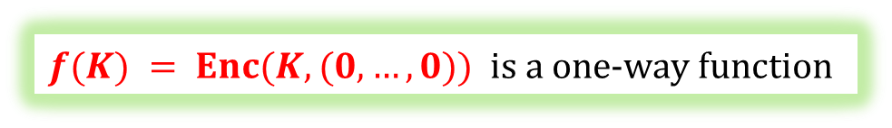
The implication also holds in the other direction
semantically-secure encryption exists
one-way functions
exist
Enc
plaintext $M$
ciphertext
$$C(K,M)$$
key
$$K$$
$f(K) = Enc(K,(0,…,0))$is a one-way function

Slide 51
“Minicrypt”
P ≠ NP
?
open problem
(most likely: no implication)
one-way functions
exist
CPA and semantically-secure
encryptions exists
cryptographic PRGs
exist
The “world” where the one-way functions exist
is called “minicrypt”.

Slide 52
Plan
If semantically-secure encryption exists then P ≠ NP
A proof that “the PRGs imply secure encryption”
Theoretical constructions of PRGs
Stream ciphers

Slide 53
Stream ciphers
The pseudorandom generators used in practice are called stream ciphers
$$s$$
$$s$$
. . .
They are called like this because their output is an “infinite” stream of bits.

Slide 54


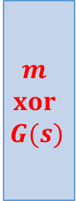



How to encrypt multiple messages using pseudorandom generators?
$$xor$$
$$G(s)$$
$$m$$
$$m$$
$$xor$$
$$G(s)$$
$$Enc(s,m)$$
$$s$$
Of course we cannot just reuse the same seed
(remember the problem with the one-time pad?)
It is not just a theoretical problem!

Slide 55




Misuse of RC4 in Microsoft Office
[Hongjun Wu 2005]
RC4 – a popular PRG (or a “stream cipher”)
“Microsoft Strong Cryptographic Provider”
(encryption in Word and Excel, Office 2003)
The key s is a function of a password and an initialization vector.
These values do not change between the different versions of the document!
Suppose Alice and Bob work together on some document:
$$Enc(s,m)$$
$$Enc(s,m’)$$
The adversary can compute $m xor m’$

Slide 56
What to do?
There are two solutions:
The synchronized mode
The unsynchronized mode

Slide 57











How to encrypt several messages
$G:\{0,1\}n → \{0,1\}very large$– a PRG.
this can be proven to be CPA-secure
divide $G(s)$ in blocks:
$$s$$
$G$is computed “on fly”
. . .
$$G(s)$$
$$m0$$
$$m1$$
$$m2$$
$$m3$$
xor
$$c0$$
$$c1$$
$$c2$$
$$c3$$

Slide 58







Unsynchronized mode
Idea
Randomize the encryption procedure.
Assume that $G$takes as an additional input
an initialization vector ($IV$).
The Enc algorithm selects a fresh random IV_{i} for each message m_{i}.
Later IV_{i} is included in the ciphertext
weaker version: a nonce
$$IVi$$
$$s$$
$$G(IVi,s)$$
$$mi$$
xor
$$IVi$$
$$G(IVi,s)$$
$$Enc(s,m_{i})$$

Slide 59
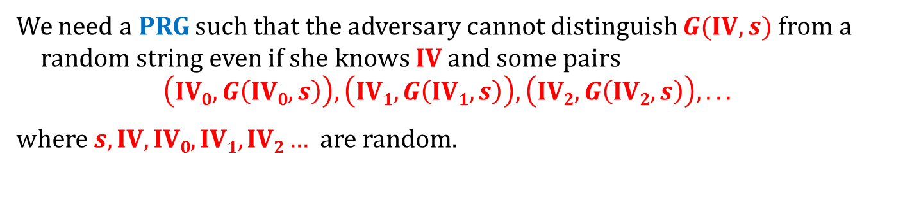



We need an “augmented” PRG
We need a PRG such that the adversary cannot distinguish $G(\text{IV},s)$ from a random string even if she knows IV and some pairs
$$\left(\text{IV}0,G\left(\text{IV}0,s\right)\right), \left(\text{IV}1,G\left(\text{IV}1,s\right)\right), \left(\text{IV}2,G\left(\text{IV}2,s\right)\right), . . .$$
where $s,\text{IV},\text{IV}0,\text{IV}1,\text{IV}2…$are random.
with a non-negligible advantage
IV
s
G
$$G(\text{IV},s)$$
$$R$$
or
?
$$IV$$
$$\left(\text{IV}0,G\left(\text{IV}0,s\right)\right), \left(\text{IV}1,G\left(\text{IV}1,s\right)\right), \left(\text{IV}2,G\left(\text{IV}2,s\right)\right), . . .$$

Slide 60

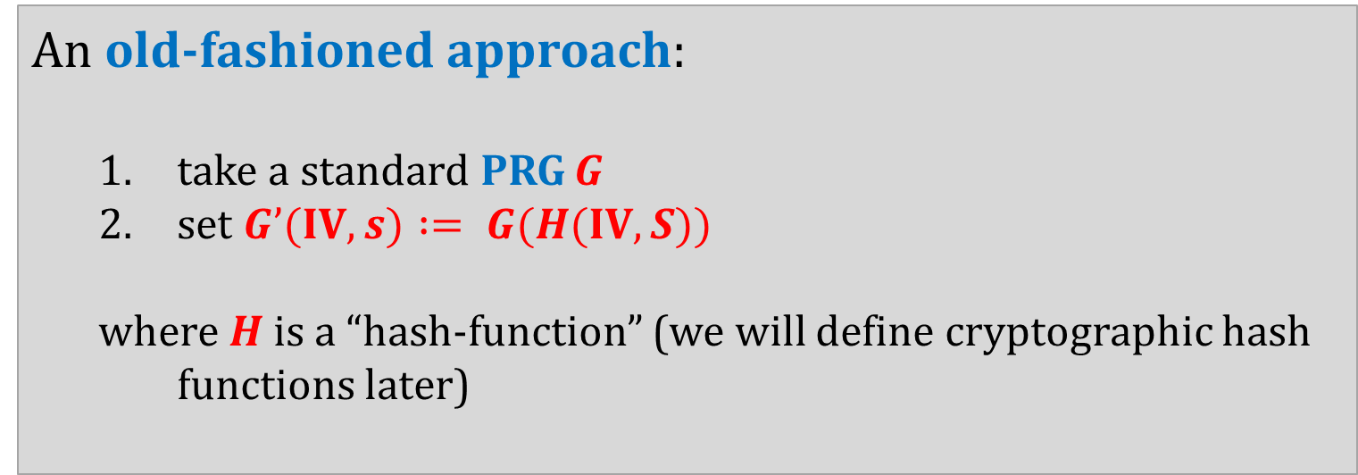
How to construct such a PRG?
An old-fashioned approach:
  take a standard PRG G
  set $G’(IV,s) := G(H(IV,S))$
  where $H$ is a “hash-function” (we will define cryptographic hash functions later)
often:
just concatenate
IV and S
A more modern approach:
  design such a $G$ from scratch.

Slide 61
Popular historical stream ciphers
Based on the linear feedback shift registers:
A5/1 and A5/2 (used in GSM)
Ross Anderson:
Content Scramble System (CSS) encryption
Other:
RC4
completely broken
"there was a terrific row between the NATO signal intelligence agencies in the mid 1980s over whether GSM encryption should be strong or not. The Germans said it should be, as they shared a long border with the Warsaw Pact; but the other countries didn't feel this way, and the algorithm as now fielded is a French design."
completely broken
until recently very popular, but has serious security weaknesses

Slide 62
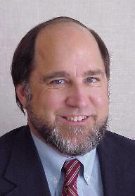
RC4
Designed by Ron Rivest (RSA Security)
in 1987.
RC4 = “Rivest Cipher 4”, or “Ron's Code 4”.
Trade secret, but in September 1994 its
description leaked to the internet.
For legal reasons sometimes it is called: "ARCFOUR" or "ARC4“.
Used in WEP and WPA and TLS.
Very efficient and simple, but has security flaws

Slide 63



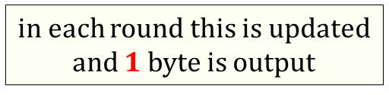

RC4 – an overview
note: no IV
$$|k| = 40 – 256 bits$$
key $k$
key-scheduling
algorithm
(KSA)
indices
i
j
array $S$
$$|S| = 256 bytes$$
in each round this is updated
and $1$ byte is output
(this is called a “pseudo-random generation algorithm (PRGA)”)

Slide 64
RC4
KSA
for i from 0 to 255
  S[i] := i
end
for j := 0 for i from 0 to 255
  j := (j + S[i] + key[i mod 256]) mod 256
  swap(S[i],S[j])
endfor
don’t read it!
PRGA
i := 0
j := 0
while GeneratingOutput:
  i := (i + 1) mod 256
  j := (j + S[i]) mod 256
  swap(S[i],S[j])
  output S[(S[i] + S[j]) mod 256]
endwhile

Slide 65
Problems with RC4
Doesn’t have a separate IV.
It was discovered that some bytes of the output are biased.
[Mantin, Shamir, 2001]
First few bytes of output sometimes leak some information about the key
[Fluhrer, Mantin and Shamir, 2001]
Recommendation: discard the first 768-3072 bytes.
Other weaknesses are also known...

Slide 66
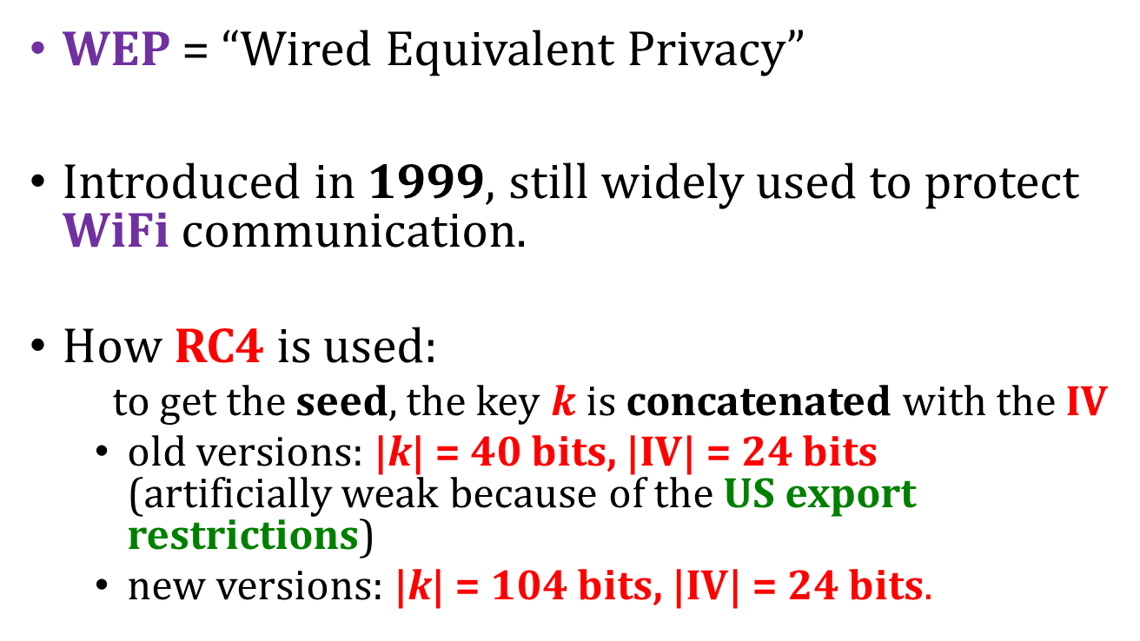
Use of RC4 in WEP
WEP = “Wired Equivalent Privacy”
Introduced in 1999, still widely used to protect WiFi communication.
How RC4 is used:
  to get the seed, the key $k$ is concatenated with the IV
  old versions: |k| = 40 bits, |IV| = 24 bits
  (artificially weak because of the US export restrictions)
  new versions: |k| = 104 bits, |IV| = 24 bits.

Slide 67
RC4 in WEP – problems with the key length
|k| = 40 bits is not enough:
can be cracked using a brute-force attack
IV is changed for each packet.
Hence |IV| = 24 bits is also not enough:
  assume that each packet has length 1500 bytes,
  with 5Mbps bandwidth the set of all possible IVs will be exhausted in half a day
Some implementations reset IV := 0 after each restart – this makes things even worse.
see Nikita Borisov, Ian Goldberg, David Wagner (2001). "Intercepting Mobile Communications: The Insecurity of 802.11"

Slide 68
RC4 in WEP – the weak IVs
[Fluhrer, Mantin and Shamir, 2001]
(we mentioned this attack already)
For so-called “weak IVs” the key stream reveals some information about the key.
In response the vendors started to “filter” the weak IVs.
But then new weak IVs were discovered.
[see e.g. Bittau, Handley, Lackey The final nail in WEP's coffin.]

Slide 69
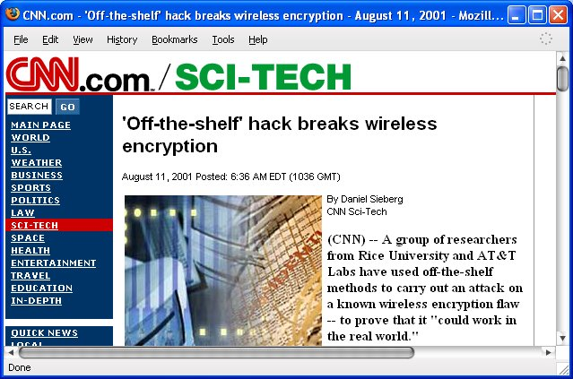
These attacks are practical!
[Fluhrer, Mantin and Shamir, 2001] attack:
Already in 2010: Aircrack-ng tool could break WEP in 1 minute (on a normal PC)
[see also: Tews, Weinmann, Pyshkin
Breaking 104 bit WEP in less than 60 seconds, 2007]

Slide 70
How bad is the situation?
RC4 is still rather secure if used in a correct way.
Example:
Wi-Fi Protected Access (WPA) – a successor of WEP:
several improvements (e.g. 128-bit key and a 48-bit IV).

Slide 71
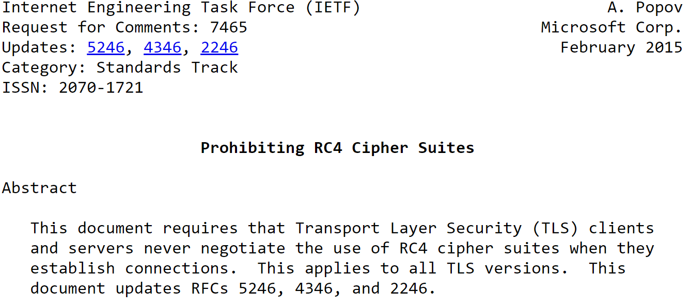
RC4 forbidden in TLS

Slide 72
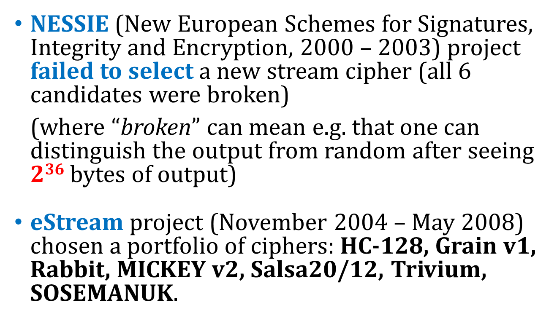
Competitions for new stream ciphers
NESSIE (New European Schemes for Signatures, Integrity and Encryption, 2000 – 2003) project failed to select a new stream cipher (all 6 candidates were broken)
(where “broken” can mean e.g. that one can distinguish the output from random after seeing $236$ bytes of output)
eStream project (November 2004 – May 2008) chosen a portfolio of ciphers: HC-128, Grain v1, Rabbit, MICKEY v2, Salsa20/12, Trivium, SOSEMANUK.

Slide 73
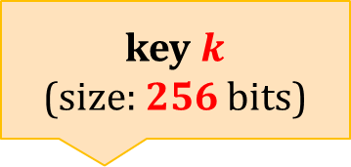
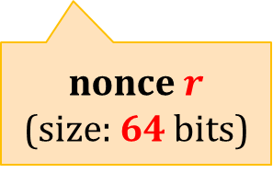
Salsa 20
One of the winners of the eStream competition.
Author: Dan Bernstein.
Very efficient both in hardware and in software.
$Salsa20\left(k,r\right)≔H\left(k,r,0\right)||H(k,r,1)||⋯$
key $k$
(size: 256 bits)
nonce $r$
(size: 64 bits)

Slide 74



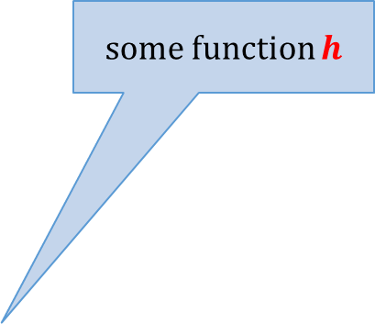

How is H defined?
word (32 bit) addition
$$H\left(k,r,i\right)$$
some function $h$
bits from $k,r$, and $i$
64 bytes
h
h
. . .
$$⊞$$
$10$ rounds

Slide 75
Benchmarks
Algorithm | MiB/Second | Cycles Per Byte | Microseconds to Setup Key and IV | Cycles to Setup Key and IV
Salsa20/12 | 643 | 2.7 | 0.483 | 884
Sosemanuk | 727 | 2.4 | 1.240 | 2269
RC4 | 126 | 13.9 | 2.690 | 4923
https://www.cryptopp.com/benchmarks.html
“All were coded in C++, compiled with Microsoft Visual C++ 2005 SP1 (whole program optimization, optimize for speed), and ran on an Intel Core 2 1.83 GHz processor under Windows Vista in 32-bit mode. x86/MMX/SSE2 assembly language routines were used for integer arithmetic, AES, VMAC, Sosemanuk, Panama, Salsa20, SHA-256, SHA-512, Tiger, and Whirlpool”

Slide 76
Is there an alternative to the stream ciphers?
Yes!
the block ciphers

Slide 77
©2018 by Stefan Dziembowski. Permission to make digital or hard copies of part or all of this material is currently granted without fee provided that copies are made only for personal or classroom use, are not distributed for profit or commercial advantage, and that new copies bear this notice and the full citation.

