Slide 1

Lecture 5a
Hash Functions II
Stefan Dziembowski
www.crypto.edu.pl/Dziembowski
University of Warsaw
24.10.18
version 1.0

Slide 2
Plan
Other uses of hash functions
  Merkle trees
  Practical randomness extraction and the random oracle model
  Password storage and Proofs of Work
Real-life constructions

Slide 3


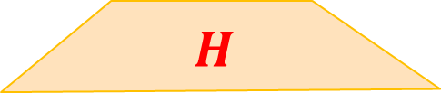

Consider again file fingerprinting
$$x= H(F)$$
$$H$$
large file $F$

Slide 4





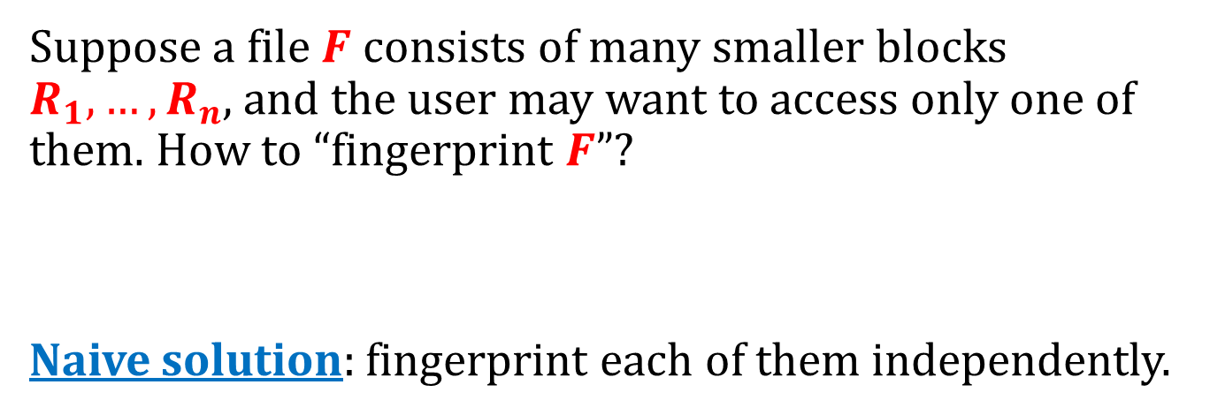






A question
Suppose a file $F$ consists of many smaller blocks $R_{1},…,R_{n}$, and the user may want to access only one of them. How to “fingerprint $F$”?
Naive solution: fingerprint each of them independently.
H
H
H
H
H
H
H
H
$$R_{1}$$
$$R_{2}$$
$$R_{3}$$
$$R_{4}$$
$$R_{5}$$
$$R_{6}$$
$$R_{7}$$
$$R_{8}$$

Slide 5






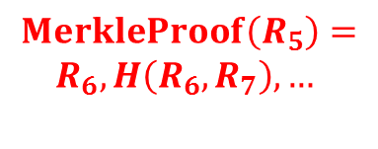



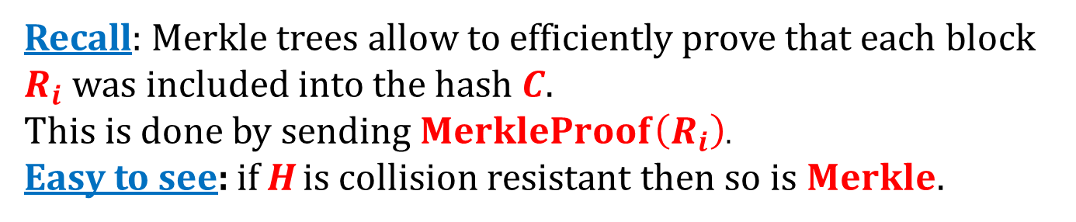




Better solution: construct a Merkle tree:
$$MerkleProof\left(R_{5}\right)=$$
$$R_{6},H\left(R_{6},R_{7}\right),…$$
$$Merkle(R_{1},…,R_{8})$$
C
$$H(R_{1},R_{2})$$
$$H(R_{3},R_{4})$$
$$H(R_{5},R_{6})$$
$$H(R_{7},R_{8})$$
$$R_{1}$$
$$R_{2}$$
$$R_{3}$$
$$R_{4}$$
$$R_{5}$$
$$R_{6}$$
$$R_{7}$$
$$R_{8}$$
Recall: Merkle trees allow to efficiently prove that each block $R_{i}$ was included into the hash $C$.
This is done by sending $MerkleProof\left(R_{i}\right)$.
Easy to see: if H is collision resistant then so is $Merkle$.

Slide 6
File sharing
BitTorrent, Gnutella, Gnutella2, and Direct Connect P2P... - a variant of the idea from the previous slides:
files in the peer-to-peer networks are identified by their hashes
each file consists of “pieces”
the users download the pieces from each other.
some of them use Merkle trees.

Slide 7
Plan
Other uses of hash functions
  Merkle trees
  Practical randomness extraction and the random oracle model
  Password storage and Proofs of Work
Real-life constructions

Slide 8
How the outputs of hash functions look in real life?
C:\> echo -n `Wydział Matematyki, Informatyki i Mechaniki` | openssl sha1
30428440c00bd45d2e2fd93ed980fbd8aa063428
C:\> echo -n `Wydział Matematyki, Informtyki i Mechaniki` | openssl sha1
9937fe966d988e8163fe07f6a1dbd9caf624e1c8
C:\> echo -n `Wydział Matematyki Informatyki i Mechaniki` | openssl sha1
456b370c5afe5f45c0af4a6290d02f6d2f557381
Observation: the outputs on different inputs are “unrelated” and “completely random”.
we will formalize this property in a moment

Slide 9
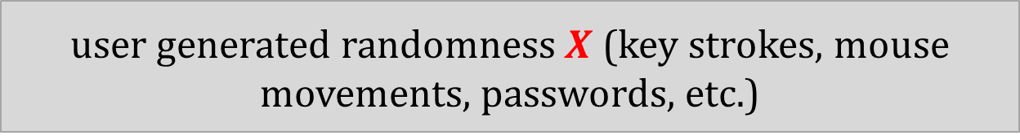

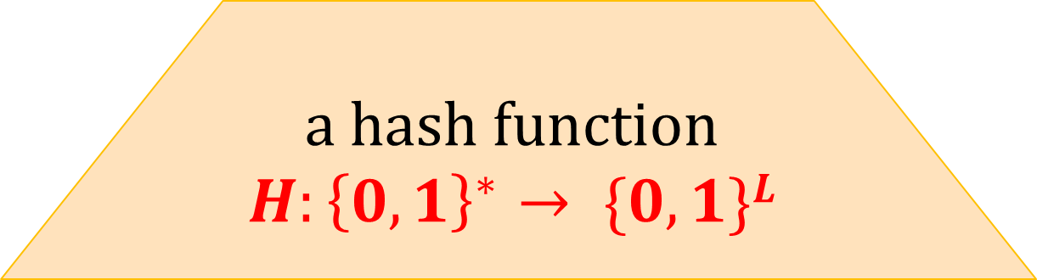
Example of how this property is used: deriving “uniformly random keys” from “non-uniform randomness"
shorter “uniformly random” $H(m)$
a hash function
$$H:{\left\{0,1\right\}}^{∗}→ \{0,1\}L$$
user generated randomness $X$ (key strokes, mouse movements, passwords, etc.)

Slide 10

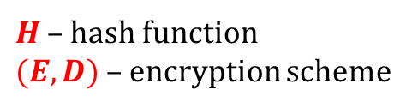


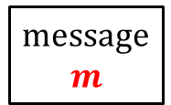

Example: password-based encryption
$H$ – hash function
$(E,D)$– encryption scheme
message
$$m$$
$$c = E(H(π),m)$$
$$m = D(H(π),c)$$
Alice
Bob
shared password $π$
shared password $π$
Informally:
The only thing that Eve can do is to examine all possible passwords .
Warning:
there exist much better solutions for this problem

Slide 11




Random oracle model
[Fiat, Shamir: How to Prove Yourself: Practical Solutions to Identification and Signature Problems. 1986]
[Bellare, Rogaway: Random Oracles are Practical: A Paradigm for Designing Efficient Protocols, 1993]
Idea: model the hash function as a random oracle.
$$x$$
$$H(x)$$
a completely random function
$$H:{\left\{0,1\right\}}^{∗}→\{0,1\}L$$

Slide 12
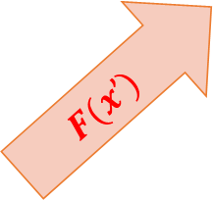
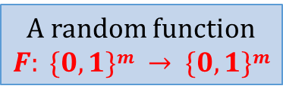
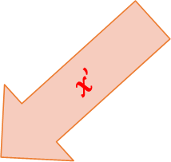
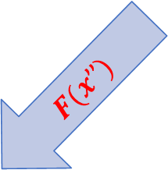
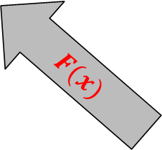
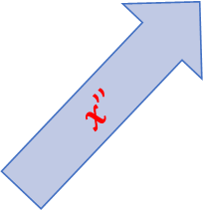
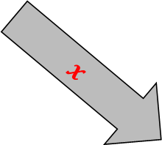
Remember the pseudorandom functions?
$$x$$
$$x’$$
$$F(x)$$
$$F(x’)$$
A random function
$F: \{0,1\}m → \{0,1\}m$
$$x’’$$
$$F(x’’)$$
Crucial difference:
Also the adversary can query the oracle

Slide 13


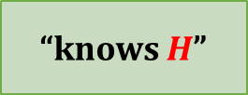

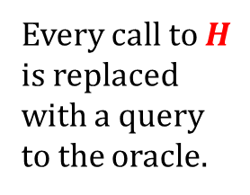
informal description:
“knows $H$”
a protocol
$$H$$
formal model:
Every call to $H$ is replaced with a query to the oracle.
$$H : \{0,{1\}}^{∗} → \{0,1\}L$$
a protocol
also the adversary is allowed to query the oracle.

Slide 14

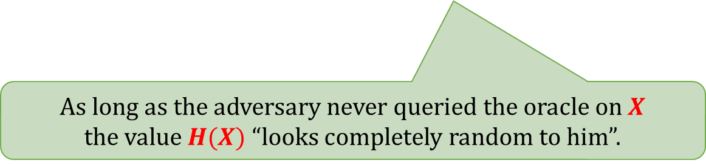
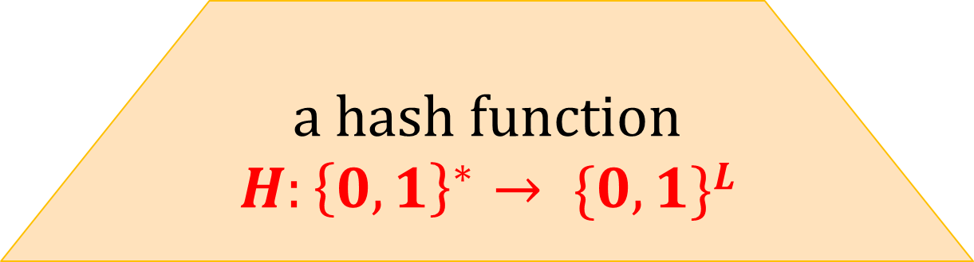
How would we use it in the proof?
shorter “uniformly random” $H(X)$
a hash function
$$H:{\left\{0,1\right\}}^{∗}→ \{0,1\}L$$
user generated randomness $X$
As long as the adversary never queried the oracle on $X$
the value $H(X)$ “looks completely random to him”.

Slide 15
Criticism of the Random Oracle Model
[Canetti, Goldreich, Halevi: The random oracle methodology, revisited. 1998]
There exists a signature scheme that is
secure in ROM
but
is not secure if the random oracle is replaced with any real hash function.
This example is very artificial. No “realistic” example of this type is know.

Slide 16
Terminology
Model without the random oracles:
“plain model”
“cryptographic model”
Random Oracle Model is also called:
the “Random Oracle Heuristic”.
Common view: a proof in ROM is better than nothing.

Slide 17
Plan
Other uses of hash functions
  Merkle trees
  Practical randomness extraction and the random oracle model
  Password storage and Proofs of Work
Real-life constructions

Slide 18
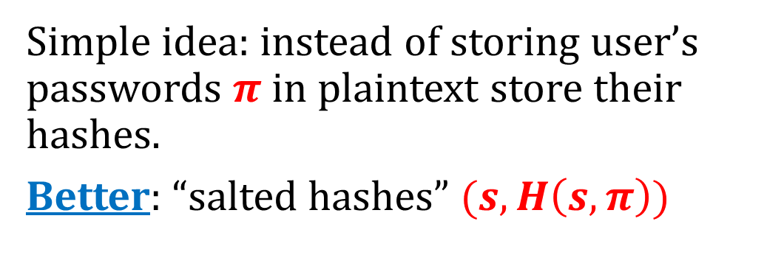
Password storage
Simple idea: instead of storing user’s passwords $π$ in plaintext store their hashes.
Better: “salted hashes” $(s,H\left(s,π\right))$
advantages:
makes “precomputation attacks” harder (we discussed these attacks on the last exercises)
if two users have the same password then the stored values are different.

Slide 19

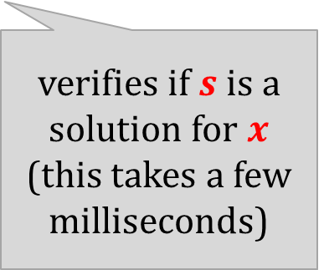
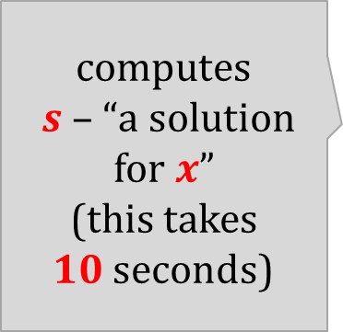
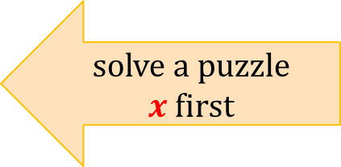
Proofs of work
Introduced by Dwork and Naor [Crypto 1992] as a countermeasure against spam.
Basic idea: Force users to do some computational work: solve a moderately difficult “puzzle” (checking correctness of the solution has to be fast).
I want to send you an email
computes
$s$ – “a solution for $x$”
(this takes $10$seconds)
solve a puzzle $x$first
verifies if $s$ is a solution for $x$
(this takes a few milliseconds)
$$s$$
ok

Slide 20

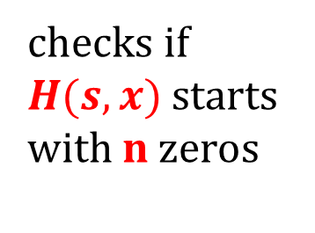
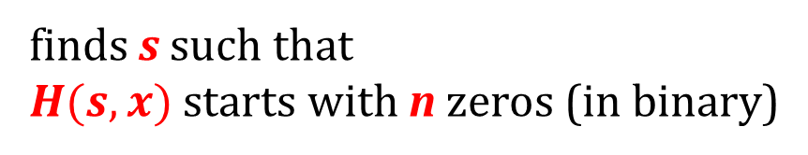
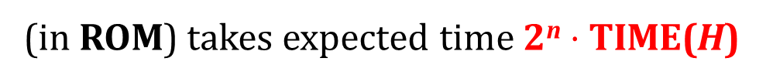
A simple hash-based PoW
H – a hash function whose computation takes time TIME(H)
random x
s
Prover
Verifier
finds s such that
$H(s,x)$ starts with n zeros (in binary)
checks if
$H(s,x)$ starts with n zeros
salt
“hardness parameter
(in ROM) takes expected time 2^{n} $⋅$ TIME(H)
takes time TIME(H)
This PoW is used in Bitcoin.

Slide 21
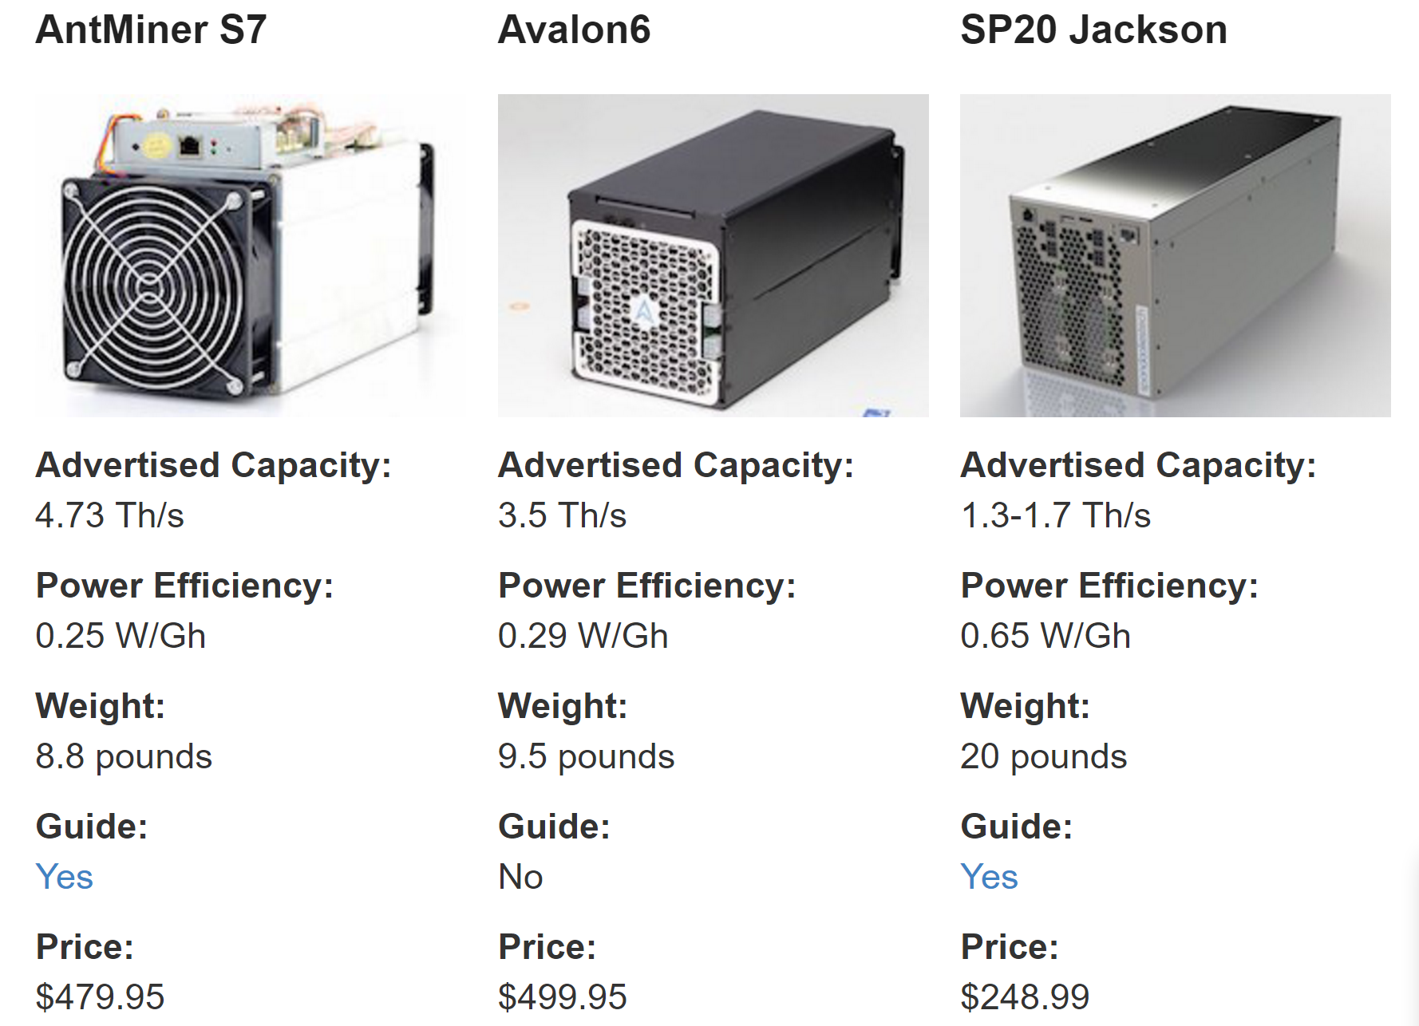
Problem
Computing typical hash functions is much faster when done in parallel and in hardware (this can give advantage to a powerful adversary).
For example “Bitcoin mining” is done almost entirely on ASICs
Notes:
See: Joel Alwen and Vladimir Serbinenko High Parallel Complexity Graphs and Memory-Hard Functions

Slide 22

Idea for a solution
Design hash functions whose computation needs to lot of memory, so it’s hard to implement it efficiently in hardware
Example: scrypt hash function introduced in:
  Colin Percival, Stronger Key Derivation via Sequential Memory-Hard Functions, 2009.
Used in Litecoin
Has one practical drawback: it’s access pattern is data-dependent (hence: it reveals the input).
bad for the side-channel resilience
Notes:
See: Joel Alwen and Vladimir Serbinenko High Parallel Complexity Graphs and Memory-Hard Functions

Slide 23
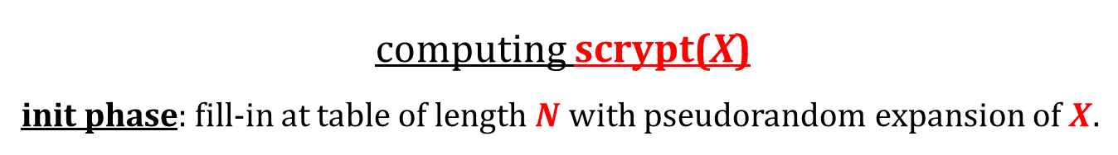

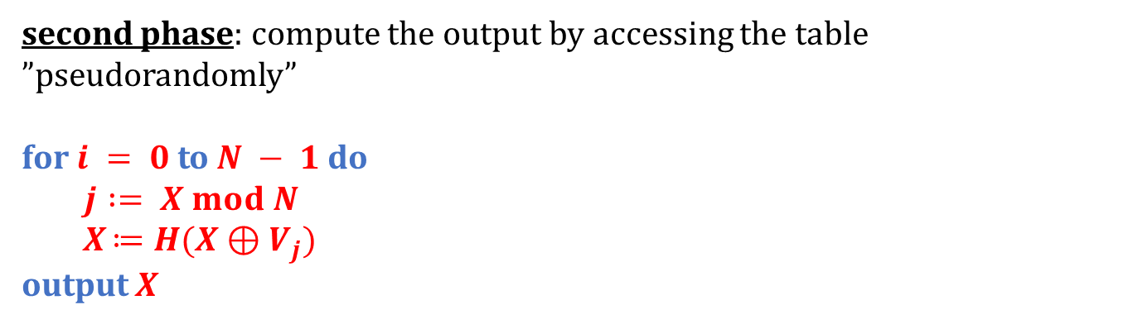



How scrypt works?
computing scrypt(X)
init phase: fill-in at table of length $N$ with pseudorandom expansion of $X.$
$$V_{0}= X$$
$$V_{1}=H(X)$$
$$V_{2}=H(V_{2})$$
. . .
$$V_{N−1}=H(V_{N−2})$$
result (for N = 10):
$$V_{0}$$ | $$V_{1}$$ | $$V_{2}$$ | $$V_{3}$$ | $$V_{4}$$ | $$V_{5}$$ | $$V_{6}$$ | $$V_{7}$$ | $$V_{8}$$ | $$V_{9}$$
second phase: compute the output by accessing the table ”pseudorandomly”
for $i = 0$to $N − 1$do
  $$j := X mod N$$
  X $≔H(X⊕V_{j})$
output X

Slide 24
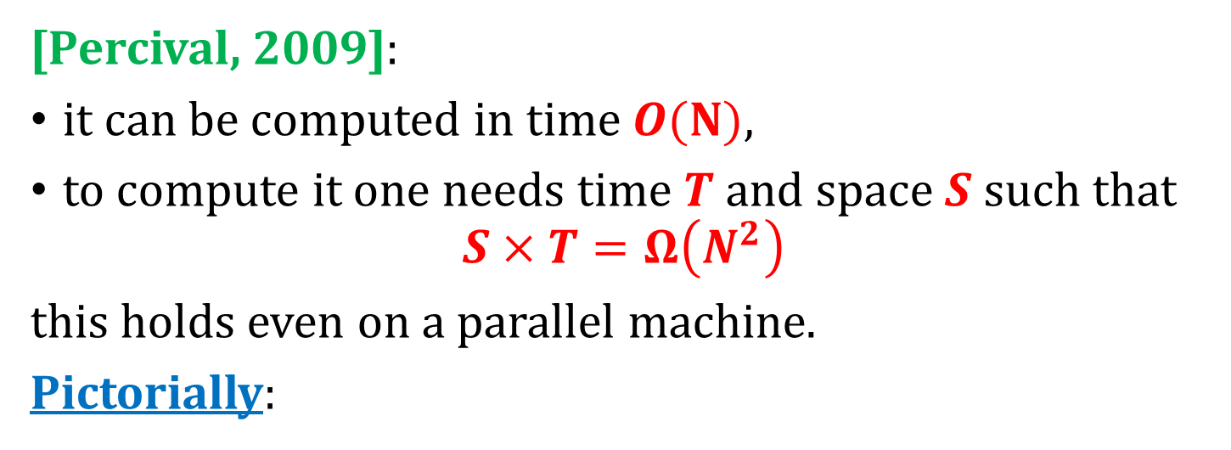
What is known about scrypt?
[Percival, 2009]:
it can be computed in time $O(N)$,
to compute it one needs time $T$ and space $S$ such that
$$S×T=Ω\left(N^{2}\right)$$
this holds even on a parallel machine.
Pictorially:
output
a circuit
computing
scrypt
T
input
S

Slide 25
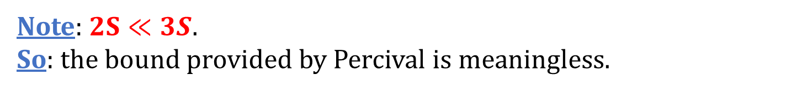

An observation
[Alwen, Serbinenko, STOC’15]: this definition is not strong enough.
The adversary that wants to compute scrypt in parallel can “amortize space”. Example:
can be computed in parallel as follows:
T
circuit for scrypt
circuit for scrypt
circuit for scrypt
S
S
S
$$2S$$
Note: $2S≪3S$.
So: the bound provided by Percival is meaningless.

Slide 26
An observation
[Alwen, Serbinenko, STOC’15]: this definition is not strong enough.
The adversary that wants to compute scrypt in parallel can “amortize space”. Example:
can be computed in parallel as follows:
T
circuit for scrypt
circuit for scrypt
circuit for scrypt
S
S
S
$$2S$$
Note: $2S≪3S$.
So: the bound provided by Percival is meaningless.

Slide 27

The “right” definition [Alwen and Serbinenko]
instead of looking at $S×T$. . .
look at the sum of memory cells used over time
“the area on the picture”
a circuit
computing
scrypt
T
S
A recent result
Alwen, Chen, Pietrzak, Reyzin, and Tessaro: Scrypt is Maximally Memory-Hard, Cryptology ePrint Archive, Oct 2016

Slide 28
Password Hashing Competition
announced in 2013
run by an independent panel of experts
website: password-hashing.net
winner (2015): Argon2 (by Biryukov, Dinu, and Khovratovic)
broken (together with several other competition finalists) by
Alwen, Gaži, Kamath, Klein, Osang, Pietrzak, Reyzin, Rolínek, Rybár: On the Memory-Hardness of Data-Independent Password-Hashing Functions, Aug 2016
Several improvements to Argon2 (e.g.: “Argon2i 1.3” were also broken)

Slide 29
Plan
Other uses of hash functions
  Merkle trees
  Practical randomness extraction and the random oracle model
  Password storage and Proofs of Work
Real-life constructions

Slide 30
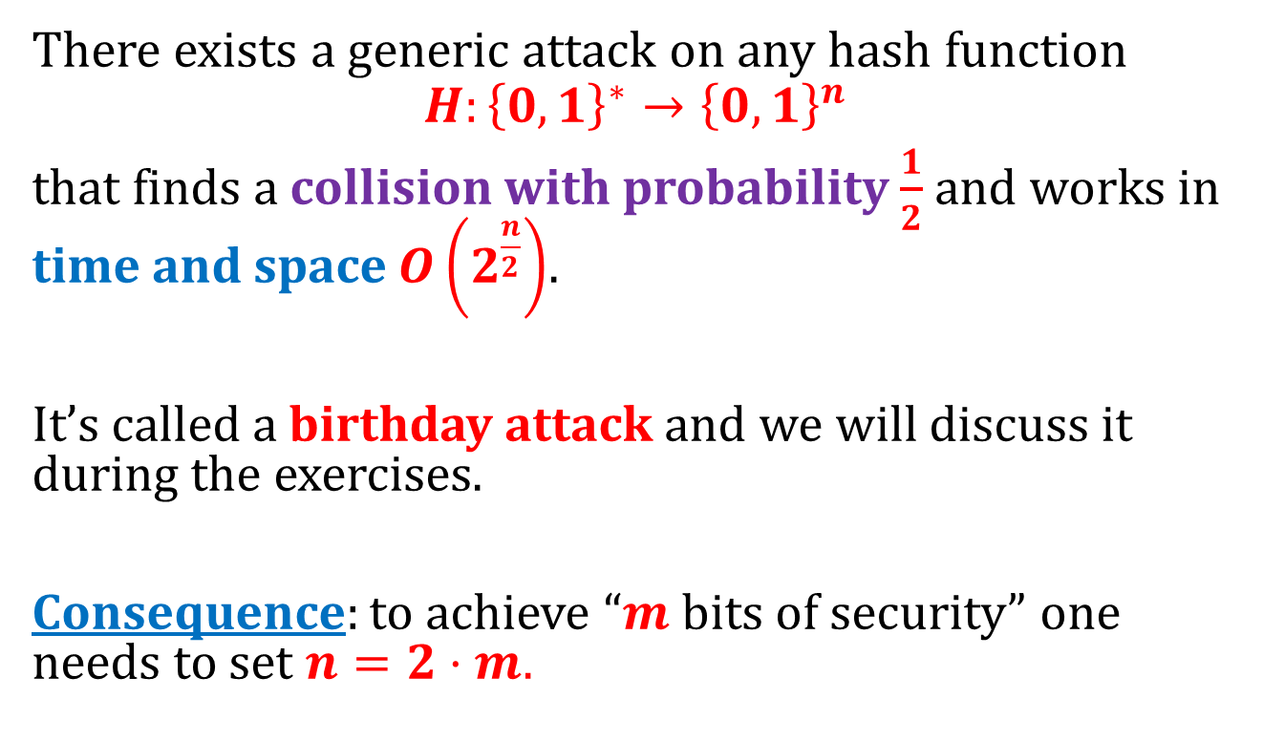
Fact
There exists a generic attack on any hash function
$$H:{\left\{0,1\right\}}^{∗}→{\left\{0,1\right\}}^{n}$$
that finds a collision with probability $\frac{1}{2}$ and works in time and space $O\left(2^{\frac{n}{2}}\right)$.
It’s called a birthday attack and we will discuss it during the exercises.
Consequence: to achieve “$m$ bits of security” one needs to set $n=2⋅m.$

Slide 31
MD5 (Message-Digest Algorithm 5)
based on the Merkle-Damgard paradigm
output length: 128 bits,
designed by Rivest in 1991,
in 1996, Dobbertin found collisions in the compressing function of MD5,
in 2004 a group of Chinese mathematicians designed a method for finding collisions in MD5,

Slide 32
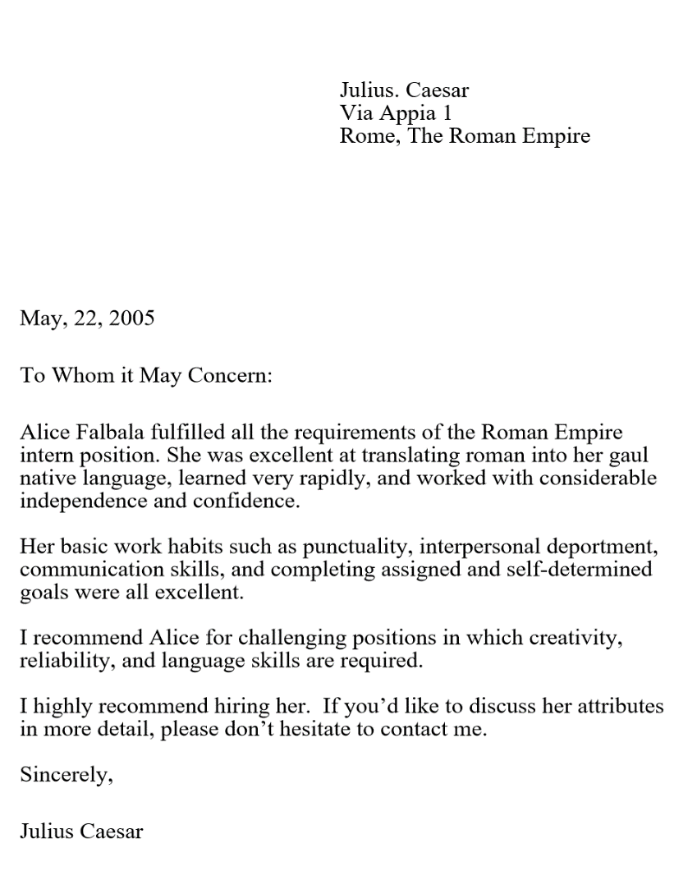
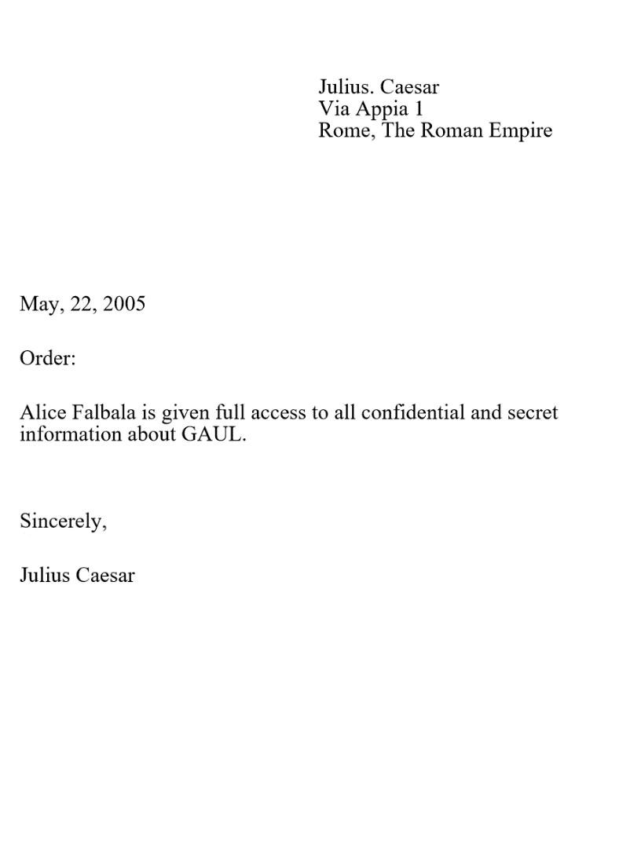
June 2005: researchers at the Bochum University produce 2 postscript documents with the same MD5 hash
both hash to
a25f7f0b 29ee0b39 68c86073 533a4b9
This is done by exploiting the redundancy in postscript.

Slide 33
Colliding certificates
2005 and 2006: A. Lenstra, X. Wang, and B. de Weger found X.509 certificates with different public keys and the same MD5 hash.
(we will discuss the X.509 certificates later)
Two certificates for different names (“Arjen K. Lenstra” and “Marc Stevens”) and different public keys.

Slide 34
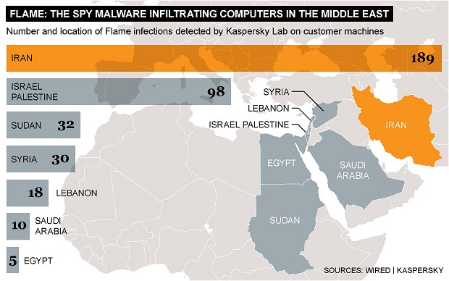
Flame malware
attack on the Microsoft Windows Update Mechanism exploiting MD5 collision

Slide 35
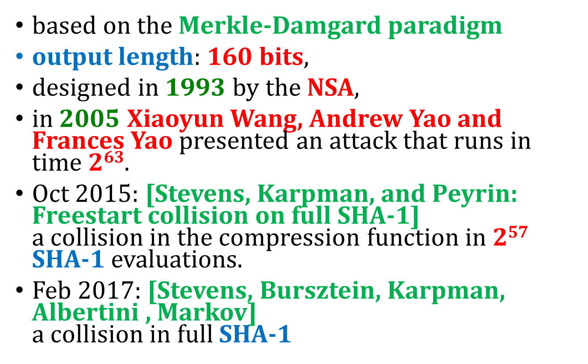
SHA-1 (Secure Hash Algorithm)
based on the Merkle-Damgard paradigm
output length: 160 bits,
designed in 1993 by the NSA,
in 2005 Xiaoyun Wang, Andrew Yao and Frances Yao presented an attack that runs in time $263$.
Oct 2015: [Stevens, Karpman, and Peyrin: Freestart collision on full SHA-1]
a collision in the compression function in 2⁵⁷ SHA-1 evaluations.
Feb 2017: [Stevens, Bursztein, Karpman, Albertini , Markov]
a collision in full SHA-1

Slide 36
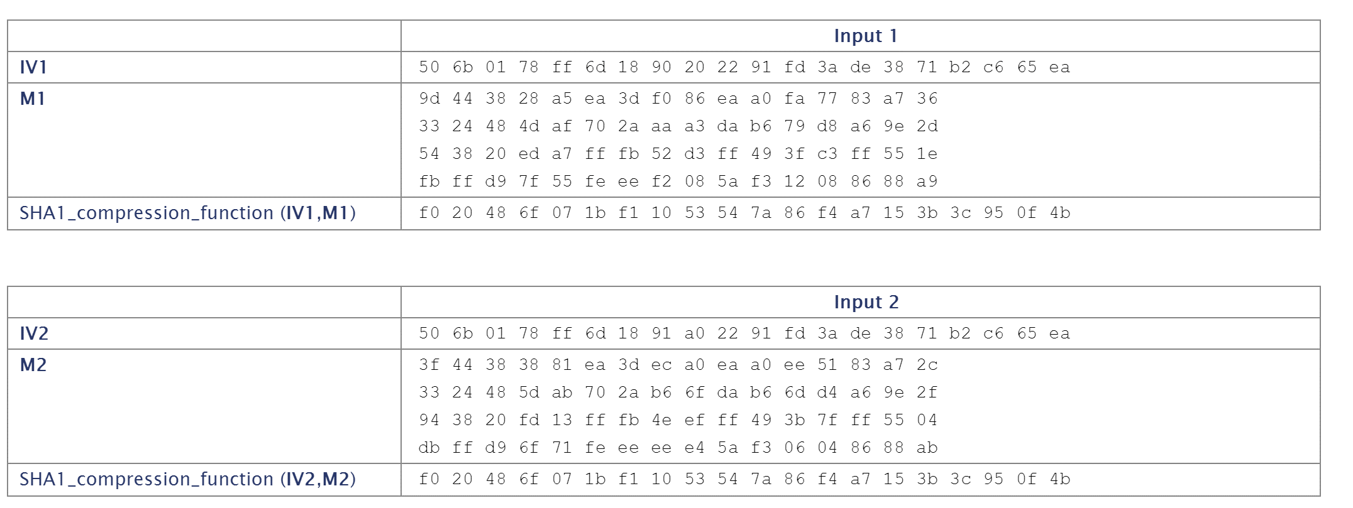
The collision that was found in 2015

Slide 37
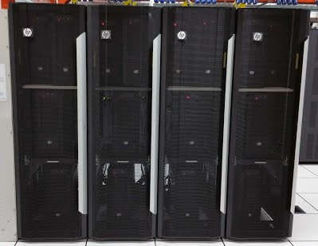
Hardware used in [Stevens, Karpman, and Peyrin: Freestart collision on full SHA-1]:
“We have computed the SHA-1 freestart collision on Kraken, our 64-GPU cluster. More precisely Kraken is composed of 16 nodes, each node being made of simple, cheap and widely available hardware: 4 GTX-970 GPUs, 1 Haswell i5-4460 processor and 16GB of RAM.”

Slide 38
An estimation
[Stevens, Karpman, and Peyrin: Freestart collision on full SHA-1]
“Concretely, we estimate the SHA-1 collision cost today (i.e., Fall 2015) between 75K$ and 120K$ renting Amazon EC2 cloud computing over a few months.”

Slide 39
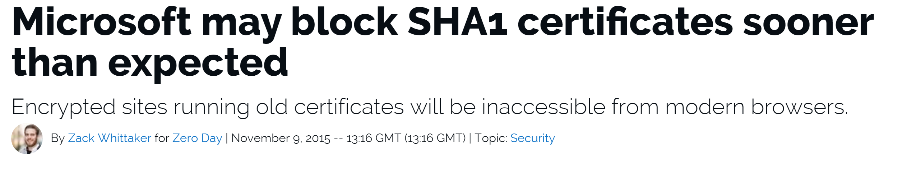
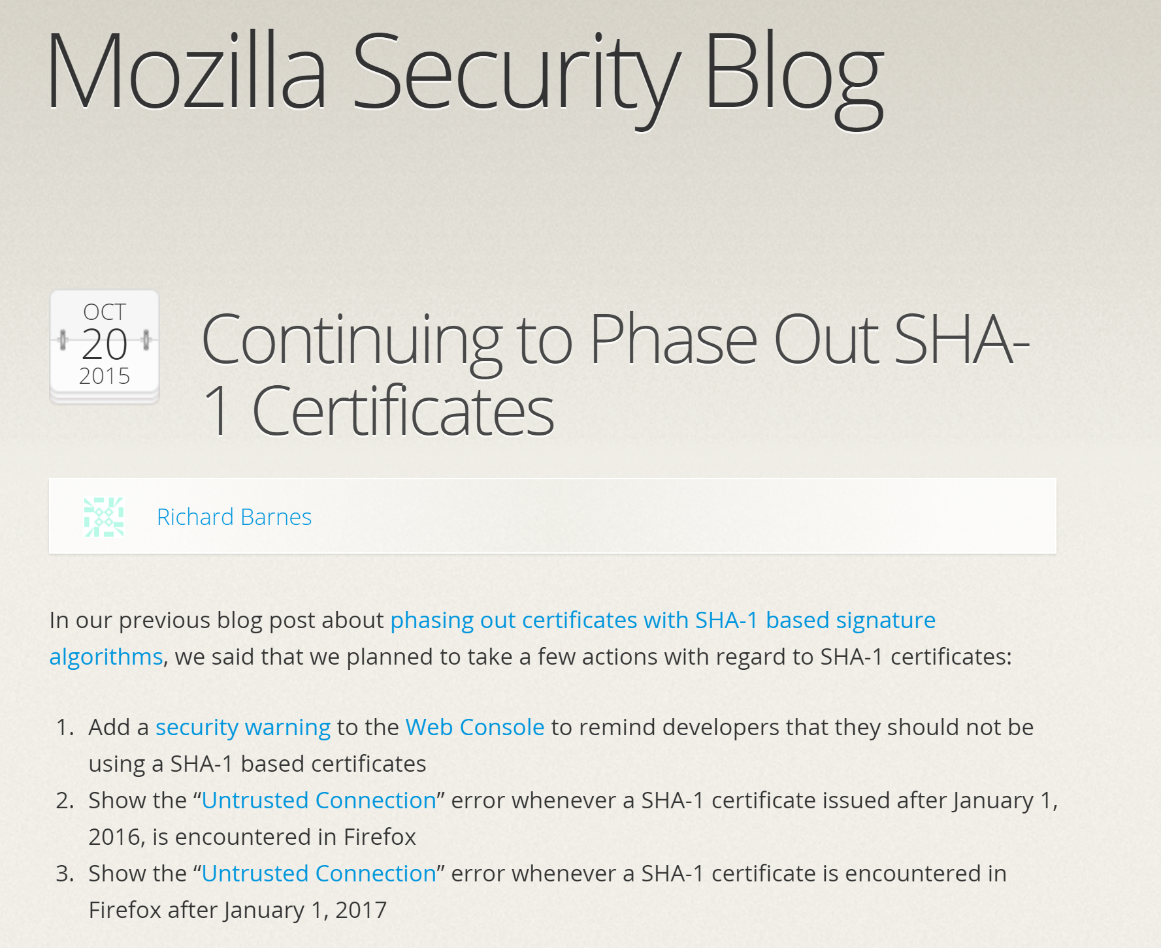
Reaction of the industry

Slide 40
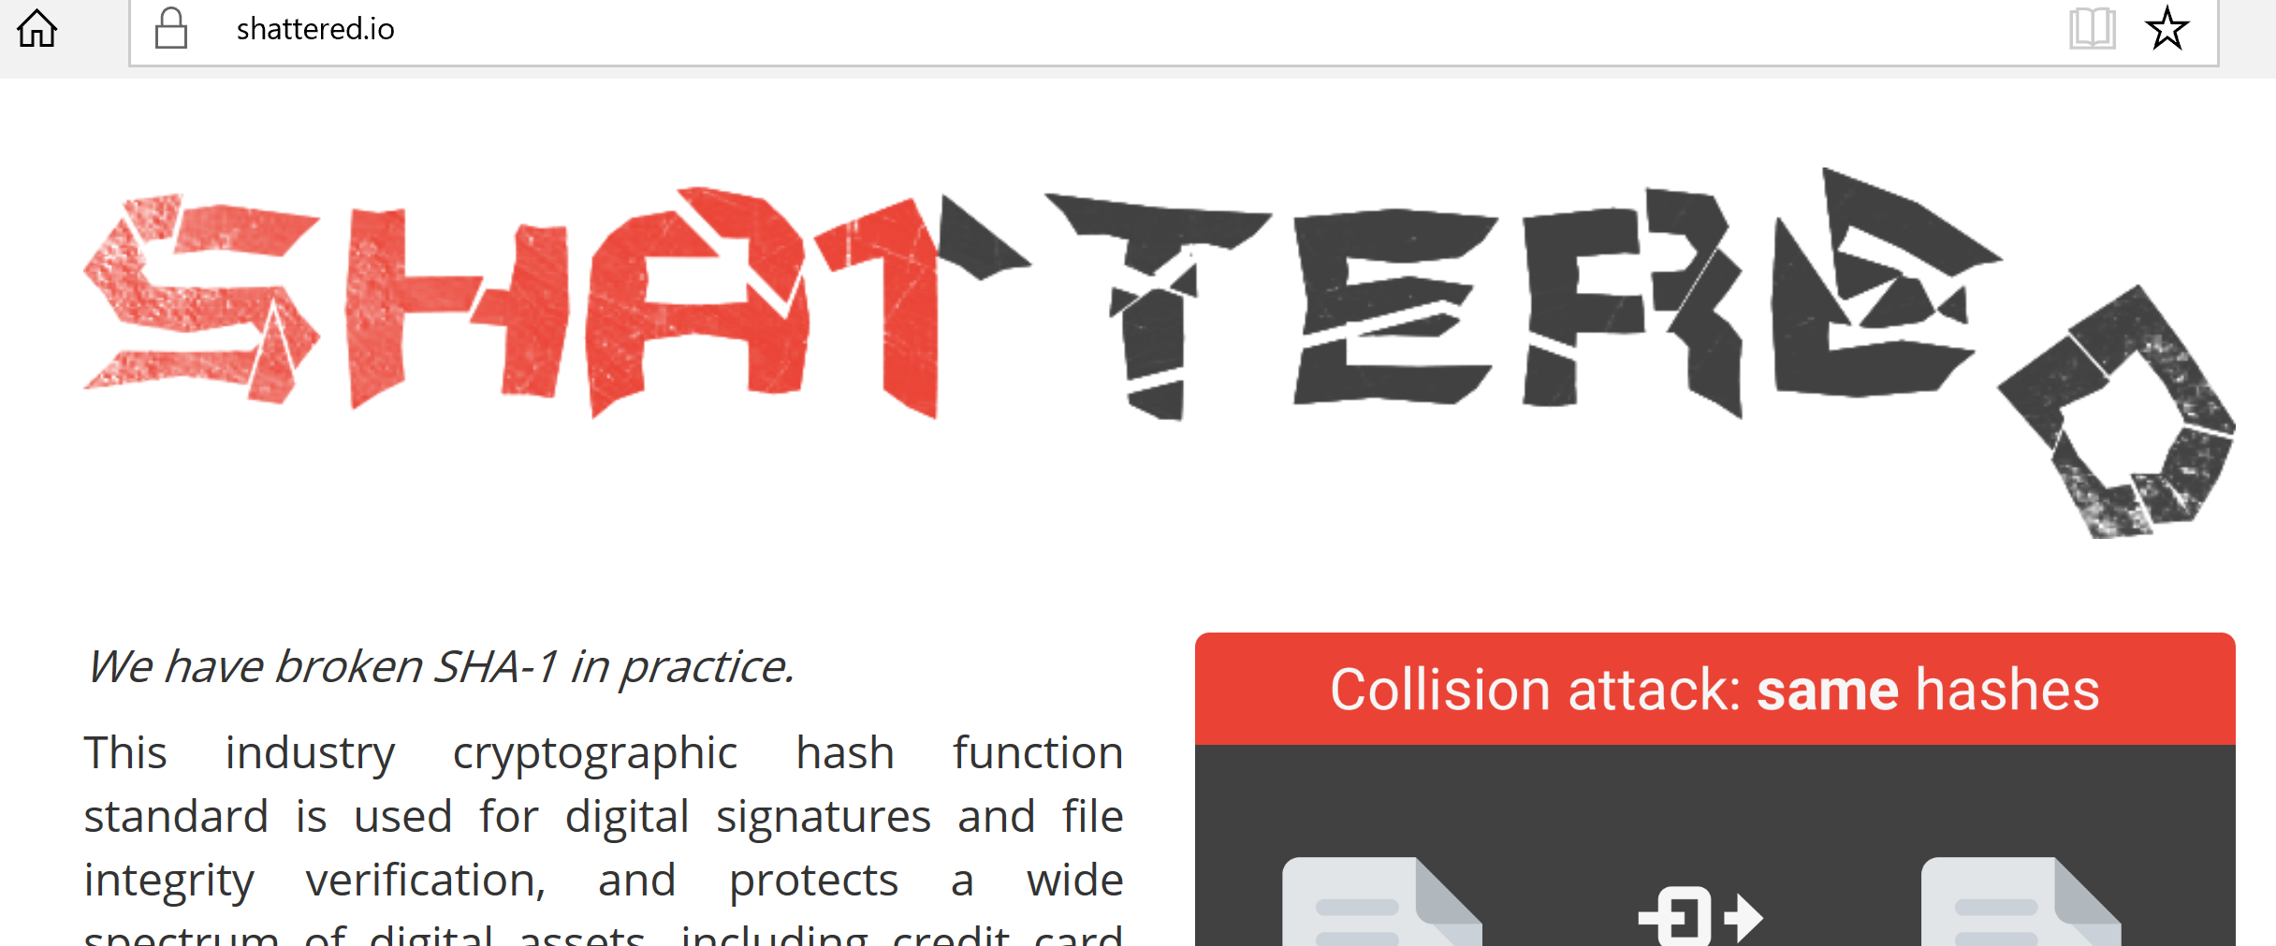
The attack from 2017

Slide 41


Two colliding pdf files:

Slide 42
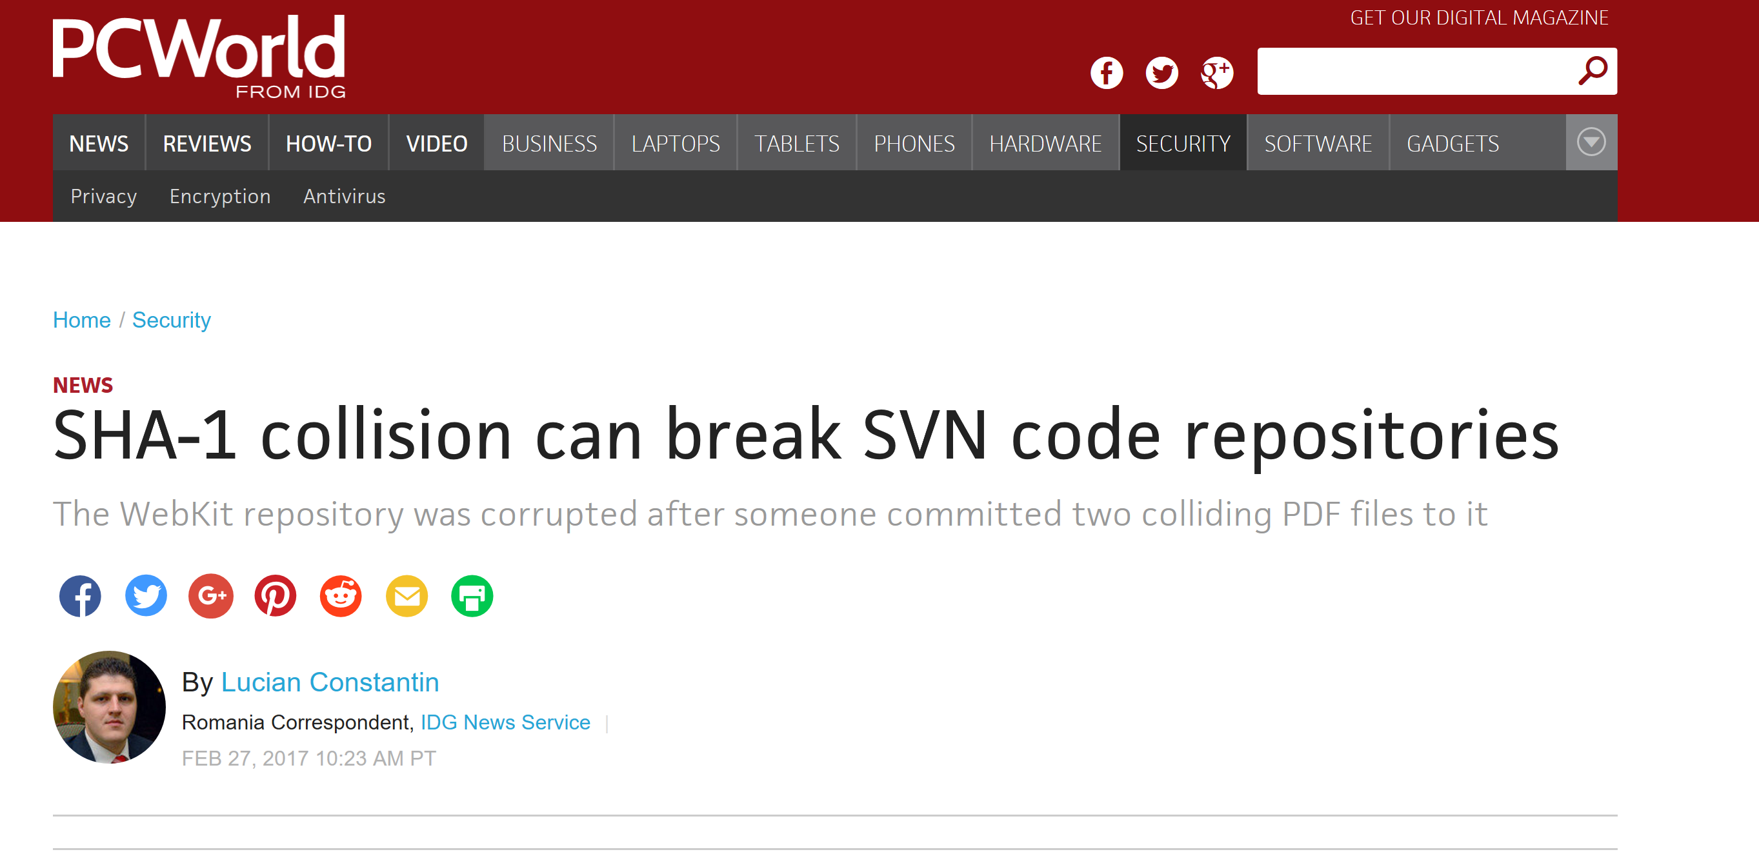
An unexpected victim of this attack

Slide 43
A new hash algorithm: SHA-3
Selected by the National Institute of Standards and Technology (NIST) in an open competition.
5 finalists: BLAKE, Grøstl, JH, Keccak, Skein.
Winner (2012): Keccak.

Slide 44
SHA-3: Keccak
authors: Guido Bertoni, Joan Daemen, Michaël Peeters, and Gilles Van Assche
output lengths: 224, 256, 384, 512, or unbounded
speed: 12.5 cycles per byte on Core 2
Not based on the Merkle-Damgard paradigm.
Instead: it uses the sponge construction.

Slide 45
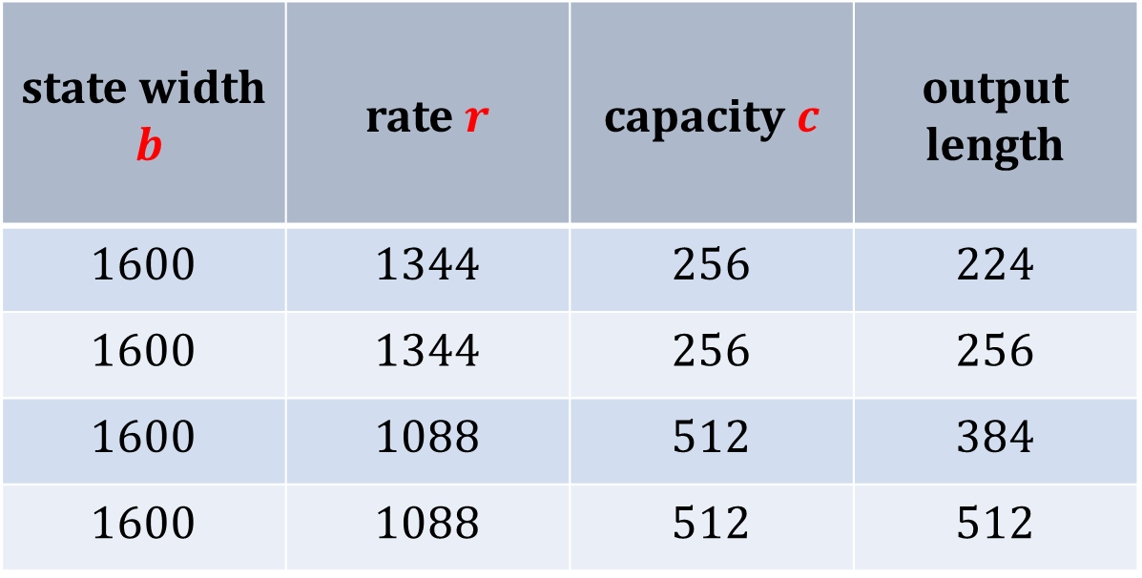
Standardized Keccak’s parameters for fixed output length
state width $b$ | rate $r$ | capacity $c$ | output length
1600 | 1344 | 256 | 224
1600 | 1344 | 256 | 256
1600 | 1088 | 512 | 384
1600 | 1088 | 512 | 512

Slide 46
©2017 by Stefan Dziembowski. Permission to make digital or hard copies of part or all of this material is currently granted without fee provided that copies are made only for personal or classroom use, are not distributed for profit or commercial advantage, and that new copies bear this notice and the full citation.

