Slide 1

Lecture 11
Commitment Schemes and Zero Knowledge
Stefan Dziembowski
www.crypto.edu.pl/Dziembowski
University of Warsaw
12.12.18
version 1.0

Slide 2
Plan
Coin-flipping by telephone
Commitment schemes
  definition
  construction based on QRA
  construction based on discrete log
  construction based on PRG
Zero-knowledge (ZK)
  motivation and definition
  ZK protocol for graph isomorphism
  ZK protocol for Hamiltonian cycles
  applications

Slide 3


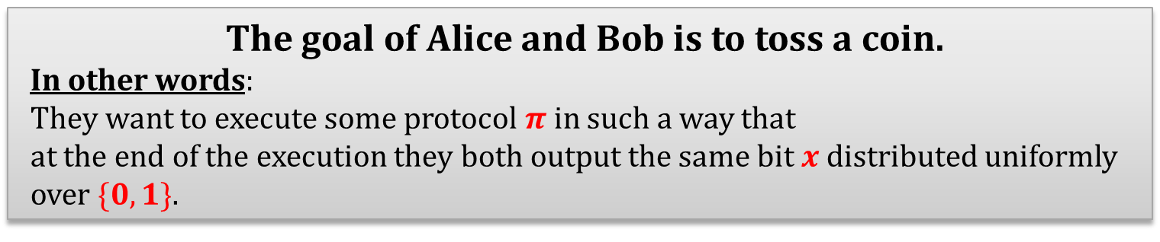
Coin-flipping by telephone [Blum’81]
privacy and authenticity is not a problem
Suppose Alice and Bob are connected by a secure internet link:
internet
$$x$$
$$x$$
The goal of Alice and Bob is to toss a coin.
In other words:
They want to execute some protocol $π$ in such a way that
at the end of the execution they both output the same bit$x$distributed uniformly over $\{0,1\}$.

Slide 4
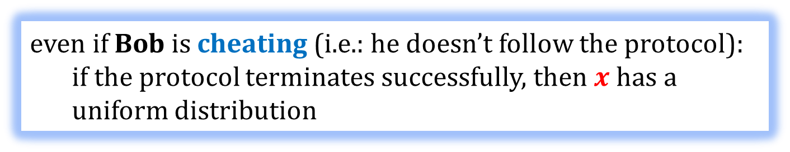


How to define security? [1/2]
Let us just stay at an informal level...
From the point of view of Alice:
internet
$$x$$
$$x$$
even if Bob is cheating (i.e.: he doesn’t follow the protocol):
  if the protocol terminates successfully, then $x$ has a uniform distribution

Slide 5
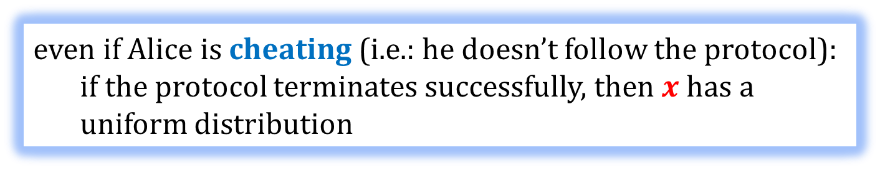


How to define security? [2/2]
The same holds from the point of view of Bob
internet
$$x$$
$$x$$
even if Alice is cheating (i.e.: he doesn’t follow the protocol):
  if the protocol terminates successfully, then $x$ has a uniform distribution

Slide 6
Note the difference
Unlike what we saw on the previous lectures:
the enemy can be one of the parties
(not an external entity)
A cheating party is sometimes called a corrupted party, or a malicious party.
We will see many other examples of this later!

Slide 7

How to solve this problem?
Idea
Remember the old game:
rock-paper-scissors?

Slide 8




Alice
 | draw | Alice wins | Bob wins
 | Bob wins | draw | Alice wins
 | Alice wins | Bob wins | draw
Bob

Slide 9
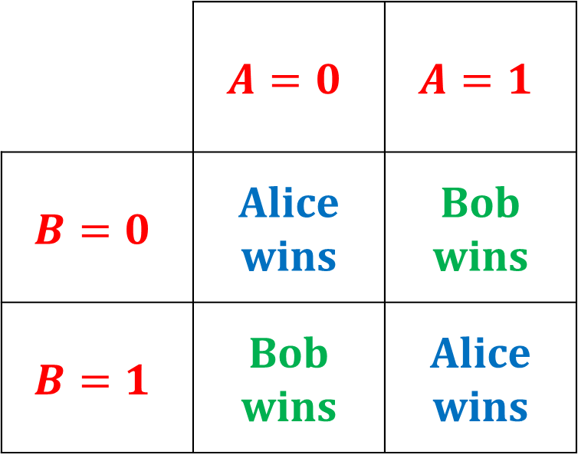
Let’s simplify this game
Alice
 | $$A=0$$ | $$A=1$$
$$B=0$$ | Alice wins | Bob wins
$$B=1$$ | Bob wins | Alice wins
Bob
In other words: Alice wins iff $A⊕B =0$.

Slide 10
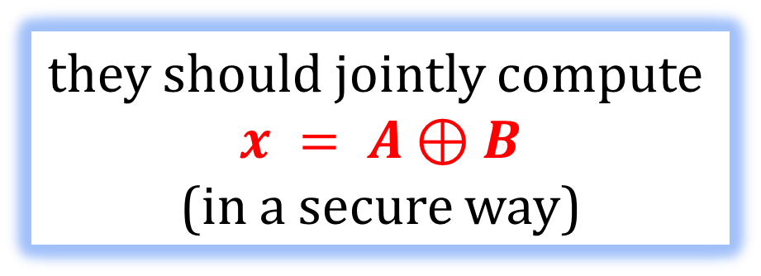
Another way to look at it
Alice
has an input A
Bob
has an input B
they should jointly compute
$$x = A⊕B$$
(in a secure way)

Slide 11
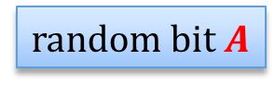
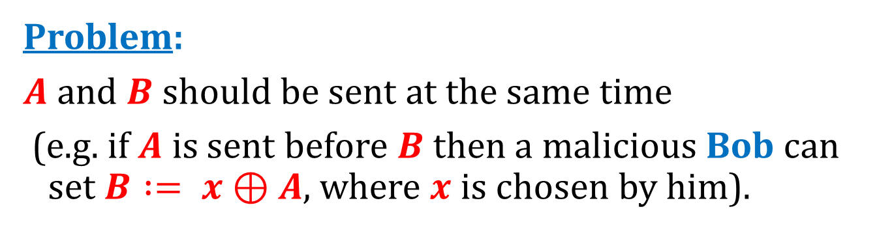
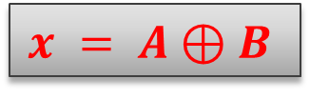
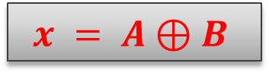
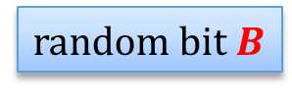
What to do?
random bit $A$
random bit $B$
$$x = A⊕B$$
$$x = A⊕B$$
Problem:
$A$ and $B$ should be sent at the same time
(e.g. if $A$ is sent before $B$ then a malicious Bob can set $B := x⊕A$, where $x$ is chosen by him).

Slide 12
How to prevent this?
Seems hard:
the internet is not synchronous...
A solution:
bit commitments

Slide 13
Plan
Coin-flipping by telephone
Commitment schemes
  definition
  construction based on QRA
  construction based on discrete log
  construction based on PRG
Zero-knowledge (ZK)
  motivation and definition
  ZK protocol for graph isomorphism
  ZK protocol for Hamiltonian cycles
  Applications

Slide 14
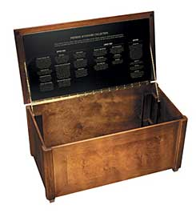
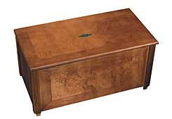



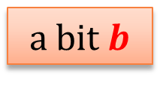
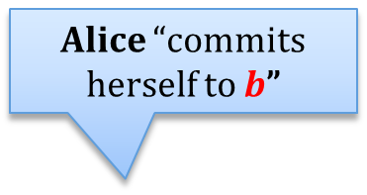
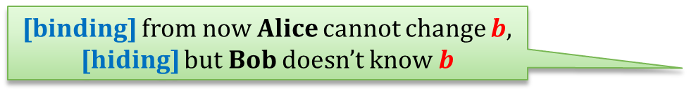

Commitment schemes – an intuition
a bit $b$
Alice “commits herself to $b$”
b
Alice sends a locked box to Bob
[binding] from now Alice cannot change $b$,
[hiding] but Bob doesn’t know $b$
Alice can later send the key to Bob
$$b$$
Alice “opens the commitment”

Slide 15
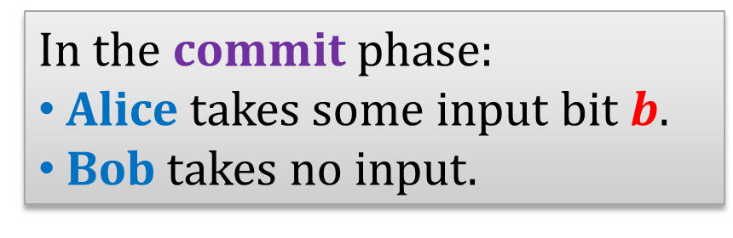
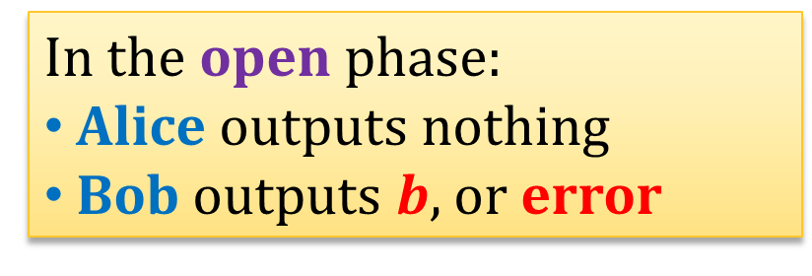
Commitment schemes – a functional definition
A commitment scheme is a protocol executed between Alice and Bob consisting of two phases: commit and open.
In the commit phase:
Alice takes some input bit $b$.
Bob takes no input.
In the open phase:
Alice outputs nothing
Bob outputs $b$, or error

Slide 16
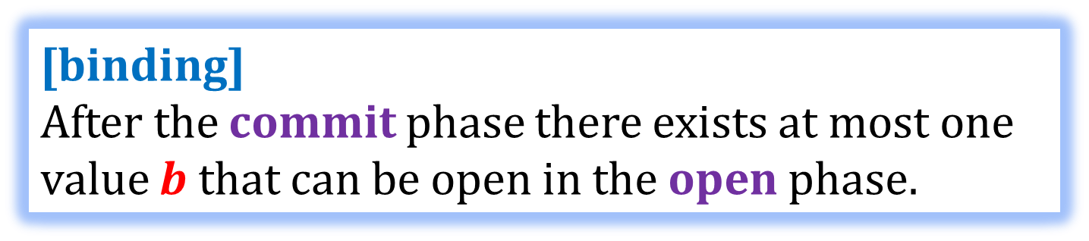
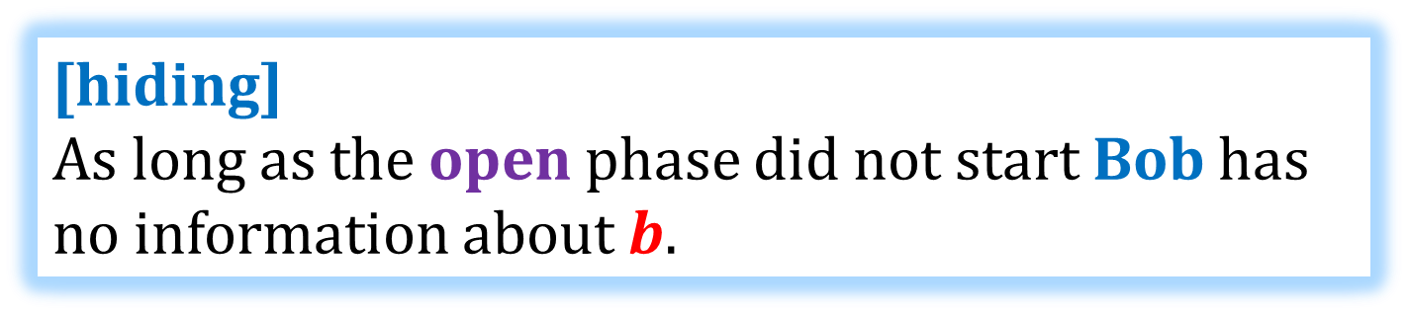
Security requirements - informally
[binding]
After the commit phase there exists at most one value $b$ that can be open in the open phase.
[hiding]
As long as the open phase did not start Bob has no information about $b$.

Slide 17
How to define security formally?
Not so trivial – remember that the parties can misbehave arbitrarily.
We do not present a complete definition here.
(The hiding property can be defined using the “indistinguishability” principle.)
The definition depends on some options.
What is the computational power of a cheating Alice?
What is the computational power of a cheating Bob?

Slide 18
The computational power of the adversary
If a cheating Alice can be infinitely powerful, we say that the protocol is unconditionally binding.
Otherwise it is computationally binding.
If a cheating Bob can be infinitely powerful, we say that the protocol is unconditionally hiding.
Otherwise it is computationally hiding.
Of course, to be formal we would need to introduce a security parameter...

Slide 19
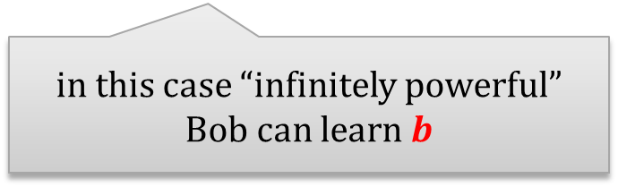
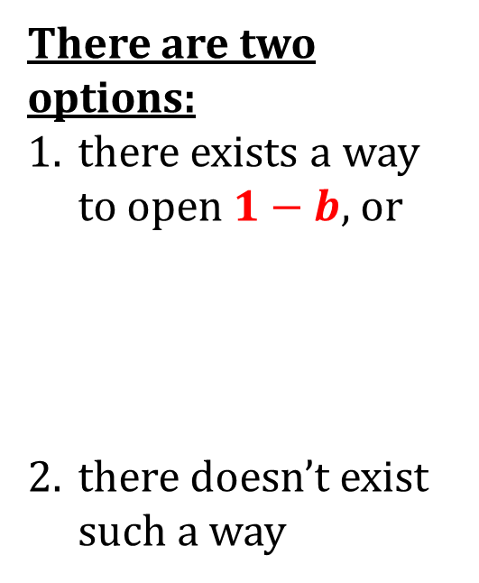

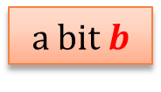
Unconditionally hiding and binding commitment schemes do not exist
There are two options:
there exists a way to open $1−b$, or
there doesn’t exist such a way
Proof (intuition)
a bit $b$
in this case “infinitely powerful” Alice can cheat
$$commit(b)$$
in this case “infinitely powerful” Bob can learn $b$

Slide 20
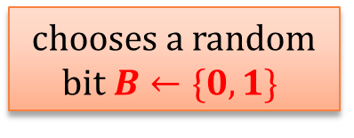


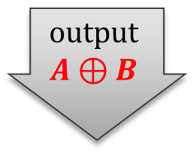
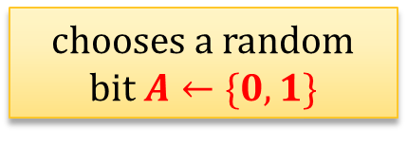
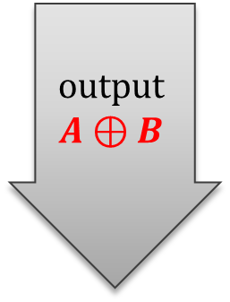

So, how does it solve the coin-flipping problem?
chooses a random
bit $A←\{0,1\}$
commits to $A$
chooses a random bit $B←\{0,1\}$
sends $B$
output
$$A⊕B$$
opens $A$
output
$$A⊕B$$

Slide 21
Problem
Alice can always refuse to send the last message.
This is unavoidable (there has to be the last message in the protocol).
But they can use a convention:
if Alice didn’t send the last message – she lost!

Slide 22
Plan
Coin-flipping by telephone
Commitment schemes
  definition
  construction based on QRA
  construction based on discrete log
  construction based on PRG
Zero-knowledge (ZK)
  motivation and definition
  ZK protocol for graph isomorphism
  ZK protocol for Hamiltonian cycles
  Applications

Slide 23

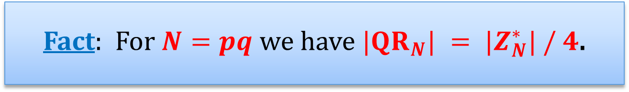






Remember quadratic residues modulo an RSA modulus?
$$QR_{N}=\{x^{2} mod N:x∈Z_{N}^{∗}\}$$
Fact: For $N=pq$ we have $|QR_{N}| = |Z_{N}^{∗}| / 4$.
$Z_{N}^{∗}$:
$$QR_{p}$$
$$mod p$$
$$QR_{q}$$
$$QR_{N}$$
$$mod q$$

Slide 24
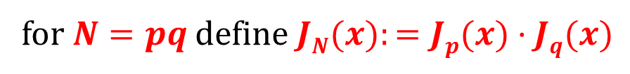





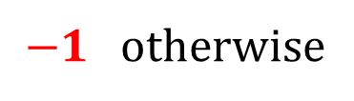

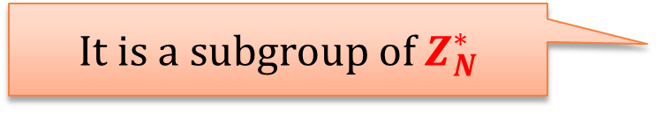
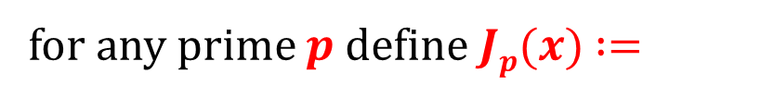

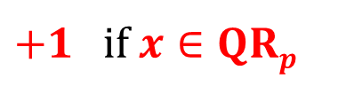
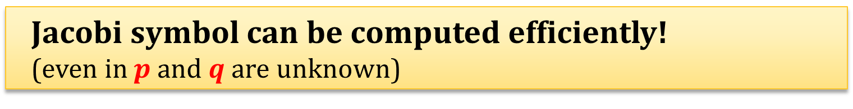
Jacobi Symbol
$+1$ if $x∈QRp$
for any prime $p$ define $Jp(x)$ $:=$
$−1$otherwise
for $N=pq$ define $JN(x):=Jp(x)·Jq(x)$
$$QR_{p}$$
$$mod p$$
$$JN(x) :=$$
+1 | -1
-1 | +1
$$QR_{q}$$
$$QR_{N}$$
$$mod q$$
It is a subgroup of $Z_{N}^{∗}$
$$Z_{N}^{+}:= \{x∈Z_{N}^{∗}: J_{N}(x)=+1\}$$
Jacobi symbol can be computed efficiently!
(even in $p$ and $q$ are unknown)

Slide 25



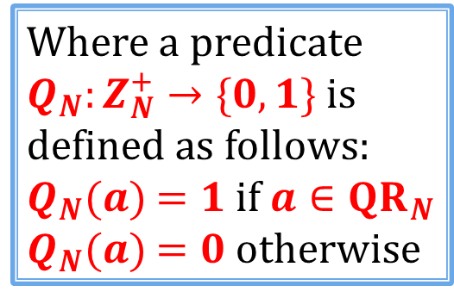
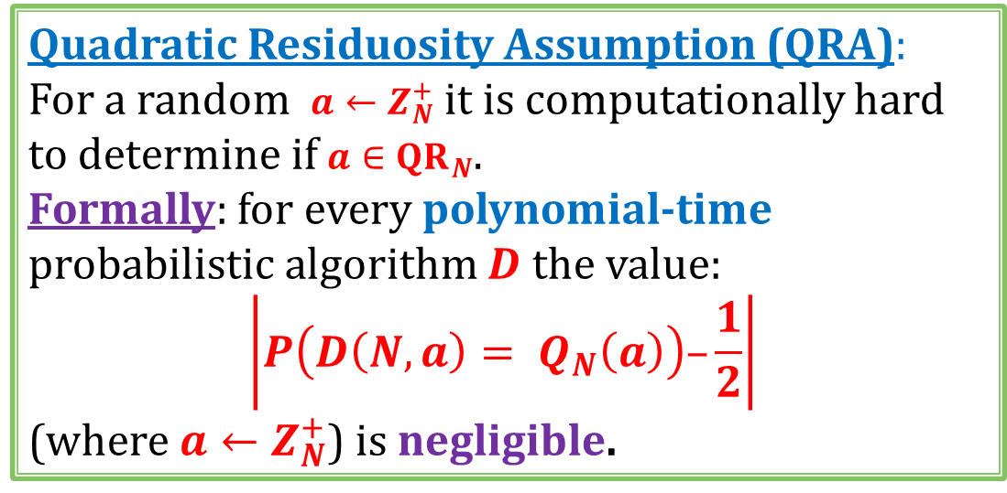



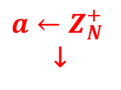
Quadratic Residuosity Assumption
$a←Z_{N}^{+}$
↓
?
$Z_{N}^{∗}$:
$$QR_{p}$$
$$Q{NR}_{p}$$
$$QR_{q}$$
$$QR_{N}$$
$$Q{NR}_{p}$$
Quadratic Residuosity Assumption (QRA):
For a random $a←Z_{N}^{+}$ it is computationally hard to determine if $a∈QR_{N}$.
Formally: for every polynomial-time probabilistic algorithm $D$ the value:
$$\left|P\left(D\left(N,a\right)= Q_{N}\left(a\right)\right)–\frac{1}{2}\right|$$
(where $a←Z_{N}^{+}$) is negligible.
Where a predicate $Q_{N}:Z_{N}^{+}→\{0,1\}$ is defined as follows:
$Q_{N}(a)$ $=1$if $a∈QR_{N}$
$Q_{N}(a)$ $=0$otherwise

Slide 26



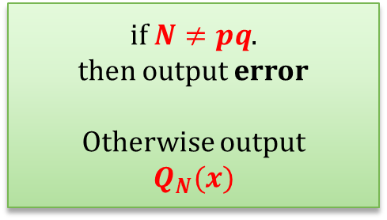
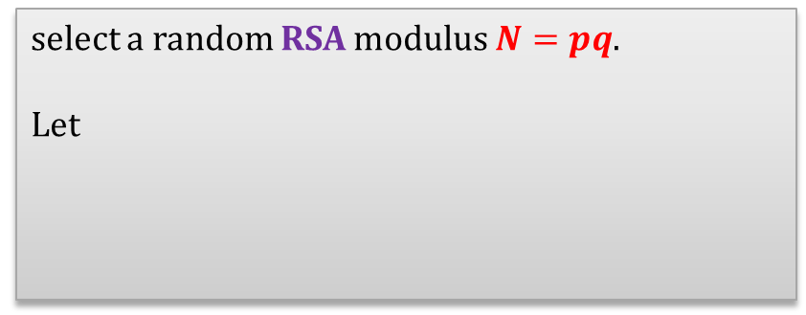
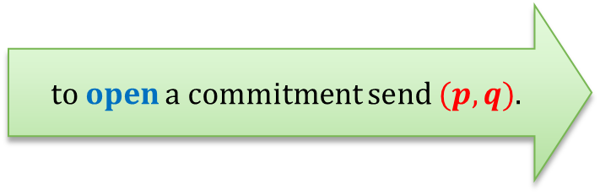

A construction based on QRA
a bit b
select a random RSA modulus $N=pq$.
Let
a random $QRN$ if $b =1$
$x$ :=
a random $Z_{N}^{+}∖QRN$if $b =0$
to commit to $b$sends$(N,x)$
to open a commitment send $(p,q)$.
if $N≠pq$.
then output error
Otherwise output
$$Q_{N}(x)$$

Slide 27
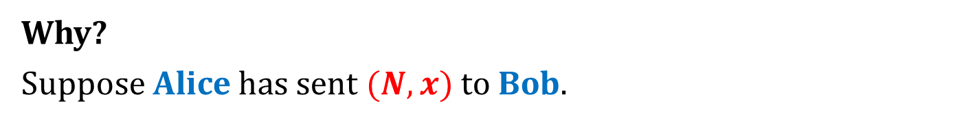
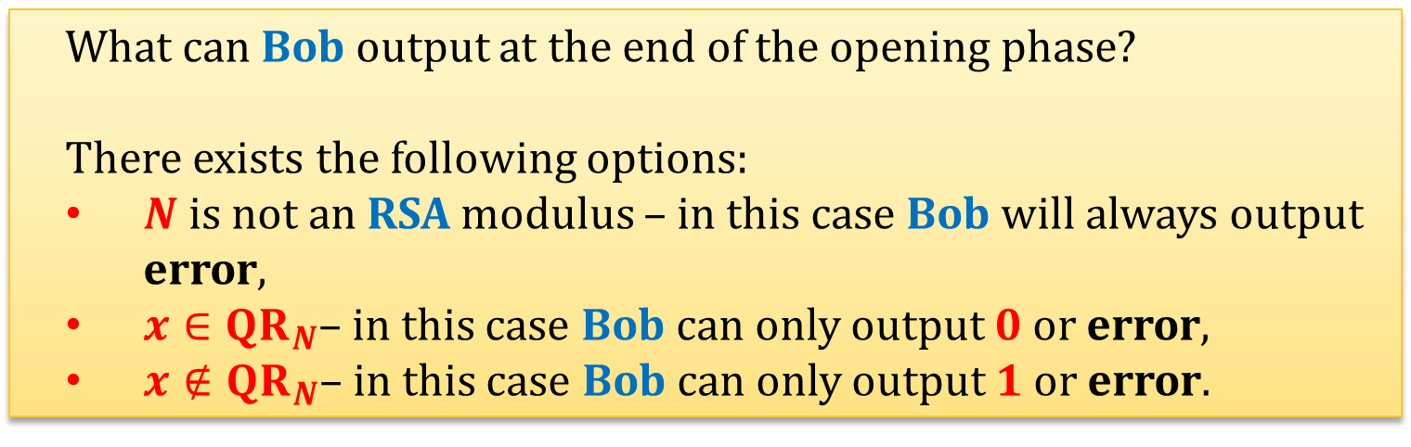
This commitment scheme is unconditionally binding
Why?
Suppose Alice has sent $(N,x)$to Bob.
What can Bob output at the end of the opening phase?
There exists the following options:
$N$ is not an RSA modulus – in this case Bob will always output error,
$x∈QR_{N}$– in this case Bob can only output $0$ or error,
$x∉QR_{N}$– in this case Bob can only output $1$ or error.

Slide 28
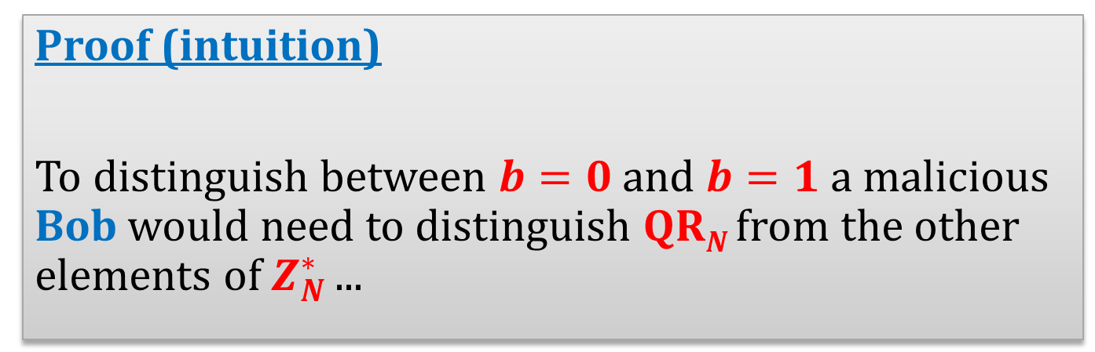
This commitment scheme is computationally hiding, assuming QRA holds
Proof (intuition)
To distinguish between $b=0$ and $b=1$ a malicious Bob would need to distinguish $QRN$ from the other elements of $Z_{N}^{∗}$ ...

Slide 29
Plan
Coin-flipping by telephone
Commitment schemes
  definition
  construction based on QRA
  construction based on discrete log
  construction based on PRG
Zero-knowledge (ZK)
  motivation and definition
  ZK protocol for graph isomorphism
  ZK protocol for Hamiltonian cycles
  applications

Slide 30

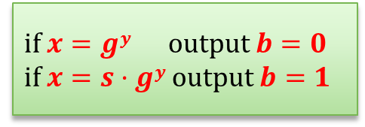




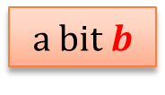
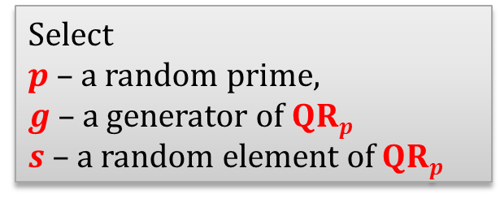


A construction based on discrete log
Select
$p$ – a random prime,
$g$ – a generator of $QRp$
$s$ – a random element of $QRp$
a bit $b$
check if $p$ is prime and
$g$ and $s$ are in $QRp$
select a random
$$y←Z_{(p−1)/2}$$
Let
$$p,g,s$$
$gy$ if $b = 0$
$x$ :=
$s · gy$if $b = 1$
to commit to $b$send $x$
to open a commitment send $y$.
if $x=gy$ output $b=0$
if $x=s·gy$ output $b=1$

Slide 31
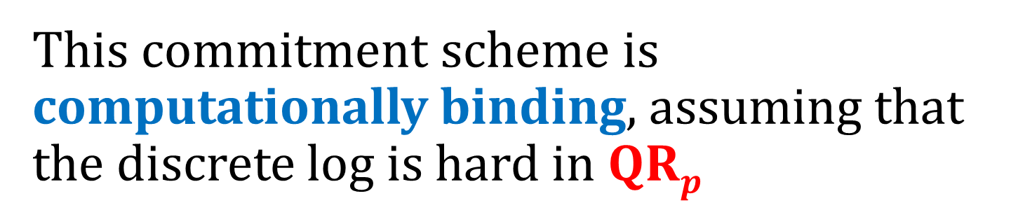
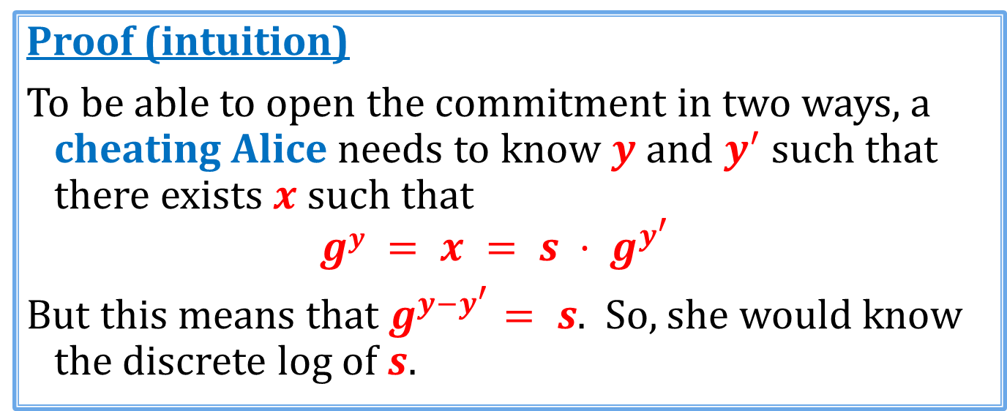
This commitment scheme is computationally binding, assuming that the discrete log is hard in $QRp$
Proof (intuition)
To be able to open the commitment in two ways, a cheating Alice needs to know $y$ and $y^{′}$ such that there exists $x$ such that
$$gy = x = s · g^{y^{′}}$$
But this means that $g^{y−y^{′}}= s$. So, she would know the discrete log of $s$.

Slide 32
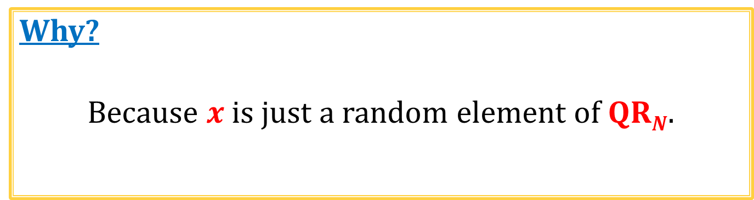
This commitment scheme is unconditionally hiding
Why?
Because $x$ is just a random element of $QRN$.

Slide 33
Plan
Coin-flipping by telephone
Commitment schemes
  definition
  construction based on QRA
  construction based on discrete log
  construction based on PRG
Zero-knowledge (ZK)
  motivation and definition
  ZK protocol for graph isomorphism
  ZK protocol for Hamiltonian cycles
  applications

Slide 34

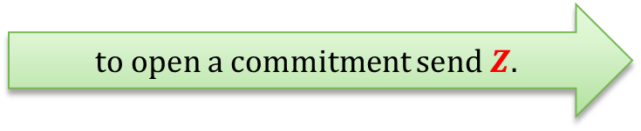









A construction based on PRGs [Naor’91]
$G:\{0,1\}L→\{0,1\}3L$a PRG
select a random string
$$X←{\left\{0,1\right\}}^{3L}$$
a bit $b$
$$X$$
select a random string
$$Z←{\left\{0,1\right\}}^{L}$$
and let
$G\left(Z\right)⊕X$if $b=0$
$Y$ :=
$G(Z)$ if $b=1$
to commit to $b$ send $Y$
to open a commitment send $Z$.
if $Y=G\left(Z\right)⊕X$output $b=0$
if $Y=G(Z)$ output $b=1$

Slide 35


This commitment scheme is unconditionally binding
Proof (intuition)
To be able to open the commitment in two ways, a cheating Alice needs to find $Z$ and $Z’$ such that there exists $Y$ such that:
$$G\left(Z\right)⊕X = Y = G(Z’)$$
This means that $G\left(Z\right)⊕G(Z’) = X$.
How many $X$’s have the property that
there exist $Z$ and $Z’$ such that $G\left(Z\right)⊕G(Z’) = X$?
By the counting argument: at most ${\left(2^{L}\right)}^{2}=2^{2L}$.
Therefore, the probability that a random $X∈{\left\{0,1\right\}}^{3L}$ has this property is at most
$\frac{2^{2L}}{2^{3L}}=2^{−L}$.
QED

Slide 36

This commitment scheme is computationally hiding, assuming G is a secure PRG
Why?
Obviously, if, instead of $G(Z)$ Alice uses a completely random string $R$, then the scheme is secure against a cheating Bob.
If a scheme behaved differently with $R$ and with $G(Z)$, then a cheating Bob could be used as a distinguisher for $G$.

Slide 37
Moral
one-way functions
exist
commitment schemes
exist
this can also be shown
Commitment schemes are a part of Minicrypt!

Slide 38

String commitment
How to commit to a longer string $x=(x_{1},…,x_{n})$?
Just commit to every $x_{i}$ separately.
To open the commitment, open each commitment to $x_{i}$.
(Bob accepts only if all the openings were ok)

Slide 39
Plan
Coin-flipping by telephone
Commitment schemes
  definition
  construction based on QRA
  construction based on discrete log
  construction based on PRG
Zero-knowledge (ZK)
  motivation and definition
  ZK protocol for graph isomorphism
  ZK protocol for Hamiltonian cycles
  applications

Slide 40




Zero-knowledge (ZK)
We will now talk about the zero-knowledge proofs.
Informally:
A proof of some statement $φ$ is zero-knowledge, if it doesn’t reveal any information (besides the fact that $φ$ holds).
Introduced in:
[Shafi Goldwasser, Silvio Micali, Charles Rackoff: The Knowledge Complexity of Interactive Proof-Systems, STOC 1985, SIAM J. Comput. 1989]
Turing Award in 2012
S. Goldwasser
S. Micali
C. Rackoff

Slide 41










A motivating example: public-key identification (see: the last lecture)
$(Enc,Dec)$– a public key encryption scheme
$(pk,sk)$– a (public key, private key) pair of Alice
Everybody the knows $pk$ can verify the identity of Alice
$$pk$$
Alice
Take a random message $m$
$$c :=Enc(pk, m)$$
$$sk$$
$$m^{′}≔Dec(sk,c)$$
verifier
Check if
$$m = m’$$

Slide 42
Is it secure against actively cheating verifier?
can ask arbitrary queries
malicious verifier

Slide 43


So is it secure?
(we didn’t define security, so this is just an informal question)
To impersonate Alice one needs to be able to decrypt $c$ without the knowledge of $m$.
What does the verifier learn about $sk$?
If the verifier follows the protocol – he doesn’t learn anything that he didn’t know before (he already knows $m$).
But what if the verifier is malicious?
Alice acts as a decryption oracle!
(so the verifier learns something that he didn’t know)
is it a problem? – depends on the application

Slide 44
A question
Is it possible to design a protocol where
a verifier learns nothing,
besides of the fact that he is talking to Alice?

Slide 45











A new variant of the protocol
$(pk,sk)$– a (public key, private key) pair of Alice
$$pk$$
Take a random message $m$
$$c ≔Enc(pk, m)$$
commit to $m^{′}≔Dec(sk,c)$
$$sk$$
verifier
$$m$$
abort if
$$m≠m′$$
open the commitment to $m^{′}$
$$m’ := Dec(sk,c)$$
check if
$$m=m′$$

Slide 46

Can a malicious verifier learn something from this protocol?
Intuition:
No, because he
doesn’t learn $m′$
(he already knows $m′$).

Slide 47
Can this be proven formaly?
Yes!
But we first need to
define what it means that
“the verifier learns nothing”.
This will lead us to the concept of
zero knowledge

Slide 48


The general picture
$L$ – some language (usually not in $P$)
$$x∈L$$
$$x∈L$$
the prover is infinitely powerful
the verifier is poly-time
prover
verifier
Two main properties:
soundness
zero-knowledge
I am convinced!

Slide 49





Soundness - informally
A cheating prover cannot convince the verifier that
$$x∈L$$
if it is not true
(negligible error probability is allowed)
$$x∉L$$
$$x∉L$$
prover
verifier
It’s not true!

Slide 50



Zero Knowledge
The only thing that the verifier should learn is that $x∈L$
$$x∈L$$
is $x∈L$?
prover
verifier
YES!
verifier
This should hold even if the verifier doesn’t follow the protocol.
(again: we allow some negligible error)

Slide 51






An example of a protocol that is not Zero Knowledge
$L$ – some NP-complete language
we will also call it a “statement”
$$x∈L$$
$$x∈L$$
finds an
NP-witness $w$ for $x$
$$w$$
can verify if $x∈L$
prover
verifier
Why it is not ZK?
Because the verifier learned $w$

Slide 52




Notation
Suppose we are given a protocol consisting of two randomized machines $P$ and $V$.
Suppose $P$ and $V$ take some common input $x$, and then $V$ outputs yes or no.
We say that $(P,V)$accepts $x$ if $V$ outputs yes. Otherwise we say that it rejects $x$.
$View(P,V,x)$ – a random variable denoting the “view of $V$”, i.e.:
the random input of $V$ and the input $x$,
the transcript of the communication.

Slide 53

Zero-knowledge proofs
A pair $(P, V)$is a zero-knowledge proof system for $L$ if it satisfies the following conditions:
$P$ has an infinite computing power and $V$ is poly-time.
Completeness: If $x∈L$, then the probability that $(P, V)$rejects $x$ is negligible in the length of $x$.
Soundness: If $x∉L$ then for any prover $P^{∗}$, the probability that $(P^{∗},V)$ accepts $x$ is negligible in the length of $x$.
Zero-Knowledge: “a cheating $V$ should not learn anything besides of the fact that $x∈L$”
How to define it formally?

Slide 54



“a cheating $V$ should not learn anything besides of the fact that $x∈L$”
“What a cheating $V$ can learn can be simulated without interacting with $P$”
Definition (main idea)
For every (even malicious) poly-time $V^{∗}$ there exists an (expected) poly-time machine $S$ such that
${\left\{View\left(P,V^{∗},x\right)\right\}}_{x∈L}$ is
“indistinguishable from” ${\left\{S\left(x\right)\right\}}_{x∈L}$
we will formalize it in a moment

Slide 55










The idea of simulation
$$∀$$
$$∃$$
$$∀$$
$$x∈L$$
$$x∈L$$
$$x∈L$$
simulator $S$
prover
view of the malicious verifier
$$≈$$
view of the simulator

Slide 56



Indistinguishability
Let $α={\left\{A\left(x\right)\right\}}_{x∈L}$ and $β={\left\{B\left(x\right)\right\}}_{x∈L}$ be two sets of distributions.
$α$ and $β$ are computationally indistinguishable if for every poly-time $D$ there exists a negligible function $ε$ such that for every $x∈L$
$\left|P\left(D\left(x,A\left(x\right)\right)=1\right)−P\left(D\left(x,B\left(x\right)\right)=1\right)\right|≤ε(\left|x\right|)$ $(∗)$
$α$ and $β$ are statistically indistinguishable if $(∗)$holds also for infinitely powerful $D$.
$α$ and $β$ are perfectly indistinguishable if $(∗)$ holds also for infinitely powerful $D$, and $ε=0$.

Slide 57


“a cheating $V$ should not learn anything besides of the fact that $x∈L$”
Definition (a bit more formally)
For every (even malicious) poly-time $V^{∗}$ there exists an (expected) poly-time machine $S$ such that
${\left\{View\left(P,V^{∗},x\right)\right\}}_{x∈L}$
is computationally indistinguishable from ${\left\{S\left(x\right)\right\}}_{x∈L}$
This is a definition of a computational zero-knowledge.
By changing the “computational indistinguishability” into
“statistical indistinguishability” we get a statistical zero-knowledge
“perfect indistinguishability” we get a perfect zero-knowledge

Slide 58
Plan
Coin-flipping by telephone
Commitment schemes
  definition
  construction based on QRA
  construction based on discrete log
  construction based on PRG
Zero-knowledge (ZK)
  motivation and definition
  ZK protocol for graph isomorphism
  ZK protocol for Hamiltonian cycles
  applications

Slide 59




Graph isomorphism
A graph is a pair $(V,E)$, where $E$is a binary symmetric relation on $V$.
A graph isomorphism between $(V,E)$and $\left(V^{′},E^{′}\right)$is a function:
$φ : V → V′$
such that
$\left(e_{1},e_{2}\right)∈V$ iff $\left(φ\left(e_{1}\right),φ\left(e_{2}\right)\right)∈V′$
Graphs $G$ and $H$ are isomorphic if there exists an isomorphism between them.
Example
isomorphism:
$$f(a)=1$$
f $\left(b\right)=6$
$$f(c)=8$$
$$f(d)=3$$
$$f(g)=5$$
$$f(h)=2$$
$$f(i)=4$$
$$f(j)=7$$
© Wikipedia

Slide 60

Hardness of graph isomorphism
No poly-time algorithm for the graph isomorphism problem is known.
Without loss of generality we will consider only isomorphism between $(V,E)$and $\left(V^{′},E^{′}\right)$, where
$V =V′=\{1,…,n\}$(for some $n$).
That is, a bijection:
$$φ : V → V′$$
is a permutation of the set $\{1,…,n\}$.

Slide 61




A zero knowledge proof of graph isomorphism – a wrong solution
statement
graphs $G0$ and $G1$are isomorphic
prover
verifier
$$φ$$
computes the isomorphism $φ$ between
$G0$ and $G1$
checks if $φ$ is an isomorphism between
$G0$ and $G1$

Slide 62

Notation
If $G=(V,E)$is a graph, and
$π: V→V$is a permutation
then by $π(G)$we mean a graph
$G′=\left(V^{′},E^{′}\right)$
where
$\left(a,b\right)∈E$ iff $\left(π\left(a\right),π\left(b\right)\right)∈E^{′}$

Slide 63








A fact
a set of all graphs with vertices in some set $V$
$Γ$ - a class of all graphs isomorphic to $G$
some graph $G$
$$G$$
$$π$$
$$π(G)$$
If $π$ is a random permutation
then $π(G)$is a random element of $Γ$

Slide 64













A zero knowledge proof of graph isomorphism
statement
graphs $G0$ and $G1$are isomorphic
prover
verifier
iterate $n$ times:
$$H :=π(G1)$$
selects a random permutation $π$
a random $i∈\{0,1\}$
an isomorphism between $H$ and $Gi$
accepts only if the answer is correct
Note:
Prover does not need to be infinitely powerful, if he knows the isomorphism isomorphism $φ$ between $G0$ and $Gi$.
if $i=1$ then he just sends $π$
if $i=0$ then he sends $π · φ$
$$G0$$
$$φ$$
$$G1$$
$$π · φ$$
$$π$$
$$H$$

Slide 65










Why is this a zero-knowledge proof system?
Completeness: trivial
Soundness:
Suppose $G0$ and $G1$ are not isomorphic
$$G0$$
$$φ$$
$$G1$$
$$π · φ$$
$$π$$
$$H$$
Then, at least one of the following has to hold:
$G0$and $H$ are not isomorphic
$H$ and $G1$are not isomorphic
probability that a verifier rejects is at least $1/2$.
Since the protocol is repeated $n$ times, the probability that the verifier rejects is at least $1−{\left(\frac{1}{2}\right)}^{n}$.
Setting $n :=|G0|+|G1|$we are done!

Slide 66

Zero-knowledge?
Intuitively, the zero-knowledge property comes from the fact that:
The only thing that verifier learns is:
a permutation between $H$ and $G0$ or $G1$
where
graph $H$ is random graph isomorphic to $G0$
(and isomorphic to $G1$).
(In fact: we can show that this is a perfect zero knowledge proof system.)

Slide 67





More formally
For every poly-time
malicious verifier $V^{∗}$
there exists an (expected) poly-time
simulator $S$
such that
${\left\{View\left(P,V^{∗},x\right)\right\}}_{x∈L}$
is perfectly indistinguishable from ${\left\{S\left(x\right)\right\}}_{x∈L}$

Slide 68









statement: graphs $G0$ and $G1$are isomorphic
simulator $S$
$G0$ and $G1$
malicious verifier $V^{∗}$
select a random permutation $π$
and a bit $c$
$$H :=π(Gc)$$
$i∈\{0,1\}$
if $i=c$send an isomorphism between $H$ and $Gi$
otherwise:
restart everything
output the view of $V^{∗}$

Slide 69

The running time
First, observe, that the distribution of $H$ doesn’t depend on $c$ (since it is uniform in the class of graphs isomorphic with $G0$ and $G1$)
Therefore the probability that $S$ needs to restart $V^{∗}$ is equal to $1/2$.
So the expected number of restarts is $2$.
Therefore, the running time is (expected) polynomial time.

Slide 70





Indistinguishability of the distributions
uniform in the class of graphs isomorphic with $G0$ and $G1$
Suppose $i=c$, and hence we didn’t restart.
In this case, the simulator simply simulated “perfectly” execution of $V^{∗}$ against $P$.
$$H := π(Gi)$$
a random $i∈\{0,1\}$
an isomorphism between $H$ and $Gi$
QED

Slide 71
Plan
Coin-flipping by telephone
Commitment schemes
  definition
  construction based on QRA
  construction based on discrete log
  construction based on PRG
Zero-knowledge (ZK)
  motivation and definition
  ZK protocol for graph isomorphism
  ZK protocol for Hamiltonian cycles
  applications

Slide 72

What is provable in NP?
Theorem [Goldreich, Micali, Wigderson, 1986]
Assume that the one-way functions exist.
Then, every language $L∈NP$ has a computational zero-knowledge proof system.
How to prove it?
It is enough to show it for one NP-complete problem!

Slide 73



Take the following NP-complete problem: Hamiltonian graphs
Example of a Hamiltonian cycle:
Hamiltonian graph – a graph that has a Hamiltonian cycle
$$L := \{G : G is Hamiltonian\}$$

Slide 74




How to construct a ZK proof that a graph $G$is Hamiltonian?
Of course:
sending the Hamiltonian cycle in a graph $G$ to the verifier doesn’t work.
$H$ is Hamiltonian
iff
$G$ is Hamiltonian
Idea:
We permute the graph $G$ randomly – let $H$ be the permuted graph.
Then we prove that
$H$ is Hamiltonian,
$H$ is a permutation of $G$.

Slide 75




The first idea:
statement
graph $G$ is Hamiltonian
prover
random bit $i∈\{0,1\}$
verifier
chooses a random permutation $π$
and sets
$H≔π(G)$
if $i=0$sends $π$
otherwise sends a Hamiltonian cycle in $H$
Problem: Prover can choose his response depending on $i$.

Slide 76

Solution: use commitments
Remember, that we assumed that the one-way functions exist, so we are “allowed” to use commitments!
Assume the vertices of the graph are natural numbers $\{1,…,n\}$.
How to commit to a permutation of a graph?
Represent it as a string
How to commit to a graph?
Represent it as an adjacency matrix,
and commit to each bit in the matrix separately.

Slide 77




Example
graph $H$:
$$M={\left\{M_{ij}\right\}}_{i,j∈\{A,…,B\}}$$
 | A | B | C | D | E
A | 0 | 1 | 1 | 1 | 0
B | 1 | 0 | 1 | 0 | 1
C | 1 | 1 | 0 | 1 | 1
D | 1 | 0 | 1 | 0 | 1
E | 0 | 1 | 1 | 1 | 0
C
B
E
D
A
to commit to $H$:
for $i=A,…,E$
for $j=A,…,E$
$$Commit(M_{ij})$$

Slide 78








statement: graph $G$ is Hamiltonian
iterate $n$ times:
prover
commit to $π$
commit to every bit $M_{ij}$
verifier
chooses a random permutation $π$
and sets
$$H :=π(G)$$
random bit $i∈\{0,1\}$
if $i=0$:
open all the commitments
check if everything was done correctly
open only the commitments to the edges that represent a Hamiltonian cycle in $H$
if $i=1$:
check if it is indeed a Hamiltonian cycle
verifier accepts only if all commitments were open correctly and all checks are ok

Slide 79
Example of a Hamiltonian graph
1
2
4
5
3
1
2
 | A | B | C | D | E
A | 0 | 1 | 1 | 1 | 0
B | 1 | 0 | 1 | 0 | 1
C | 1 | 1 | 0 | 1 | 1
D | 1 | 0 | 1 | 0 | 1
E | 0 | 1 | 1 | 1 | 0
C
B
E
D
A
1
4
2
4
5
5
3
3

Slide 80



Example of a “permuted graph”
 | A | B | C | D | E
A | 0 | 1 | 1 | 1 | 0
B | 1 | 0 | 1 | 0 | 1
C | 1 | 1 | 0 | 1 | 1
D | 1 | 0 | 1 | 0 | 1
E | 0 | 1 | 1 | 1 | 0
 | $$π(B)$$ | $$π(C)$$ | $$π(D)$$ | $$π(E)$$ | $$π(A)$$
$$π(B)$$ | 0 | 1 | 0 | 1 | 1
$$π(C)$$ | 1 | 0 | 1 | 1 | 1
$$π(D)$$ | 0 | 1 | 0 | 1 | 1
$$π(E)$$ | 1 | 1 | 1 | 0 | 0
$$π(A)$$ | 1 | 1 | 1 | 0 | 0
$π$
$$π\left(A\right)=E,π\left(B\right)=A,π\left(C\right)=B,π\left(D\right)=C,π\left(E\right)=D$$
Case $0$:
open everything but don’t show the Hamiltonian cycle

Slide 81


Case $1$
Open only the Hamiltonian cycle
 | $$π(B)$$ | $$π(C)$$ | $$π(D)$$ | $$π(E)$$ | $$π(A)$$
$$π(B)$$ | 0 | 1 | 0 | 1 | 1
$$π(C)$$ | 1 | 0 | 1 | 1 | 1
$$π(D)$$ | 0 | 1 | 0 | 1 | 1
$$π(E)$$ | 1 | 1 | 1 | 0 | 0
$$π(A)$$ | 1 | 1 | 1 | 0 | 0
1
1
1
1
1

Slide 82

Why is it a ZK proof?
Completeness: trivial
Soundness: If $G$ is not Hamiltonian, then either
$H$ is not Hamiltonian or $π$ is not a permutation.
Therefore, to cheat with probability higher than $1/2$ the prover needs to break the binding property of the commitment scheme.
If we use the commitment scheme of Naor, this probability is negligible, even against an infinitely-powerful adversary
Since the protocol is repeated $n$ times, the probability that the verifier rejects is at least
$1 −{\left(\frac{1}{2}\right)}^{n}$.

Slide 83





Zero-Knowledge - intuition
“a cheating $V$ should not learn anything besides of the fact that $x∈L$”
if $i=0$
if $i=1$
$P$ “opens everything”, so $V$ just learns a randomly permuted graph $G$.
$P$ “opens only the Hamiltonian cycle”, so $V$ just learns a randomly permuted cycle of vertices
Note, that this gives us only computational indistinguishability.
This is because the commitment scheme is only computationally binding.

Slide 84
Observation
The honest prover doesn’t need to be infinitely powerful, if he receives the NP-witness as an additional input!
Corollary
“Everything that is provable is provable in Zero Knowledge!”

Slide 85
Plan
Coin-flipping by telephone
Commitment schemes
  definition
  construction based on QRA
  construction based on discrete log
  construction based on PRG
Zero-knowledge (ZK)
  motivation and definition
  ZK protocol for graph isomorphism
  ZK protocol for Hamiltonian cycles
  applications

Slide 86

Example
Suppose, Alice knows a signature $σ$ of Bob on some document $m=(m_{1}||m_{2})$.
$$σ = Signsk(m)$$
She want to reveal the first part $m1$ of $m$to Carol, and convince her that it was signed by Bob, while keeping $m2$ and $σ$ secret.
$$L = \{m1: there exists m2 and σ such that Vrfy_{pk}(m_{1}||m2,σ)= yes\}$$
$L$ is in $NP$. So (in principle) Alice can do it!

Slide 87

Another example
Alice has a document (signed by some public authority) saying:
“Alice was born on DD-MM-YYYY”.
She can now prove in zero-knowledge that
she is at least $18$ years old (without revealing her exact age)

Slide 88

There are many other examples!
For instance:
Alice can show that some message $m$ was signed by Bob or by Carol,
without revealing which was the case.
etc...

Slide 89

Other applications of ZK
a building block in some other protocols
A recent application: Zcash – a fully anonymous cryptocurrency (deployed in 2016)
zero-knowledge identification (e.g. a Feige-Fiat-Shamir protocol, based on quadratic residues)

Slide 90

Example
We show a zero-knowledge proof that some$x$is a quadratic residue modulo $N$.
How does it work?
Similarly to the proof that two graphs are isomorphic!

Slide 91


Fact
For $a,b∈Z_{N}^{+}$we have
$$a⋅b∈ QRN$$
iff
$a∈QRN$and $b∈QR_{N}$
or
$a∉QR_{N}$ or $b∉QR_{N}$

Slide 92






Main idea
$G0$ is isomorphic with $H$
$H$ is isomorphic with $G1$
$G0$ is isomorphic with $G1$
$v$ is a QR
$v·x$is a QR
$x$is a QR

Slide 93









RSA modulus $N$,
statement: ${x∈Z}_{N}^{+}$ in $QRN$
$y$ such that
$$y2 = x mod N$$
iterate $n$ times:
chose a random
$$u←Z_{N}^{∗}$$
$$v ≔u2 mod N$$
random bit $i←\{0,1\}$
$$w :=u⋅yi mod N$$
accept if
$$w2=v·x^{i}(mod N)$$
$=u$ if $i=0$
$=u⋅y$ if $i=1$

Slide 94







Why is this a zero-knowledge proof system?
$y$ such that
$$y2 = x mod N$$
chose a random
$$u←Z_{N}^{∗}$$
$$v ≔u2 mod N$$
random bit $i←\{0,1\}$
$$w :=u⋅yi mod N$$
accept if
$$w2=v·x^{i}(mod N)$$
1. Completeness:
$$w^{2}={\left(u⋅y^{i}\right)}^{2}$$
$$=u^{2}⋅{\left(y^{2}\right)}^{i}$$
$$=v⋅x^{i}$$

Slide 95

$y$ such that
$$y2 = x mod N$$
chose a random
$$u←Z_{N}^{∗}$$
$$v ≔u2 mod N$$
random bit $i←\{0,1\}$
$$w :=u⋅yi mod N$$
accept if
$$w2=v·x^{i}(mod N)$$
2. Soundness: suppose that $x∉QRN$
Then
if $v$ is a $QRN$ then the cheating prover will be caught when $i=1$ since we cannot have
QR · QNR = QR
if $v$ is a $QNRN$ the cheating prover gets caught when $i=0$.
So, the prover can cheat with probability at most $1/2$ (in each iteration of the protocol).

Slide 96



$y$ such that
$$y2 = x mod N$$
chose a random
$$u←Z_{N}^{∗}$$
$$v ≔u2 mod N$$
random bit $i←\{0,1\}$
$$w :=u⋅yi mod N$$
accept if
$$w2=v·x^{i}(mod N)$$
3. Zero-knowledge (intuition)
The only information that the verifier gets is:
$$v := u2$$
and
$w≔u$if $i=0$, or
$w≔u·y$ if $i=1$.
This obviously gives him no information on $x$
This also gives him no information on $y$, since $y$ is “encrypted” with $u$

Slide 97

Observation
In fact, the prover demonstrated not only that $x$ in $QRN$, but also that she knows the square root of $x$.
This is called a zero-knowledge proof of knowledge.
It can be defined formally!

Slide 98

Zero-knowledge public-key identification
The protocol on the previous slides can be used as a simple zero-knowledge public-key identification scheme:
public key: $N, x$
private key: $y$ such that $y2=x mod N$
It’s extension is called a Feige-Fiat-Shamir protocol.

Slide 99










Is Shorr’s protocol zero-knowledge proof of knowledge?
$G$ – group, $q=|G|$
$g$ – generator
From last lecture:
knows $x$
knows
$$y :=gx$$
prover
verifier
$$k←Z_{q}$$
$$I≔g^{k}$$
$$I$$
$$r←Z_{q}$$
$$r$$
$$s≔rx+k mod q$$
$$s$$
output yes iff
$$g^{s}⋅y^{−r}=I$$

Slide 100

The situation
We have proven that the transcripts
$$(I,r,s)$$
do not reveal any information about prover’s secret $x$.
This is a weaker property than zero-knowledge (because the verifier does not choose $r$).
It is called an honest verifier zero-knowledge.
Schnorr’s protocol is believed to be also zero knowledge, but nobody can prove it (from standard assumptions).

Slide 101
©2018 by Stefan Dziembowski. Permission to make digital or hard copies of part or all of this material is currently granted without fee provided that copies are made only for personal or classroom use, are not distributed for profit or commercial advantage, and that new copies bear this notice and the full citation.

