Slide 1

Lecture 8
Public-Key Encryption I
Stefan Dziembowski
www.crypto.edu.pl/Dziembowski
University of Warsaw
21.11.18
version 1.1

Slide 2
Plan
Problems with the “handbook RSA”
Definition of the CPA security
Constructions of CPA-secure RSA encryption schemes
  theoretical
  practical
The hybrid encryption and the KEM/DEM paradigm
Definition of the CCA security
Constructions of CCA-secure symmetric encryption
Constructions of CCA-secure RSA encryption schemes

Slide 3
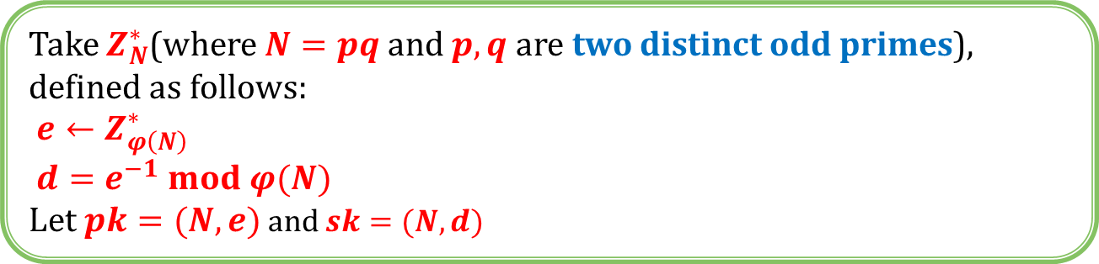
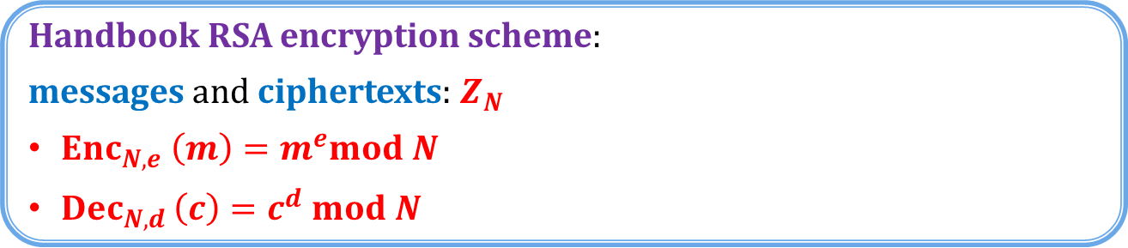
“Handbook RSA” encryption
Take $Z_{N}^{∗}$(where $N=pq$ and $p,q$ are two distinct odd primes), defined as follows:
$e←Z_{φ\left(N\right)}^{∗}$
$d=e^{−1} mod φ(N)$
Let $pk=(N,e)$ and $sk=(N,d)$
Handbook RSA encryption scheme:
messages and ciphertexts: $Z_{N}$
$Enc_{N,e} \left(m\right)=m^{e}mod N$
$Dec_{N,d }\left(c\right)=c^{d} mod N$
Is it secure?

Slide 4
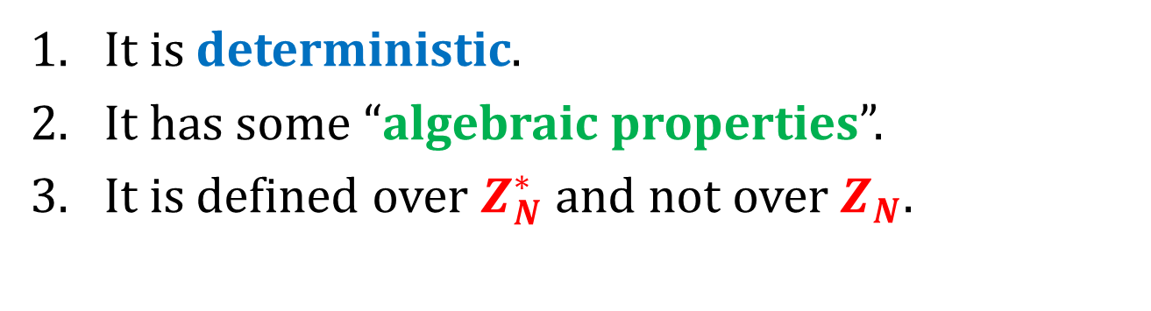
Issues with the “handbook RSA”
It is deterministic.
It has some “algebraic properties”.
It is defined over $Z_{N}^{∗}$ and not over $Z_{N}$.
this is not really a problem (exercise)

Slide 5
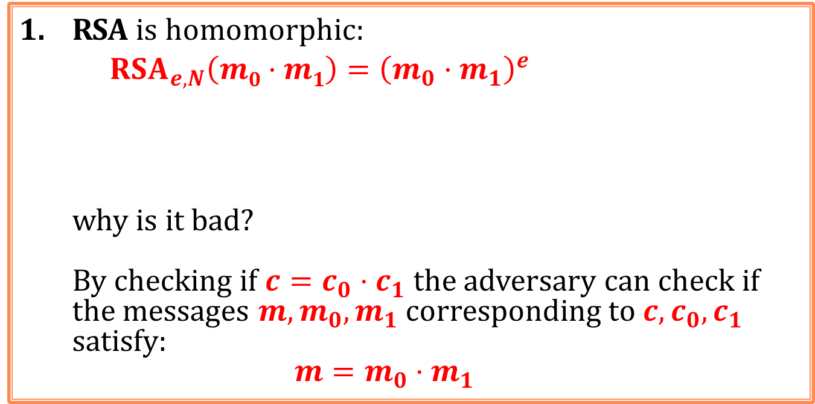


Algebraic properties of RSA
RSA is homomorphic:
    $$RSA_{e,N}\left(m0·m1\right)={\left(m_{0}·m_{1}\right)}^{e}$$
why is it bad?
By checking if ${c=c}_{0}⋅c_{1}$ the adversary can check if the messages $m,m_{0},m_{1}$ corresponding to $c,c_{0},c_{1}$ satisfy:
$$m=m_{0}⋅m_{1}$$
$=m_{0}^{e}⋅m_{1}^{e}$
$$=RSA_{e,N}\left(m1\right)⋅RSA_{e,N}\left(m_{2}\right)$$
The Jacobi symbol leaks.

Slide 6
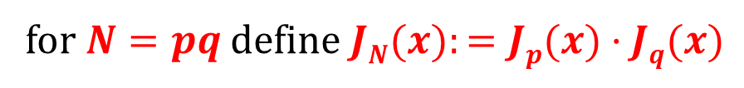





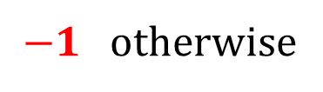

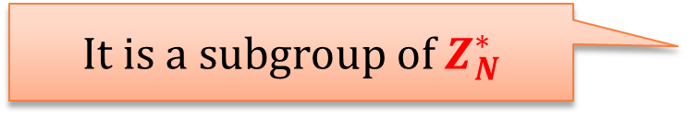
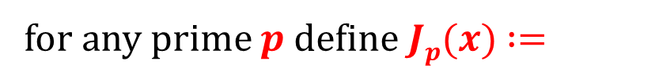

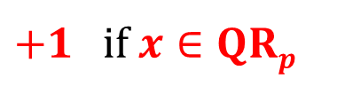
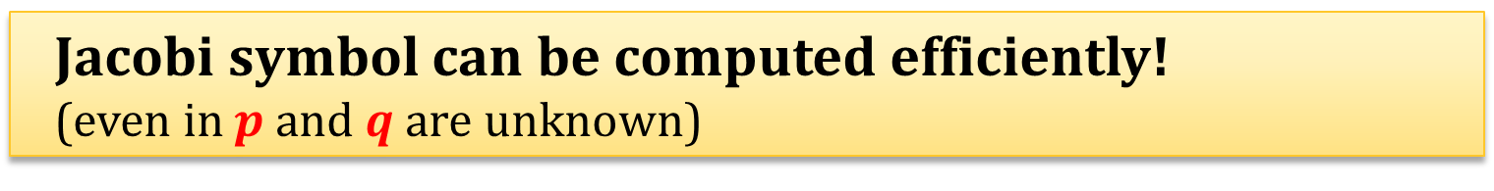
Jacobi Symbol (from the last lecture)
$+1$ if $x∈QRp$
for any prime $p$ define $Jp(x)$ $:=$
$−1$otherwise
for $N=pq$ define $JN(x):=Jp(x)·Jq(x)$
$$QR_{p}$$
$$mod p$$
$$JN(x) :=$$
+1 | -1
-1 | +1
$$QR_{q}$$
$$QR_{N}$$
$$mod q$$
It is a subgroup of $Z_{N}^{∗}$
$$Z_{N}^{+}:= \{x∈Z_{N}^{∗}: J_{N}(x)=+1\}$$
Jacobi symbol can be computed efficiently!
(even in $p$ and $q$ are unknown)

Slide 7
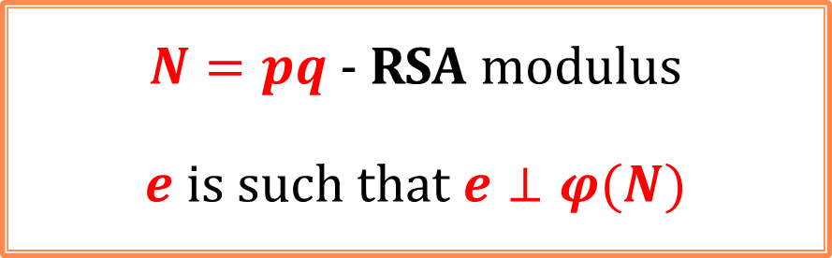
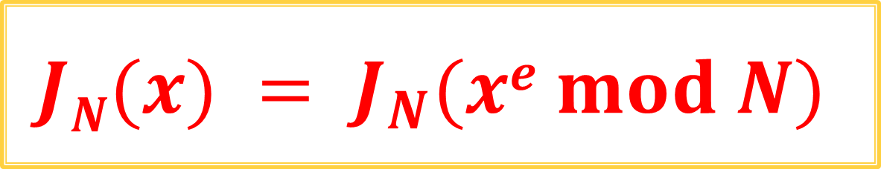
Fact: the RSA function “preserves” the Jacobi symbol
$N=pq$- RSA modulus
$e$ is such that $e⊥φ(N)$
$$JN(x) = J_{N}(xe mod N)$$

Slide 8



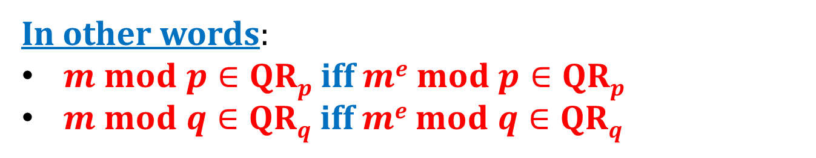
Actually, something even stronger holds:
$RSA_{N,e}$ is a permutation on each “quarter” of $Z_{N}^{∗}$
$$QRp$$
$$QRp$$
$$QRp$$
In other words:
$m mod p∈QRp$iff $me mod p∈QRp$
$m mod q∈QRq$iff $me mod q∈QRq$

Slide 9
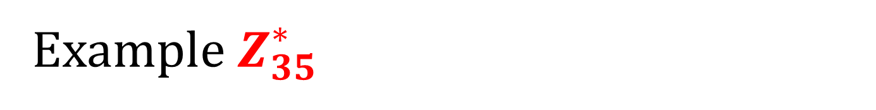
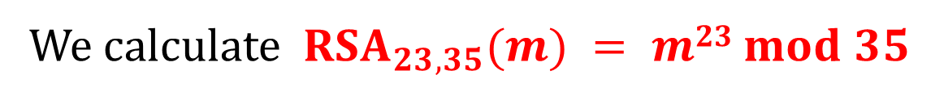
Example $Z_{35}^{∗}$
We calculate $RSA_{23,35}(m) = m23 mod 35$
QR₇
mod 7
QR₅
 | 1 | 2 | 4 | 3 | 5 | 6
1 | 1 | 16 | 11 | 31 | 26 | 6
4 | 29 | 9 | 4 | 24 | 19 | 34
2 | 22 | 2 | 32 | 17 | 12 | 27
3 | 8 | 23 | 18 | 3 | 33 | 13
 | 1 | 4 | 2 | 5 | 3 | 6
1 | 1 | 11 | 16 | 26 | 31 | 6
4 | 29 | 4 | 9 | 19 | 24 | 34
3 | 8 | 18 | 23 | 33 | 3 | 13
2 | 22 | 32 | 2 | 12 | 17 | 27
mod 5

Slide 10
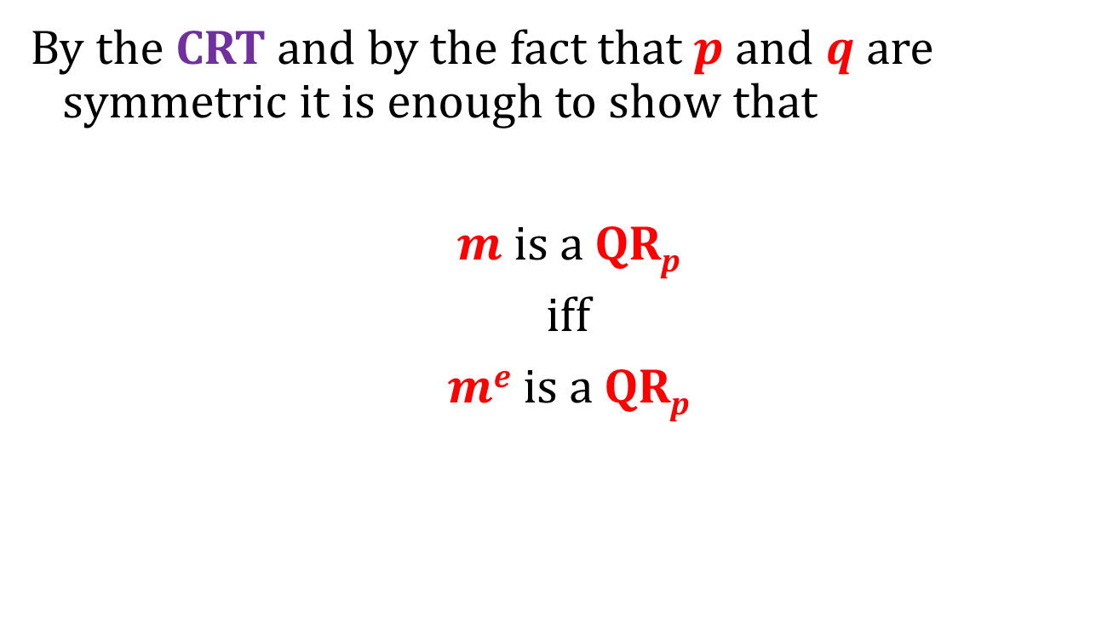
How to prove it?
By the CRT and by the fact that $p$ and $q$ are symmetric it is enough to show that
$m$ is a QR_{p}
iff
$me$ is a QR_{p}

Slide 11
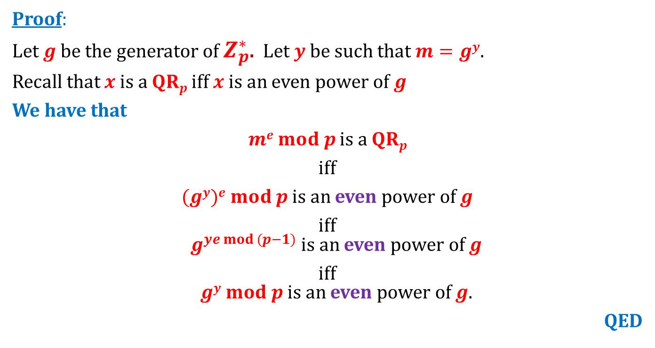

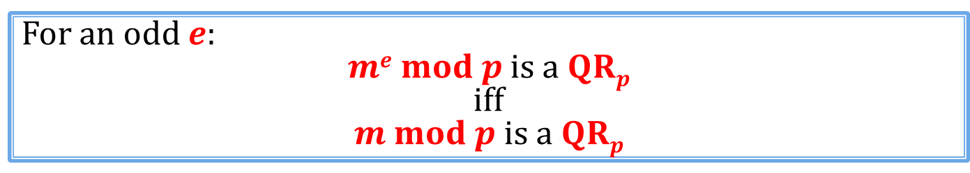
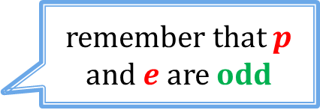
Fact
For an odd $e$:
$me mod p$ is a $QRp$
iff
$m mod p$ is a $QRp$
Proof:
Let $g$ be the generator of $Z_{p}^{∗}$. Let $y$be such that $m=gy$.
Recall that $x$ is a $QRp$ iff $x$ is an even power of $g$
We have that
$me mod p$ is a $QRp$
iff
$(gy)e mod p$is an even power of $g$
iff
$g^{ye mod (p−1)}$ is an even power of $g$
iff
$gy mod p$is an even power of $g$.
QED
remember that $p$ and $e$ are odd
$$= m mod p$$

Slide 12
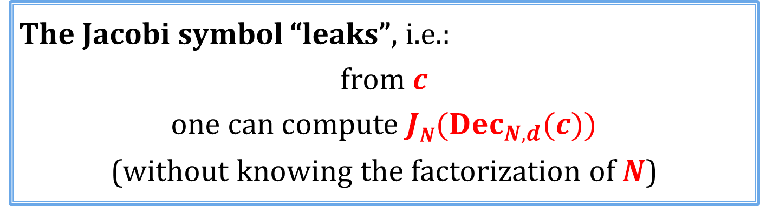
Conclusion
The Jacobi symbol “leaks”, i.e.:
from $c$
one can compute $JN(Dec_{N,d}(c))$
(without knowing the factorization of $N$)
Is it a big problem?
Depends on the application...

Slide 13
Plan for today
Provide a formal security definition of public key encryption.
Modify RSA so that it is secure according to this definition.

Slide 14
Plan
Problems with the “handbook RSA”
Definition of the CPA security
Constructions of CPA-secure RSA encryption schemes
  theoretical
  practical
The hybrid encryption and the KEM/DEM paradigm
Definition of the CCA security
Constructions of CCA-secure symmetric encryption
Constructions of CCA-secure RSA encryption schemes

Slide 15
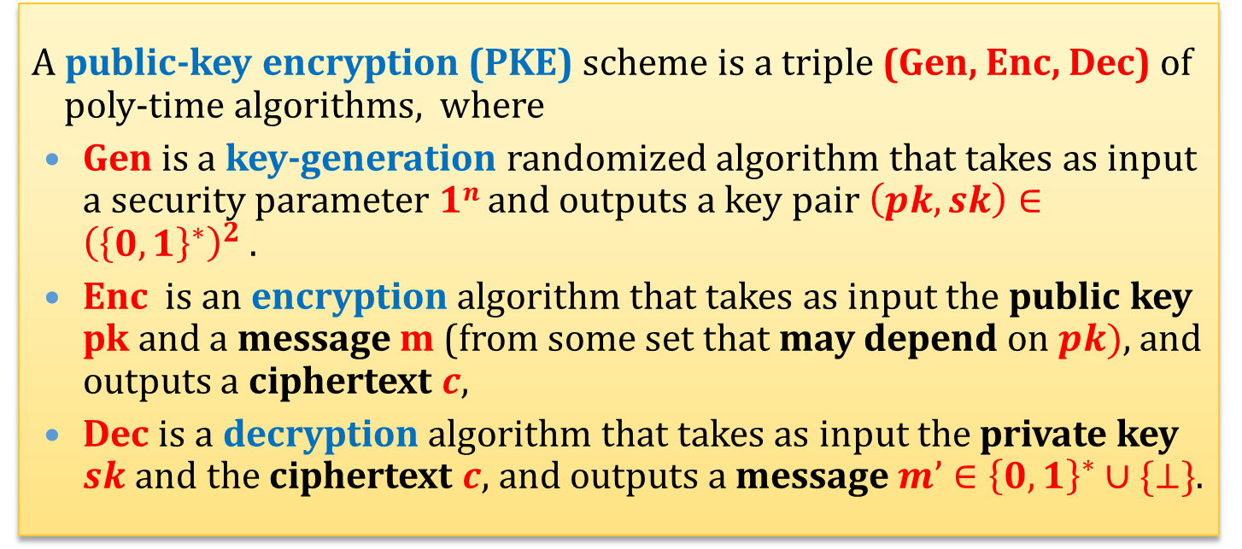
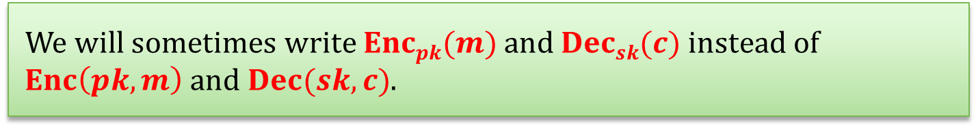
A mathematical view
A public-key encryption (PKE) scheme is a triple (Gen, Enc, Dec) of poly-time algorithms, where
Gen is a key-generation randomized algorithm that takes as input a security parameter $1n$and outputs a key pair $\left(pk,sk\right)∈{\left({\left\{0,1\right\}}^{∗}\right)}^{2}$.
Enc is an encryption algorithm that takes as input the public key pk and a message m (from some set that may depend on $pk)$, and outputs a ciphertext $c$,
Dec is a decryption algorithm that takes as input the private key $sk$ and the ciphertext $c$, and outputs a message $m’∈{\left\{0,1\right\}}^{∗}∪\{⊥\}$.
We will sometimes write $Encpk(m)$and $Decsk(c)$instead of $Enc\left(pk,m\right)$ and $Dec(sk,c)$.

Slide 16




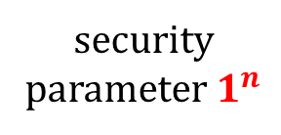


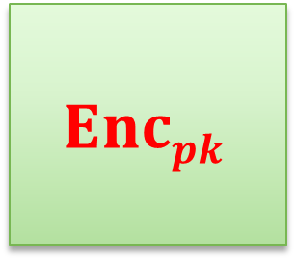


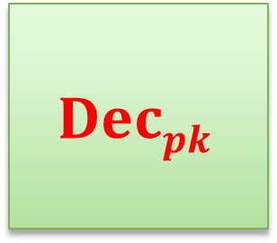
Pictorially
public key
secret key
security parameter $1^{n}$
$$Gen$$
$$(pk,sk)$$
$$m$$
$$c$$
$$Encpk$$
$$Decpk$$
$$pk$$
$$sk$$
$$Enc_{pk}(m)$$
$$Dec_{sk}(c)$$

Slide 17
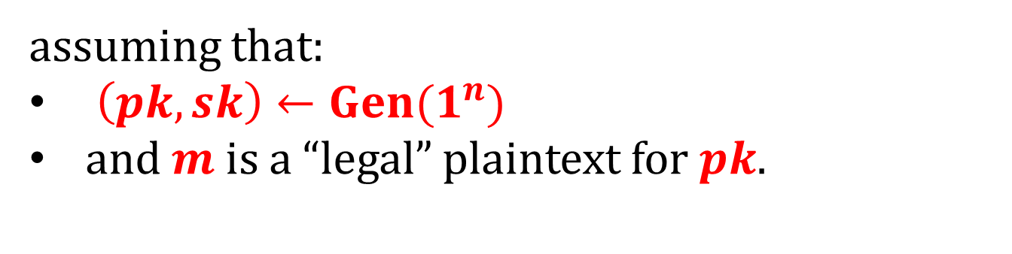
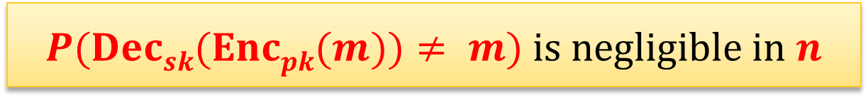
Correctness
We will require that it always holds that
$P(Decsk(Encpk(m))≠ m)$is negligible in $n$
assuming that:
$\left(pk,sk\right)←Gen(1^{n})$
and $m$ is a “legal” plaintext for $pk$.

Slide 18
The security definition
Remember the symmetric-key case?
We considered a chosen-plaintext attack.
How would it look in the case of the public-key encryption?

Slide 19



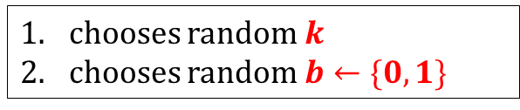



CPA in the symmetric settings
security parameter
1^{n}
chooses random $k$
chooses random $b←\{0,1\}$
chooses $m_{1}^{′}$
$$m_{1}^{′}$$
c₁ = Enc(k,$m_{1}^{′}$)
oracle
. . .
chooses $m_{t}^{′}$
$$m_{t}^{′}$$
c_{t} = Enc(k,$m_{t}^{′}$)
challenge phase:
chooses m₀,m₁
m₀,m₁
c = Enc(k,m_{b})
the interaction continues . . .
has to guess b

Slide 20



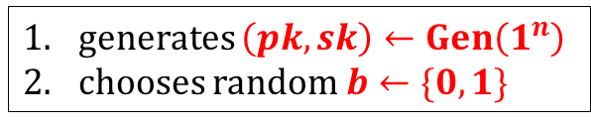

CPA in the asymmetric settings
security parameter
1^{n}
generates $\left(pk,sk\right)←Gen\left(1^{n}\right)$
chooses random $b←\{0,1\}$
$$pk$$
chooses $m_{1}^{′}$
$$m_{1}^{′}$$
c₁ = Enc(pk,$m_{1}^{′}$)
oracle
. . .
This is not
needed.
Why?
Because if Eve knows $pk$ she can compute all these ciphertexts herself!
chooses $m_{t}^{′}$
$$m_{t}^{′}$$
c_{t} = Enc(pk,$m_{t}^{′}$)
challenge phase:
chooses m₀,m₁
m₀,m₁
c = Enc(pk,m_{b})
the interaction continues . . .
has to guess b

Slide 21


The game after simplifications
security parameter
1^{n}
generates $\left(pk,sk\right)←Gen\left(1^{n}\right)$
chooses random $b←\{0,1\}$
$$pk$$
oracle
challenge phase:
chooses m₀,m₁
m₀,m₁
c = Enc(pk,m_{b})
has to guess b

Slide 22
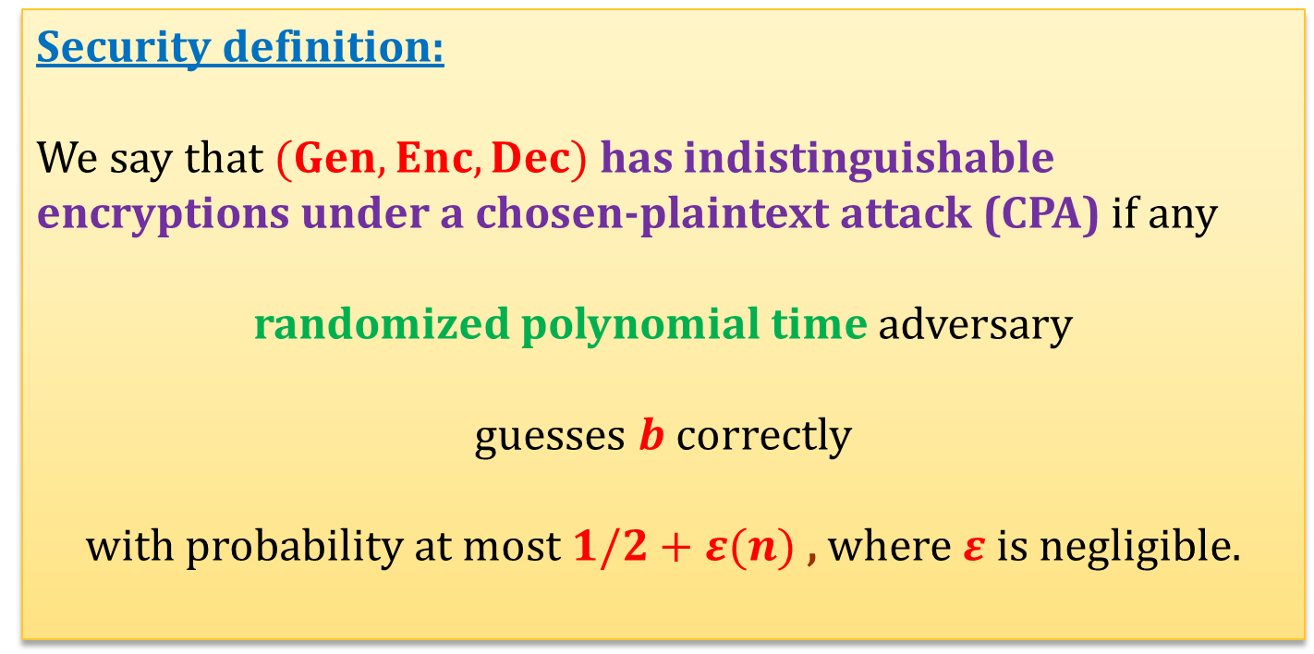
CPA-security
Alternative name: CPA-secure
Security definition:
We say that $(Gen,Enc,Dec)$has indistinguishable encryptions under a chosen-plaintext attack (CPA) if any
randomized polynomial time adversary
guesses $b$ correctly
with probability at most $1/2+ε(n)$ , where $ε$is negligible.

Slide 23
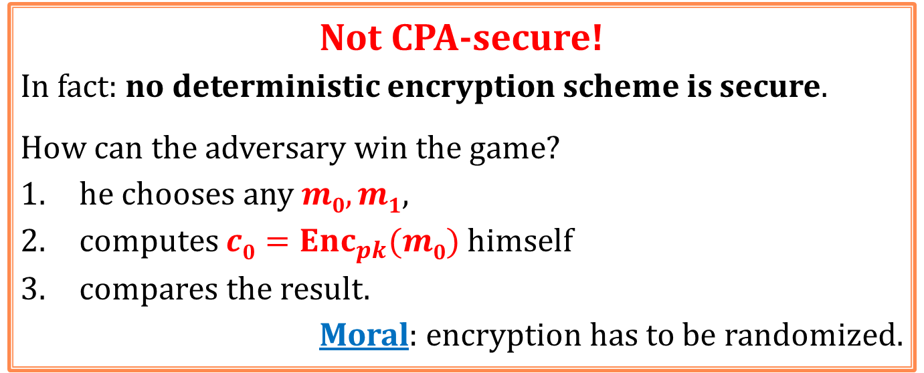
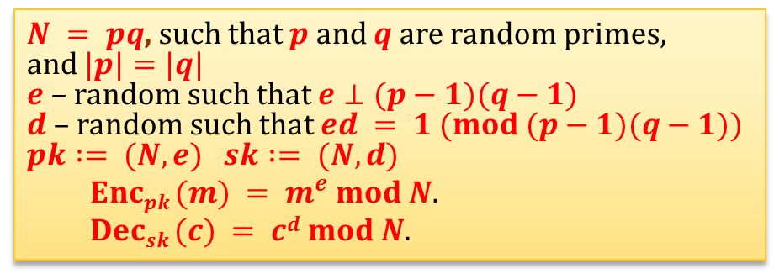
Is the “handbook RSA” CPA-secure?
$N = pq$, such that $p$and $q$ are random primes,
and $|p|=|q|$
$e$ – random such that $e⊥(p−1)(q−1)$
$d$ – random such that $ed = 1 (mod (p−1)(q−1))$
$$pk := (N,e) sk := (N,d)$$
  $Encpk (m) = m^{e} mod N$.
  $Decsk (c) = cd mod N$.
Not CPA-secure!
In fact: no deterministic encryption scheme is secure.
How can the adversary win the game?
he chooses any $m0,m1$,
computes $c0=Enc_{pk}(m0)$ himself
compares the result.
Moral: encryption has to be randomized.

Slide 24
Plan
Problems with the “handbook RSA”
Definition of the CPA security
Constructions of CPA-secure RSA encryption schemes
  theoretical
  practical
The hybrid encryption and the KEM/DEM paradigm
Definition of the CCA security
Constructions of CCA-secure symmetric encryption
Constructions of CCA-secure RSA encryption schemes

Slide 25

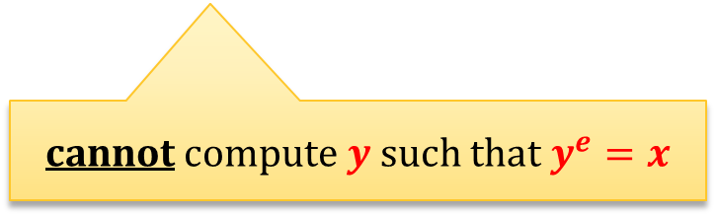


CPA-secure encryption from the RSA assumption
We now show how to construct a provably secure encryption scheme whose security is based on the RSA assumption.
security parameter $1k$
poly-time
adversary
choose:
$N=pq$where$p$and $q$ are random primes such that $|p| = |q| = k$
$x$ – a random element of $Z_{N}^{∗}$,
$e$ – a random element of $Z_{φ(N)}^{∗}$
$$(x,e,N)$$
cannot compute $y$ such that $y^{e}=x$

Slide 26
Outline of the construction
We prove that the least significant bit is a hard to compute for RSA.
We show how to “encrypt using this bit”

Slide 27
RSA hardcore bit
Question: does RSA have a bit that is for sure well-hidden?
Answer: if RSA assumption doesn’t hold, then: no.
But what if it holds?
Answer: yes – the least significant bit of the argument is hard to compute.

Slide 28
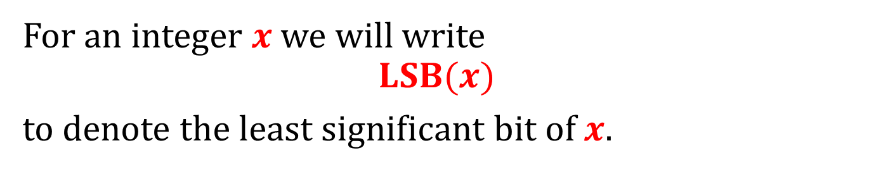
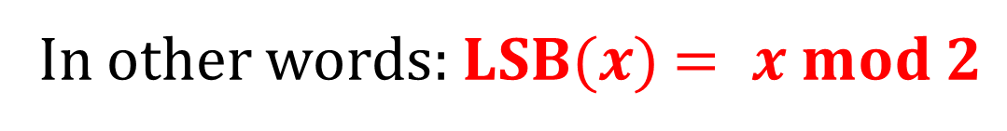
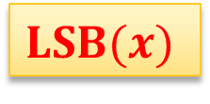

Notation
For an integer $x$we will write
$$LSB(x)$$
to denote the least significant bit of $x$.
$$LSB(x)$$
$x$:
In other words: $LSB(x)$ $= x mod 2$

Slide 29
Fact (informally)
LSB is the “hardest bit to compute” in RSA.
(it is called a “hard-core bit”).
More precisely:
If you can compute LSB then you can invert RSA.
Note:
In some sense it is a “dual” predicate to Jacobi symbol...

Slide 30
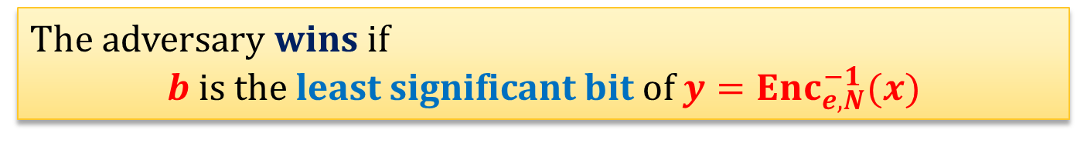

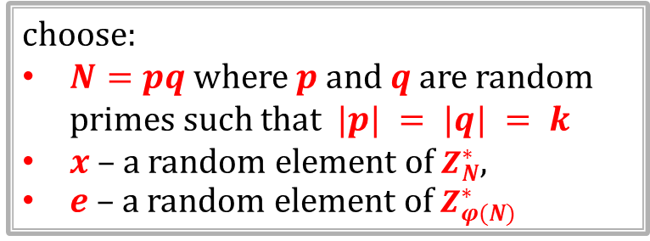
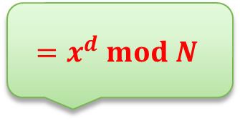

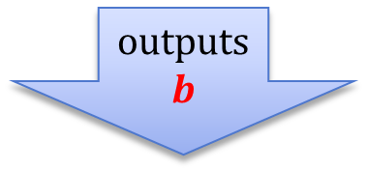
“LSB game”:
security parameter $1k$
choose:
$N=pq$where$p$and $q$ are random primes such that $|p| = |q| = k$
$x$ – a random element of $Z_{N}^{∗}$,
$e$ – a random element of $Z_{φ(N)}^{∗}$
$$(x,e,N)$$
outputs
$$b$$
$$=x^{d} mod N$$
The adversary wins if
$b$ is the least significant bit of $y={Enc}_{e,N}^{−1}(x)$

Slide 31
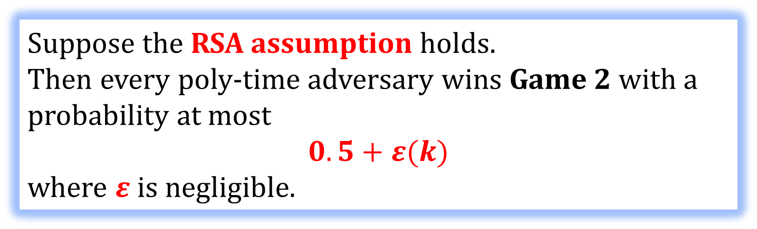
Theorem
Suppose the RSA assumption holds.
Then every poly-time adversary wins Game 2 with a probability at most
$$0.5+ε(k)$$
where $ε$is negligible.
W. Alexi, B. Chor, O. Goldreich, and C.P. Schnorr
On the hardness of the least-signficant bits of the RSA and Rabin functions, 1984
In other words:
The least significant bit is a hard-core bit for RSA.

Slide 32
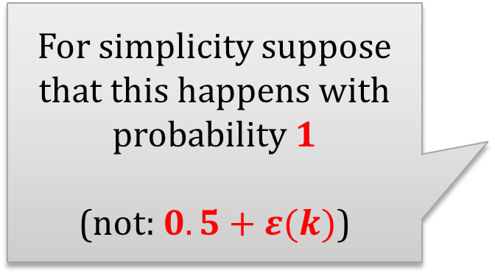
Proof strategy
Suppose we are given a poly-time adversary
that wins the LSB game.
We construct a poly-time adversary
that breaks the RSA assumption.
For simplicity suppose that this happens with probability 1
(not: $0.5+ε(k)$)

Slide 33
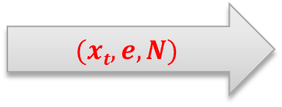
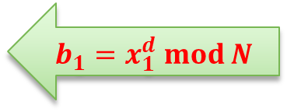

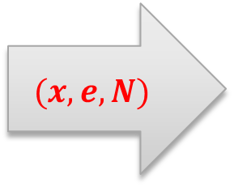
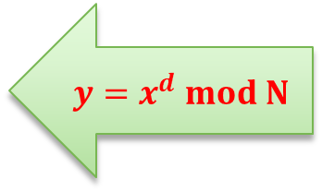
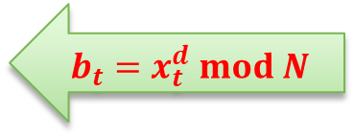
Outline of the construction
$$(x,e,N)$$
$$(x1,e,N)$$
$$b_{1}=x_{1}^{d} mod N$$
. . .
$$(xt,e,N)$$
$$y=x^{d} mod N$$
$$b_{t}=x_{t}^{d} mod N$$

Slide 34



Observation
Adversary that can compute
LSB of $xd mod N$.
can also be used to compute (for any $c∈Z_{N}^{∗}$)
LSB of $c·xd mod N$.
How?
outputs
$$b’= LSB((ce· x)d)$$
$= LSB (ced · xd )$
$= LSB (c · xd )$
$$(c^{e}⋅x,e,N)$$

Slide 35


The method
Let $y≔x^{d }mod N$
The adversary will use to
compute:
$LSB(2y)$
$LSB(4y)$
$LSB(8y)$
Why is it useful?
. . .

Slide 36








Observation
$$y≤(N−1)/2$$
$$y>(N−1)/2$$
$$y$$
1 | . . . | N-1
$$2y$$
2 | . . . | 2N-2
1 | . . . | N-1
1 | . . . | N-1
Remember:
$N=pq$ is odd
$$2y mod N$$
$$= 2y$$
$$= 2y − N$$
even
odd
Moral: $y∈[1,…,(N−1)/2]$iff $2y mod N$is even

Slide 37










$$(N−1)/2$$
$$(N−1)/4$$
$$3(N−1)/4$$
$$y$$
1 | . . . | N-1
$$4y$$
4 | . . . | 4N-4
$$4y \\ mod N$$
1 | . . . | N-1
1 | . . . | N-1
1 | . . . | N-1
1 | . . . | N-1
$$= 4y$$
$$= 4y − N$$
$$= 4y – 2N$$
$$= 4y − 3N$$
even
odd
even
odd
Moral: $y∈\left[1,…,\frac{N−1}{4}\right]∪ \left[\frac{N}{2}+1,…,\frac{3\left(N−1\right)}{4}\right]$iff $4y mod N$is even

Slide 38











$$\frac{N−1}{8}$$
. . .
$$\frac{7\left(N−1\right)}{8}$$
$$y$$
 | . . .
$$8y$$
 | . . .
$$8y$$
$$mod N$$
$$= \\ 8y$$
$$=$$
$$8y−N$$
$$=$$
$$8y−2N$$
$$=$$
$$8y−7N$$
. . .
even
odd
even
odd
even
odd
even
odd
Moral: $y∈\left[1,…,\frac{N−1}{8}\right]∪ \left[\frac{2N}{8}+1,…,\frac{3\left(N−1\right)}{8}\right]$
$$∪ \left[\frac{4N}{8}+1,…,\frac{5\left(N−1\right)}{8}\right]∪ \left[\frac{6N}{8}+1,…,\frac{7\left(N−1\right)}{8}\right]$$
iff $8y mod N$is even

Slide 39






So we can use bisection
$$1$$
$$N−1$$
calculate
$$LSB(2y)$$
0
1
calculate
$$LSB(4·y)$$
0
1
calculate
$$LSB(8·y)$$
0
1
calculate
$$LSB(16·y)$$
QED
. . .

Slide 40

Why is it interesting?
We can encrypt one bit messages as follows:
$(N,e)$– public key
$(N,d)$– private key
$$Enc_{e,N }\left(b\right)=\left(LSB\left(y\right)⊕b,y^{e}\right)$$
(where $y←Z_{N}^{∗}$)
$Dec_{d,N }\left(c,x\right)=$ $LSB\left(x^{d}\right)⊕c$
This is secure under the RSA assumption

Slide 41

How to extend it to longer messages?
Encrypt bit-by-bit:
$$Enc_{e,N}\left(m_{1},…,m_{k}\right)=$$
$$\left((LSB\left(y_{1}\right)⊕m_{1},…,LSB\left(y_{k}\right)⊕m_{k}),(y_{1}^{e},…,y_{k}^{e})\right)$$
where $y_{1},…,y_{k}←Z_{N}^{∗}$
$$Dec_{d,N}({(c}_{1},…,c_{k}),{(x}_{1},…,x_{k}))=$$
$$\left({LSB(x}_{1}^{d})⊕c_{1}, …,{LSB(x}_{k}^{d})⊕c_{k}\right)$$

Slide 42
Lemma
Assume that the RSA assumption holds. Then the encryption scheme from the previous slide is CPA-secure.
Proof: exercise

Slide 43
Conclusion
Advantage:
Security of this scheme is implied by the RSA assumption.
Disadvantage:
The ciphertext is much longer than the plaintext.
It is a rather theoretical construction!
the public-key encryption scheme that we just constructed is secure
RSA assumption holds

Slide 44
Plan
Problems with the “handbook RSA”
Definition of the CPA security
Constructions of CPA-secure RSA encryption schemes
  theoretical
  practical
The hybrid encryption and the KEM/DEM paradigm
Definition of the CCA security
Constructions of CCA-secure symmetric encryption
Constructions of CCA-secure RSA encryption schemes

Slide 45
Encoding (also called: “padding”)
Before encrypting a message we usually encode it (adding some randomness).
This has the following advantages:
it makes the encryption non-deterministic
it breaks the “algebraic properties” of encryption.

Slide 46




How is it done in real-life?
PKCS #1: RSA Encryption Standard Version 1.5:
public-key: $(N,e)$
$k$ := length on $N$ in bytes.
$D$ := length of the plaintext
requirement: $D≤k−11$.
$Enc\left(\left(N,e\right), m\right) := xe mod N$, where $x$ is equal to:
$k$ bytes
00000000 | 00000001 | r | 00000000 | m
$(k−D−3)$random non-zero bytes
$D$ bytes

Slide 47



How to encrypt?
$$m$$
$$Encoding(m) :=$$
00000000 | 00000001 | r | 00000000 | m
$Enc_{e,N}$
$$Enc_{e,N}(Encoding(m))$$

Slide 48



How to decrypt?
ciphertext $y$
De$c_{d,N}$
check if the format agrees....
00000000 | 00000001 | r | 00000000 | m
if not then output $⊥$
, otherwise
$$\text{output}$$
$$m$$

Slide 49

Example
If the adversary can calculate the Jacobi symbol of
most probably it doesn’t help him in learning any information about $m$...
00000000 | 00000001 | r | 00000000 | m

Slide 50
Security of the PKCS #1: RSA Encryption Standard Version 1.5 – security
It is believed to be CPA-secure.
(as we will later learn: it’s not “CCA-secure”)

Slide 51
Plan
Problems with the “handbook RSA”
Definition of the CPA security
Constructions of CPA-secure RSA encryption schemes
  theoretical
  practical
The hybrid encryption and the KEM/DEM paradigm
Definition of the CCA security
Constructions of CCA-secure symmetric encryption
Constructions of CCA-secure RSA encryption schemes

Slide 52
How to encrypt longer messages?
Two options:
divide the message in blocks and encrypt each block separately.
combine the public-key encryption with the private-key encryption.

Slide 53







Encrypting block-by-block
long message
$$M$$
note: this is randomized, so we don’t have the same problem as with the ECB mode
split into blocks
$$B_{1}$$ | $$…$$ | $$B_{n}$$
$$Enc_{pk}$$
$$…$$
$$Enc_{pk}$$
$$C_{1}$$ | $$…$$ | $$C_{n}$$
$$Dec_{sk}$$
$$…$$
$$Dec_{sk}$$
$$B_{1}$$ | $$…$$ | $$B_{n}$$

Slide 54

A problem with this solution
It’s rather inefficient (the number of public-key operations is proportional to $|M|$)
A more efficient solution:
hybrid encryption

Slide 55

Ingredients for the hybrid encryption
$(Gen,Enc,Dec)$– a public key encryption scheme
$(Enc^{′},Dec^{′})$– a private key encryption scheme
Main idea:
Encrypt the symmetric key with a public-key encryption scheme.

Slide 56



Key generation
The same as in the public-key scheme:
public key
secret key
security parameter $1^{n}$
$$Gen$$
$$(pk,sk)$$

Slide 57








How to encrypt?
$$k$$
$$m$$
random
private-key encryption
$$Encpk$$
$$Enc_{k}^{′}$$
$$pk$$
public-key encryption
ciphertext
$$\left(c,c^{′}\right)$$
$$c:=Encpk(k)$$
$$c′=Enc_{k}^{′}\left(m\right)$$

Slide 58







How to decrypt?
$$c$$
$$c′$$
ciphertext
private-key decryption
$$Decsk$$
$$Dec_{k}^{′}$$
$$sk$$
public-key decryption
$$k$$
decrypted plaintext
$$m$$

Slide 59

A more direct method: the KEM/DEM paradigm
DEM – Data Encapsulation Mechanism
KEM – Key Encapsulation Mechanism
consists of the following algorithms:
key generation algorithm $Gen$ – as in PKE,
encapsulation algorithm Encaps,
decapsulation algorithm Decaps.
= private key encryption

Slide 60











KEM:
public key
secret key
security parameter $1^{n}$
$$Gen$$
$$(pk,sk)$$
$$c$$
$$Encapspk$$
$$Decapssk$$
$$pk$$
$$sk$$
$$(c,k)$$
$$k$$
“ciphertext”
symmetric key
$$k∈{\left\{0,1\right\}}^{ℓ(n)}$$

Slide 61










How to encrypt?
$Gen$ – as in KEM
$(Enc^{′},Dec^{′})$ – DEM
$$m$$
private key encryption
$$Encapspk$$
$$Enc_{k}^{′}$$
$$pk$$
$$k$$
$$c$$
$$c′$$
ciphertext
$$c$$
$$c′ =Enc_{k}^{′}\left(m\right)$$

Slide 62







How to decrypt?
$$c$$
$$c′$$
ciphertext
private-key decryption
$$Decapssk$$
$$Dec_{k}^{′}$$
$$sk$$
key decapsulation
$$k$$
$$m$$

Slide 63

One method to implement KEM
Take a public-key encryption scheme $(Gen,Enc,Dec)$.
Define $KEM$ as follows:
$Gen$ is the same
$Encaps_{pk}=$generate a random symmetric key $k$ and output
$$\left(Enc_{pk}\left(k\right),k\right)$$
$Decaps_{sk}$ = on input $c$ output $Dec_{sk}(c)$

Slide 64















Pictorially:
random $k$
$$Encapspk$$
$$pk$$
=
$$Encpk$$
$$pk$$
$$c,k$$
$$\left(Enc_{pk}\left(k\right),k\right)$$
$$c$$
$$c$$
De$capssk$
De$csk$
$$sk$$
=
$$sk$$
$$k$$
$$Dec_{sk}\left(c\right)$$

Slide 65
Note
In this case KEM/DEM method is simply equal to the hybrid encryption.
However: there exist other, direct methods for key encapsulation.
(they are more efficient)

Slide 66
Consequences of these approaches
For longer messages the cost of encryption is dominated by the cost of symmetric operations.
Hence: the public-key operations (amortized over the length of the messages) are almost “for free”.

Slide 67
Plan
Problems with the “handbook RSA”
Definition of the CPA security
Constructions of CPA-secure RSA encryption schemes
  theoretical
  practical
The hybrid encryption and the KEM/DEM paradigm
Definition of the CCA security
Constructions of CCA-secure symmetric encryption
Constructions of CCA-secure RSA encryption schemes

Slide 68





Chosen-ciphertext attacks – motivation
Remember the attack on the symmetric encryption based on the error messages from the decryption oracle?
$$c$$
has a key $k$
$c′$ that depends on $c$
if $c^{′}$ cannot be decrypted then send “error”
obtains some information about $c$

Slide 69


Another scenario
$$c$$
if $Dec_{sk}(c)$ = “alarm”
then announce “alarm” to everybody.

Slide 70





A more advanced example
$$Dec_{sk}\left(c\right)=$$
$$c$$
From: Alice@gmail.com
To: Bob@gmail.com
<some text>
$$(pk,sk)$$
$c′$ that depends on $c$
replies to Eve citing
<some text>
Eve
Bob
$$Dec_{sk}\left(c′\right)=$$
From: Eve@gmail.com
To: Bob@gmail.com
<some text>

Slide 71
Note
CPA security does not imply that such attacks are impossible.
We need a stronger security definition.
This will be called:
chosen-ciphertext security (CCA)
It can be defined both for the symmetric and asymmetric case.

Slide 72








Decryption oracle
To define the CCA-security we consider a decryption oracle.
$$c1$$
$$sk$$
$$Decsk(c1)$$
$$c2$$
convention:
$$Decsk\left(ci\right)≔ ⊥$$
if $c_{i}$ cannot be
decrypted
we call such a ciphertext “invalid”
$$Decsk(c2)$$
. . .
$$ck$$
$$Decsk(ck)$$

Slide 73





Decryption/encryption oracle
this will be used in the symmetric case
We assume that also CPA is allowed.
Two types of queries:
Decrypt $ci$
$$Dec_{sk}\left(c_{i}\right)$$
$$(pk,sk)$$
Encrypt $mi$
$$Enc_{sk}\left(m_{i}\right)$$
this is called a CCA-attack

Slide 74



CCA-security– the game in the symmetric case
generates $k←Gen\left(1^{n}\right)$
chooses random $b←\{0,1\}$
security parameter
1^{n}
CCA-attack
decryption/encryption oracle
challenge phase:
chooses m₀,m₁
m₀,m₁
c = $Enc_{k}$(m_{b})
CCA-attack
has to guess b
Here the adversary cannot ask for decryption of $c$.

Slide 75




CCA-security– the game in the asymmetric case
security parameter
1^{n}
generates $\left(pk,sk\right)←Gen\left(1^{n}\right)$
chooses random $b←\{0,1\}$
$$pk$$
decryption oracle
CCA-attack
challenge phase:
chooses m₀,m₁
m₀,m₁
c = $Enc_{pk}$(m_{b})
$m_{0},m_{1}$have to be legal for $pk$
CCA-attack
has to guess b
Here the adversary cannot ask for decryption of $c$.

Slide 76


CCA security
Alternative name: CCA-secure
Security definition (in the asymmetric case):
We say that $(Gen,Enc,Dec)$has indistinguishable encryptions under a chosen-ciphertext attack (CCA) if any
randomized polynomial time adversary
guesses $b$ correctly
with probability at most $1/2+ε(n)$ , where $ε$is negligible.
In the symmetric case:$(Enc,Dec)$

Slide 77
Easy to see
CCA-security implies CPA security
(because the adversary in the “CCA game” is at least as powerful as the one in the “CPA game”)
What about the implication in the other direction?

Slide 78





CPA-security does not imply the CCA-security
$$m0,m1$$
$$c=Enc(k,mb)$$
here ask about the “related” $c′$
CCA-attack
Here Eve cannot ask for decryption of $c$.
Informally:
To win the game it is enough that Eve is computes some $c′$such that $Dec_{k}(c′)$is “related to” $Dec_{k}(c)$.
(Why? Because then she is allowed to ask for it.)
For example: it is possible for any stream cipher!
if $c^{′}=c^{′}⊕(1,…,1)$ then$Dec_{k}\left(c^{′}\right)=Dec_{k}\left(c\right)⊕(1,…,1)$

Slide 79
How to construct CCA-secure schemes?
in the symmetric case: easy
in the asymmetric case: usually harder (also: in this case the “CCA attacks” are more realistic).

Slide 80
Plan
Problems with the “handbook RSA”
Definition of the CPA security
Constructions of CPA-secure RSA encryption schemes
  theoretical
  practical
The hybrid encryption and the KEM/DEM paradigm
Definition of the CCA security
Constructions of CCA-secure symmetric encryption
Constructions of CCA-secure RSA encryption schemes

Slide 81


Symmetric case
Simplest method: authenticate every ciphertext with a MAC.
Ingredients:
$(Enc,Dec)$ – a CPA-secure symmetric encryption scheme
$\left(Tag,Vrfy\right)$ – a message authentication code that is strongly secure.
A MAC is strongly secure if the adversary cannot produce a valid tag $t′$ on a message $m$even if he saw a valid pair $(m,t)$ (where $t≠t$)

Slide 82

The method from previous lectures
encrypt-then-authenticate:
key: a pair $(k_{1},k_{2})$
to encrypt $m$ compute $c≔Enc_{k_{1}}(m)$ and $t≔Ta{g_{k}}_{2}(c)$, and output $(c,t)$
to decrypt $\left(c,t\right)$:
if $Vrfy_{k_{2}}\left(c,t\right)=no$ then output $⊥$
otherwise output $Dec_{k_{1}}(c)$

Slide 83


Why is this secure?
CCA-attack
chooses m₀,m₁
m₀,m₁
c = $Enc_{k}$(m_{b})
CCA-attack
The adversary cannot “produce himself” a valid ciphertext.
The only decryption queries Decrypt $c′$ on which he doesn’t get $⊥$ are such that he received $c′$ from the oracle before.
But he already knows the decryptions of such $c′$s.
So: the CCA attack does not help him!

Slide 84
Plan
Problems with the “handbook RSA”
Definition of the CPA security
Constructions of CPA-secure RSA encryption schemes
  theoretical
  practical
The hybrid encryption and the KEM/DEM paradigm
Definition of the CCA security
Constructions of CCA-secure symmetric encryption
Constructions of CCA-secure RSA encryption schemes

Slide 85
PKCS #1 v.2 is not CCA-secre
Bleichenbacher [1998] showed a “practical” chosen ciphertext attack on encoding proposed for the PKCS #1 v.2 standard.
[see also: Bleichenbacher, D., Kaliski B., Staddon J., "Recent results on PKCS #1: RSA encryption standard", RSA Laboratories' bulletin #7, ftp://ftp.rsasecurity.com/pub/pdfs/bulletn7.pdf ]
Why is Blaichenbacher’s attack practical?
Because it assumes that the adversary can get only one bit of information about the plaintext...

Slide 86









Bleichenbacher’s attack – the scenario
$$pk = (N,e)$$
$$sk=(N,d)$$
$$c$$
$$c1$$
computes
$$x=c_{1}^{d} mod N$$
and checks if $x$is a correct PKCS #1 v2 encoding
yes/no
. . .
Goal:
compute $cd mod N$
$$ck$$
yes/no
Bleichenbacher [1998]:
There exists a successful attack that requires $k=220$ questions for $|N|=1024$.

Slide 87






How to construct CCA-secure encryption scheme from RSA?
Observation: MACs don’t help (at least directly).
Because in the asymmetric case the parties don’t share a key for a MAC.
$$P1$$

Slide 88



First attempt
Idea: take a symmetric-key CCA-secure scheme $(Enc’,Dec’)$and use it in the KEM/DEM method.
$r$ is random from $Z_{N}^{∗}$
public key: $(N,e)$ private key: $(N,d)$
$$Enc((N,e),m) := (r^{e} mod N, Enc’(r,m))$$
$$Dec((N,d),(c0,c1)) := Dec’(c_{0}^{d} mod N, c1)$$

Slide 89


Problem
$$Enc((N,e),m) := (r^{e} mod N, Enc’(r,m))$$
$|N|$is normally much larger than the length of a key for symmetric encryption.
Typically $|N|=1024$and length of the symmetric key is $128$.
First idea: truncate.
But is it secure?
It may be the case that
RSA is hard to invert, but
$128$first bits are easy to compute...

Slide 90

Idea: instead of truncating – hash!
$t$ – length of the symmetric key
$H:{\left\{0,1\right\}}^{∗}→ \{0,1\}t$– a hash function
$$Enc((N,e),m) := (r^{e}mod N, Enc′(H(r),m))$$
$$Dec((N,d),(c0,c1)) ≔Dec′\left(H\left(c_{0}^{d}mod N\right), c1\right)$$
But can we prove anything about it?
depends...

Slide 91



Which properties should $H$ have?
If we just assume that $H$ is collision-resistant we cannot prove anything...
We have to assume that $H$ “outputs random values on different inputs”.
This can be formalized by modeling $H$ as random oracle.
Remember the Random Oracle Model?

Slide 92




Random oracle model
hash functions $≈$ random oracles
$$x$$
$$H(x)$$
a completely random function
$$H:{\left\{0,1\right\}}^{∗}→ \{0,1\}L$$

Slide 93




Security proof – the intuition
$H$ – a hash function $Enc((N,e),m) := (r^{e} mod N, Enc’(H(r), m))$
Why is this scheme secure in the random oracle model?
Because, as long as the adversary did not query the oracle on $r$, the value of $H(r)$ is completely random.
To learn $r$the adversary would need to compute it from $re mod N$, so he would need to invert RSA.
So (with a very high probability) from the point of view of the adversary $H(r)$ is random.
Therefore the CCA-security of $(Enc,Dec)$follows from the CCA-security of $(Enc’,Dec’)$.

Slide 94

A drawback of this method
$$Enc((N,e),m) := (r^{e} mod N, Enc′(H(r), m))$$
The ciphertext is longer than $N$ even if the message is short.
Therefore in practice another method is used:
Optimal Asymmetric Encryption Padding (OAEP).

Slide 95
Optimal Asymmetric Encryption Padding (OAEP) – the history
Introduced in:
[M. Bellare, P. Rogaway. Optimal Asymmetric Encryption -- How to encrypt with RSA. Eurocrypt '94]
An error in the security proof was spoted in
[V. Shup. OAEP Reconsidered. Crypto ’01]
This error was repaired in
[E. Fujisaki, T. Okamoto, D. Pointcheval, and J. Stern. RSA-OAEP is secure under the RSA assumption. Crypto ’01]
It is now a part of a PKCS#1 v. 2.0 standard.

Slide 96













OAEP
$N$ – RSA modulus
$ℓ,k_{1},k_{2}$– parameters such that
$ℓ+k_{1}+k_{2}≤⌊log_{2}N⌋$
hash functions:
$G:{\left\{0,1\right\}}^{k_{0}}→{\left\{0,1\right\}}^{ℓ+k_{1}},$
$H:{\left\{0,1\right\}}^{ℓ+k_{1}}→{\left\{0,1\right\}}^{k_{0}}$
$$OAEP(m) :=$$
$$ℓ$$
$$k_{1}$$
$$k_{0}$$
$$m$$
$$000…0$$
random $r$
$$G$$
$$H$$
$$X$$
$$Y$$

Slide 97







How to invert?
If$Z= 000…0$
  then output $m$,
otherwise
  output $⊥$.
$$m$$
$$Z$$
$$G$$
$$H$$
$$X$$
$$Y$$

Slide 98


RSA-OAEP
key pair like in the handbook RSA:
  private key: $(N,d)$
  public key: $(N,e)$
$$Enc\left(\left(N,e\right),m\right)≔(OAEP(m))e mod N$$
$Dec\left(\left(N,e\right),c\right)≔$ let $x≔c^{d} mod N$
if $x>2^{ℓ+k_{1}+k_{2}}$ then output $⊥$
otherwise output $OAEP^{−1}(x)$

Slide 99

Security of RSA-OAEP
Security of RSA-OAEP can be proven
if one models $H$ and $G$ as random oracles
assuming the RSA assumption holds.
We do not present the proof here.
We just mention some nice properties of this encoding.

Slide 100

Nice properties of OAEP
(for the right choice of parameters)
it is invertible
but to invert you need to know $(X,Y)$completely
for every message $m$ the encoding
$$OAEP(m)$$
is uniformly random
It is hard to produce a valid $(X,Y)$“without knowing $m$ first”
good for the CPA-security
good for the CCA-security

Slide 101


OAEP is hard to invert if you don’t know $X$ and $Y$ completely.
Actually:
$m$is completely hidden in such a case.
(assuming $G$ and $H$ are random oracles)

Slide 102
Why?
Look at the picture:
m
Z
G
H
X
Y

Slide 103



The encoding$OAEP\left(m\right)$ is uniformly random
Again look at the picture:
$$m$$
$$000…0$$
random $r$
G
H
X
Y

Slide 104

Why are these two properties useful for CPA-security?
The adversary obtains
$$Enc_{pk}\left(m_{b}\right)=x^{e} mod N$$
where $x=OAEP\left(m_{b}\right)$.
In order to get any information about $m_{b}$ needs to compute the entire value of $x$, where $x$ is uniformly random.
Hardness of this problem is equivalent to the RSA assumption.

Slide 105


It is hard to produce a valid $(X,Y)$“without knowing $m$ first”
requirement: $Z = 000…0$
m
Z
G
H
X
Y

Slide 106

This last property is useful for CCA-security
Why?
Informally:
Eve can produce valid ciphertexts only of those messages that she knows...
The only way to produce a valid ciphertext is to do the following:
choose $m$
compute $c ≔{\left(OAEP\left(m\right)\right)}^{e}mod N$.

Slide 107

Note
In “handbook RSA” this is not the case since every $c∈Z_{N}^{∗}$ is a valid ciphertext.
Also in the PKCS #1: RSA Encryption Standard Version 1.5 standard the probability of producing a valid ciphertext is noticeable.

Slide 108

An interesting attack on OAEP
J. Manger: A Chosen Ciphertext Attack on RSA Optimal Asymmetric Encryption Padding (OAEP) as Standardized in PKCS #1 v2.0. CRYPTO 2001
Based on the following fact:
the decryption algorithm outputs $⊥$ in two cases:
“$x>2^{ℓ+k_{1}+k_{2}}$”,
or $Z≠000…0$.
The attack exploits the fact that in the PKCS #1 v2.0 standard the error messages in these two cases were different.
Moral: implementation details matter!

Slide 109
©2018 by Stefan Dziembowski. Permission to make digital or hard copies of part or all of this material is currently granted without fee provided that copies are made only for personal or classroom use, are not distributed for profit or commercial advantage, and that new copies bear this notice and the full citation.

