Slide 1

Lecture 5b
Message Authentication
Stefan Dziembowski
www.crypto.edu.pl/Dziembowski
University of Warsaw
31.10.18
version 1.0

Slide 2
Secure communication
 | encryption | authentication
private key | private key encryption | private key authentication
public key | public key encryption | signatures
1
2
3
4

Slide 3
Plan
Introduction to Message Authentication Codes (MACs).
Constructions of MACs from block ciphers

Slide 4



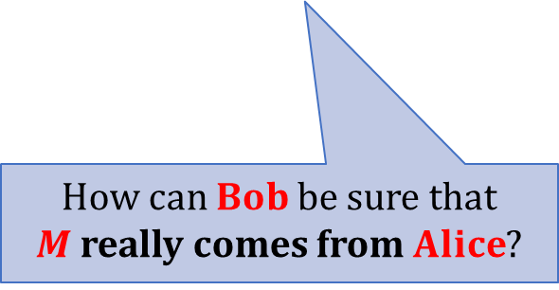
Message Authentication
Integrity:
$$M$$
$$Alice$$
interferes with the transmission
(modifies the message, or inserts a new one)
$$Bob$$
How can $Bob$be sure that
$M$ really comes from $Alice$?

Slide 5


Sometimes more important than secrecy!
transfer $\$1000$ to Bob
transfer $\$1000$to Eve
Alice
Bank
Of course: usually we want both secrecy and integrity.

Slide 6
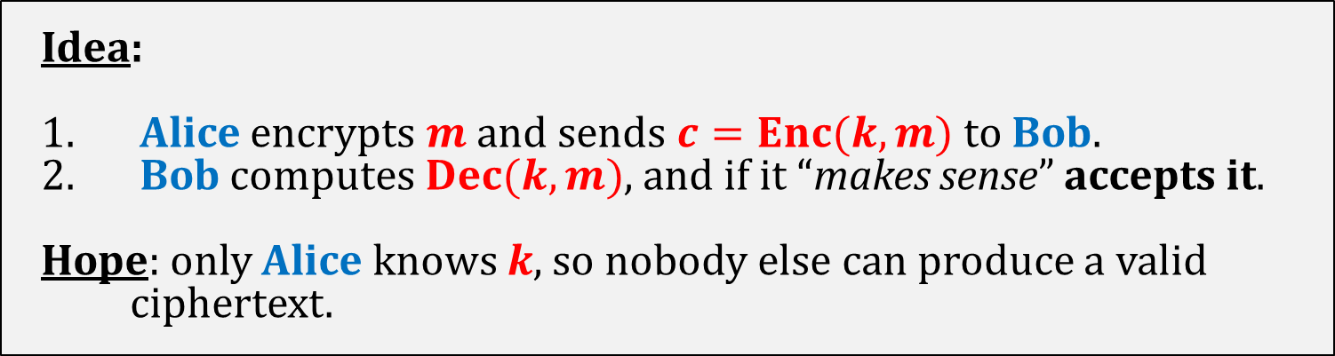




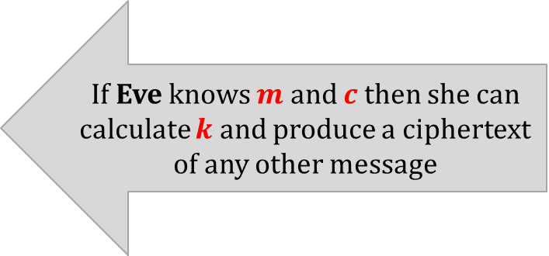
Does encryption guarantee message integrity?
Idea:
Alice encrypts $m$ and sends $c=Enc(k,m)$to Bob.
Bob computes $Dec(k,m)$, and if it “makes sense” accepts it.
Hope: only Alice knows $k$, so nobody else can produce a valid ciphertext.
This doesn’t work!
Example: one-time pad.
plaintext $m$
transfer $\$1000$ to $Bob$
If Eve knows $m$ and $c$ then she can calculate $k$ and produce a ciphertext of any other message
key $k$
xor
ciphertext $c$

Slide 7
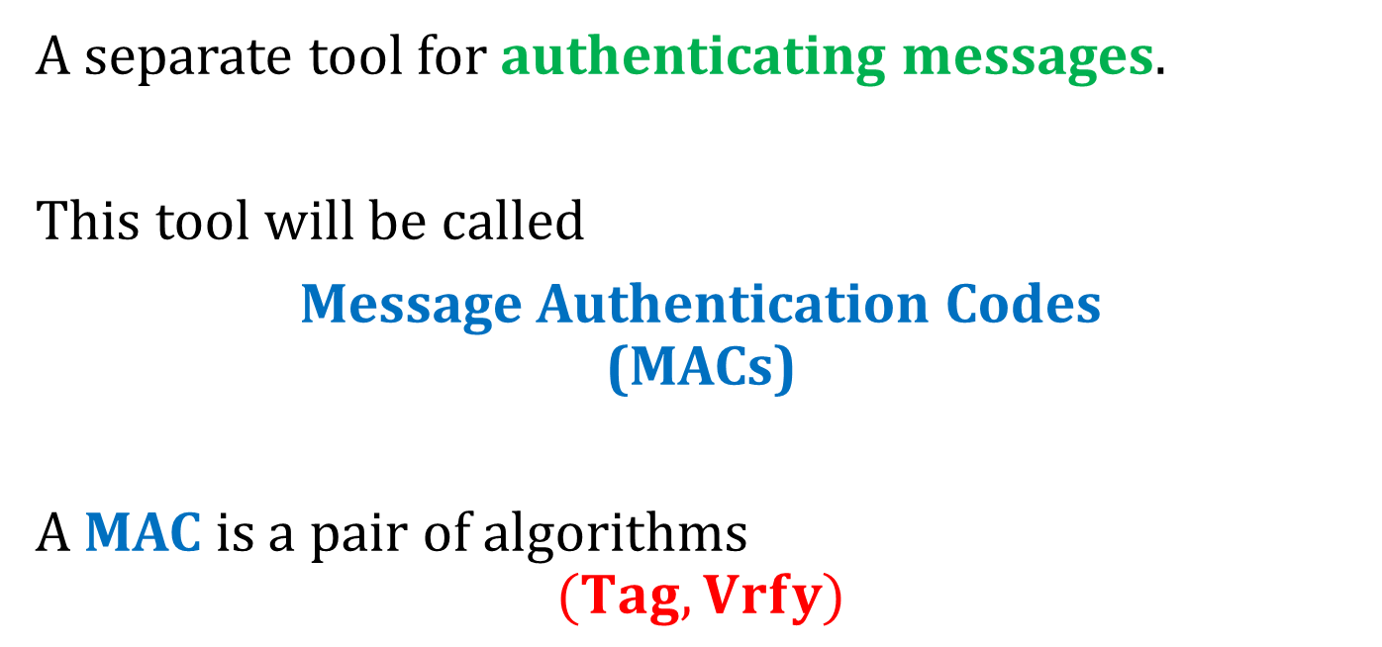
What do we need?
A separate tool for authenticating messages.
This tool will be called
Message Authentication Codes
(MACs)
A MAC is a pair of algorithms
$$(Tag,Vrfy)$$
“tagging” algorithm
“verification algorithm”

Slide 8
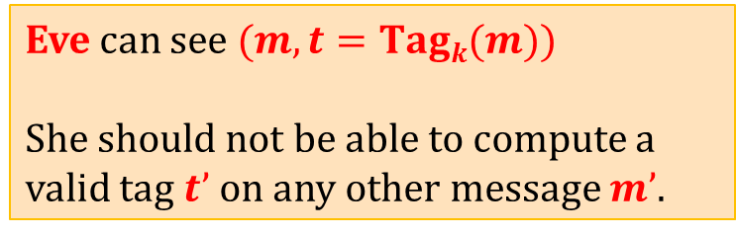
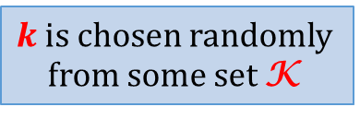
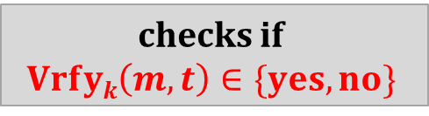





Message Authentication Codes
Eve can see $(m, t=Tagk(m))$
She should not be able to compute a valid tag $t’$on any other message $m’$.
$$(m, t=Tagk(m))$$
checks if
$$Vrfyk\left(m,t\right)∈\{yes,no\}$$
$$m$$
$$Alice$$
Bob
$$k$$
$$k$$
$k$ is chosen randomly
from some set K

Slide 9
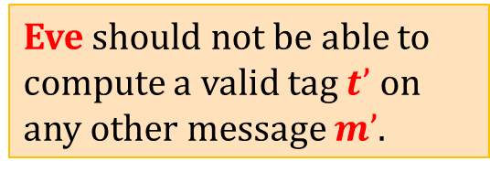









Message authentication – multiple messages
$$m1$$
$$(m1, t1 =Tagk(m1))$$
$$m2$$
$$(m2, t2 =Tagk(m2))$$
. . .
. . .
$$Alice$$
Bob
$$mw$$
$$(m_{w}, t_{w} =Tagk(m_{w}))$$
$$k$$
$$k$$
Eve should not be able to compute a valid tag $t’$ on any other message $m’$.

Slide 10
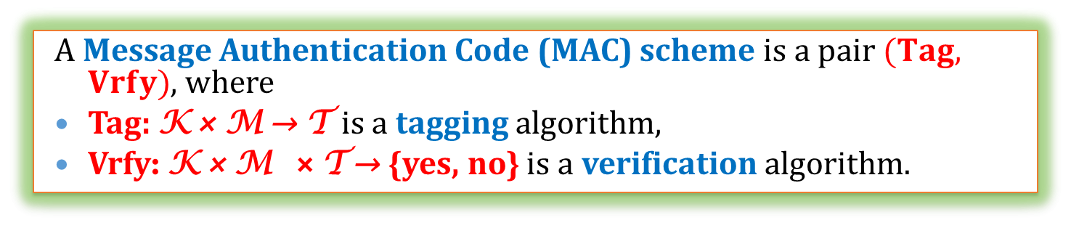

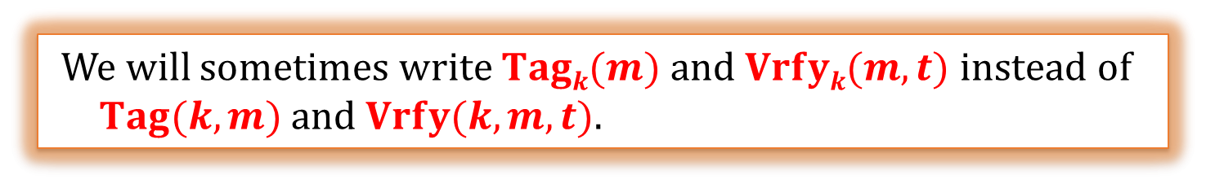
A mathematical view
K – key space
M – plaintext space
T - set of tags
A Message Authentication Code (MAC) scheme is a pair $(Tag, Vrfy)$, where
Tag: K × M → T is a tagging algorithm,
Vrfy: K × M × T → {yes, no} is a verification algorithm.
We will sometimes write $Tagk(m)$and $Vrfyk(m,t)$instead of $Tag(k,m)$and $Vrfy(k,m,t)$.
Correctness
it always holds that:
$Vrfyk(m,Tagk(m)) = yes$.

Slide 11
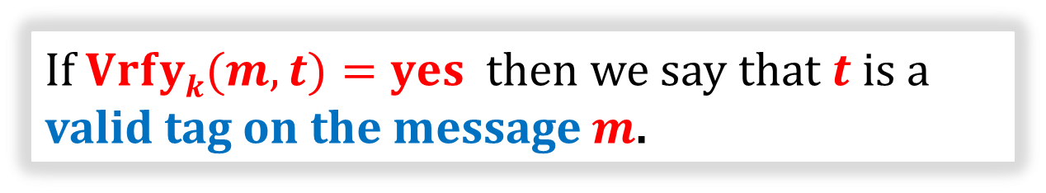
Conventions
If $Vrfyk(m,t)=yes$ then we say that $t$ is a valid tag on the message $m$.
If Tag is deterministic, then Vrfy just computes Tag and compares the result.
In this case we do not need to define Vrfy explicitly.

Slide 12
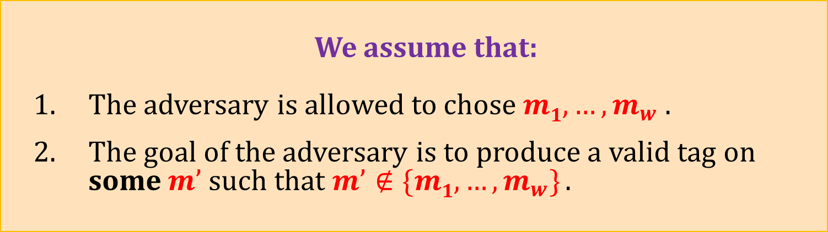
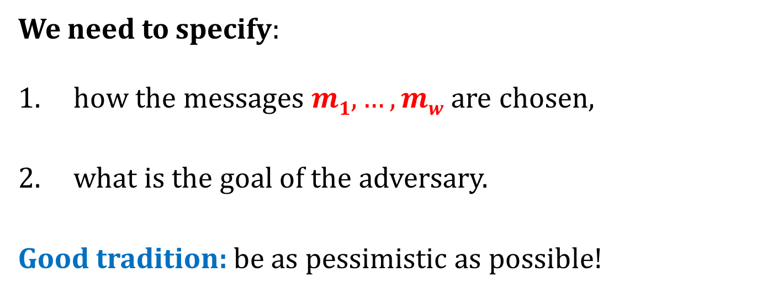
How to define security?
We need to specify:
how the messages $m1,…,mw$are chosen,
what is the goal of the adversary.
Good tradition: be as pessimistic as possible!
We assume that:
The adversary is allowed to chose $m1,…,m_{w}$ .
The goal of the adversary is to produce a valid tag on
some $m’$ such that $m’∉\{m1,…,m_{w}\}$.

Slide 13



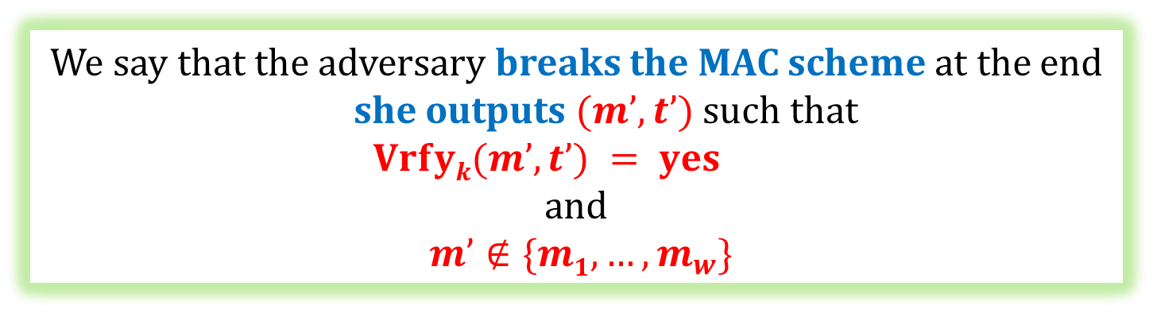
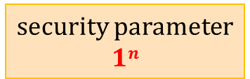


security parameter
$$1n$$
selects a random $k∈\{0,1\}n$
$$m1$$
adversary
$$(m1, t=Tagk(m1))$$
oracle
. . .
$$mw$$
$$(m_{w}, t=Tagk(m_{w}))$$
We say that the adversary breaks the MAC scheme at the end she outputs $(m’,t’)$such that
$$Vrfyk(m’,t’) = yes$$
and
$m’∉\{m1,…,m_{w}\}$

Slide 14

The security definition
We say that $(Tag,Vrfy)$is secure if
$$∀$$
P(A breaks it) is negligible (in n)
polynomial-time
adversary A

Slide 15

Aren’t we too paranoid?
Maybe it would be enough to require that:
the adversary succeds only if he forges a message that “makes sense”.
(e.g.: forging a message that consists of random noise should not count)
Bad idea:
hard to define,
is application-dependent.

Slide 16


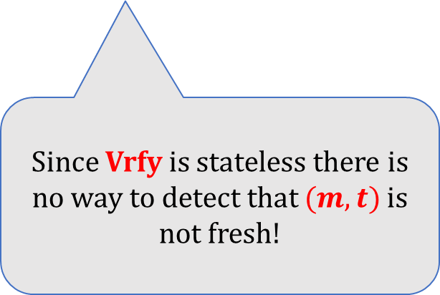


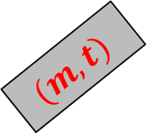
Warning: MACs do not offer protection against the “replay attacks”.
$$(m, t)$$
$$Alice$$
$$Bob$$
$$(m, t)$$
$$(m, t)$$
Since Vrfy is stateless there is no way to detect that $(m,t)$is not fresh!
$$(m, t)$$
. . .
This problem has to be solved by the higher-level application
(methods: time-stamping, nonces...).

Slide 17
Constructing a MAC
There exist MACs that are secure even if the adversary is infinitely-powerful.
These constructions are not practical.
MACs can be constructed from the block-ciphers.
We will now discuss to constructions:
  simple (and not practical),
  a little bit more complicated (and practical) – a CBC-MAC
MACs can also be constructed from the hash functions
(NMAC, HMAC).

Slide 18
Plan
Introduction to Message Authentication Codes (MACs).
Constructions of MACs from block ciphers

Slide 19
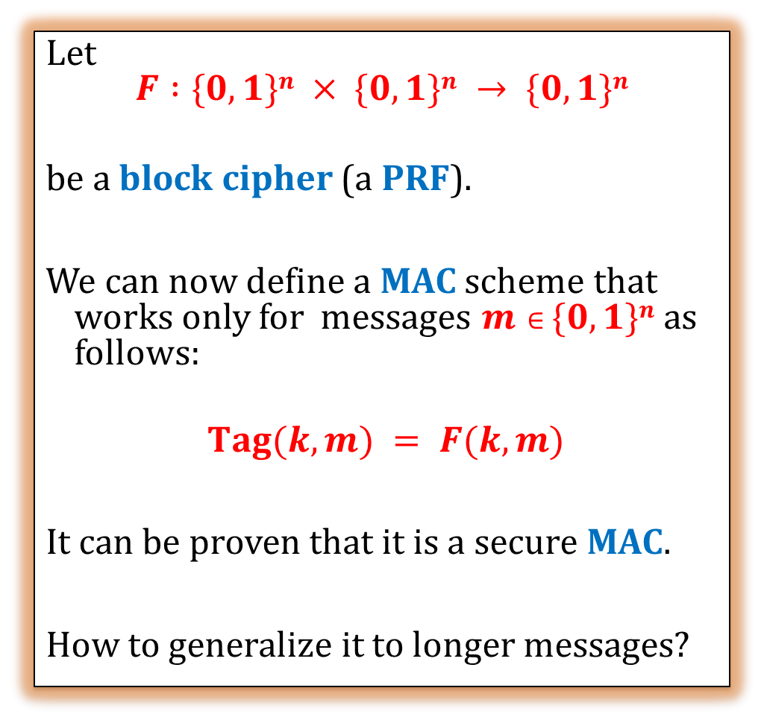



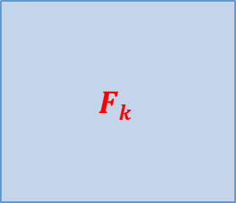
A simple construction from a block cipher
Let
$$F :\{0,1\}n × \{0,1\}n → \{0,1\}n$$
be a block cipher (a PRF).
We can now define a MAC scheme that works only for messages $m∈\{0,1\}n$as follows:
$Tag(k,m) = F(k,m)$
It can be proven that it is a secure MAC.
How to generalize it to longer messages?
$$F(k,m)$$
$$k$$
$$Fk$$
$$m$$

Slide 20

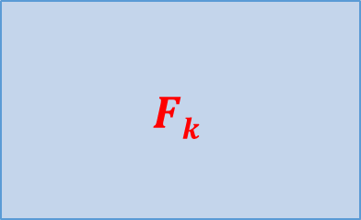




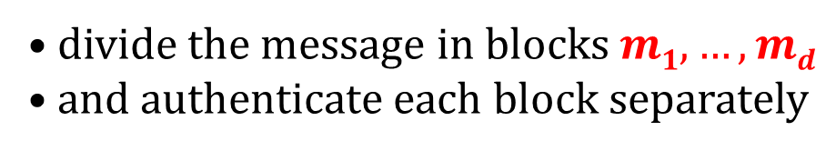
Idea 1
divide the message in blocks $m1,…,md$
and authenticate each block separately
$$F(k,m1)$$
$$F(k,md)$$
$$Fk$$
$$Fk$$
. . .
$$m1$$
$$md$$
This doesn’t work!

Slide 21




What goes wrong?
$$m:$$
$$t = Tagk(m):$$
perm
$$m’ = perm(m):$$
$$t’ = perm(t):$$
Then t’ is a valid tag on $m’$.

Slide 22

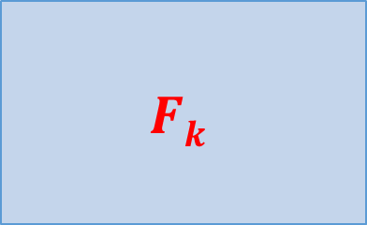








Idea 2
Add a counter to each block.
$$F(k,x1)$$
$$F(k,xd)$$
$$Fk$$
$$Fk$$
. . .
$$m1$$
$$1$$
$$md$$
$$d$$
$$x1$$
$$xd$$
This doesn’t work either!

Slide 23







$$mi$$
$$i$$
$$xi$$
$$m:$$
$$t = Tagk(m):$$
$m’$= a prefix of $m$:
$t’$= a prefix of $t$:
Then $t’$is a valid tag on $m’$.

Slide 24









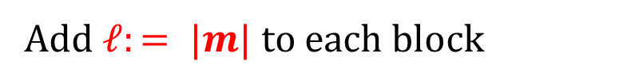

Idea 3
Add $ℓ:= |m|$to each block
$$F(k,x1)$$
$$F(k,xd)$$
$$Fk$$
$$Fk$$
. . .
$$m1$$
$$ℓ$$
$$1$$
$$md$$
$$ℓ$$
$$d$$
$$x1$$
$$xd$$
This doesn’t work either!

Slide 25











$$m1$$
$$ℓ$$
$$1$$
$$xi$$
What goes wrong?
$m$:
$m’$:
$$t = Tagk(m):$$
$$t’=Tagk(m’):$$
$m’’=$first half from $m$ $||$second half from $m’$
$t’’ =$first half from $t$ $||$ second half from $t’$
Then$t’’$is a valid tag on $m’’$.

Slide 26


Idea 4
Add a fresh random value to each block!
$$F(k,x1)$$
$$F(k,xd)$$
$$Fk$$
$$Fk$$
. . .
m₁
r
l
1
m_{d}
r
l
d
$$x_{1}$$
$$xd$$
This works!

Slide 27




























$$Tagk(m)$$
$$r$$
$$F(k,x1)$$
$$F(k,x2)$$
$$F(k,xd)$$
$$Fk$$
$$Fk$$
$$Fk$$
. . .
$$r$$
$$ℓ$$
$$1$$
$$m1$$
$$r$$
$$ℓ$$
$$2$$
$$m2$$
. . .
r
$$ℓ$$
$$d$$
$$md$$
$$x1$$
$$x2$$
$$xd$$
$r$ is chosen randomly
. . .
$$m1$$
$$m2$$
$$md$$
$$m$$
$$000$$
$n$ – block length
$$ℓ$$
$$|mi|=n/4$$
pad with zeroes if needed

Slide 28
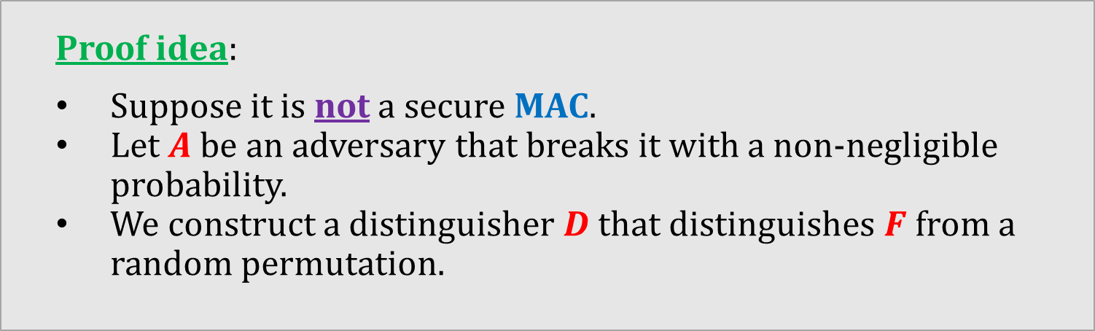
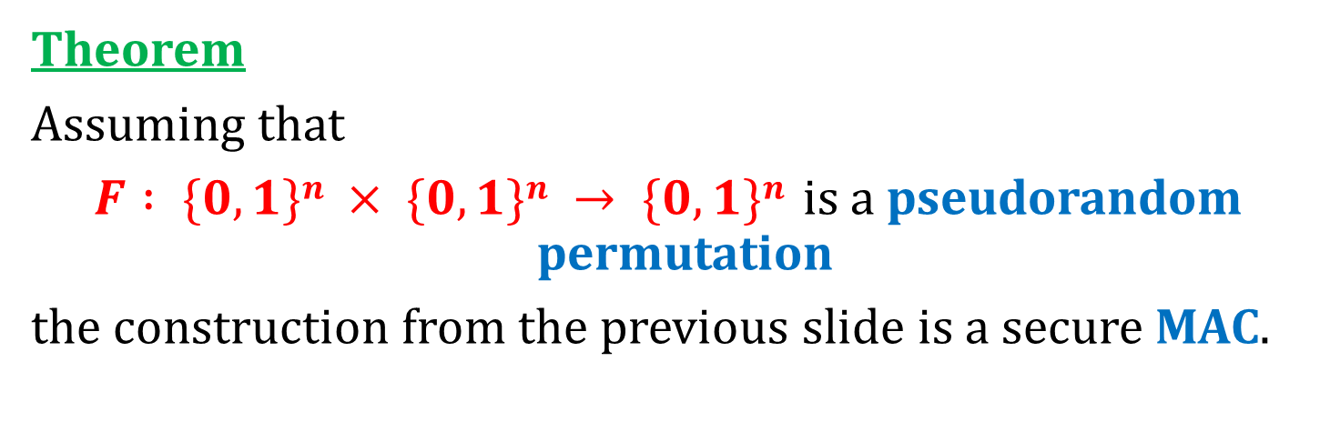
This construction can be proven secure
Theorem
Assuming that
$F : \{0,1\}n × \{0,1\}n → \{0,1\}n$is a pseudorandom permutation
the construction from the previous slide is a secure MAC.
Proof idea:
Suppose it is not a secure MAC.
Let $A$ be an adversary that breaks it with a non-negligible probability.
We construct a distinguisher $D$ that distinguishes $F$ from a random permutation.

Slide 29
A new member of “Minicrypt”
one-way functions
exist
this can be proven
this we already knew
computationally-secure
MACs exist
PRPs/PRFs
exist
this we have just shown

Slide 30
Our construction is not practical
Problem:
The tag is 4 times longer than the message...
We can do much better!

Slide 31





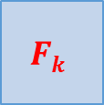



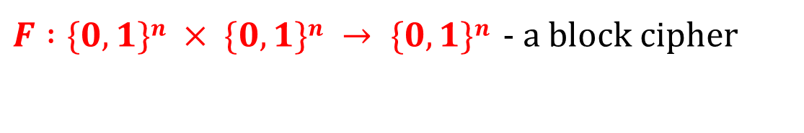


CBC-MAC
$F :\{0,1\}n × \{0,1\}n → \{0,1\}n$- a block cipher
T$agk(m)$
$$Fk$$
$$Fk$$
$$Fk$$
$$Fk$$
$$Fk$$
$$|m|$$
$$m1$$
$$m2$$
$$m3$$
$$. . .$$
$$md$$
$$m$$
$$0000$$
pad with zeroes if needed
Other variants exist!

Slide 32






$$Tagk(m)$$
$$Fk$$
$$Fk$$
$$Fk$$
$$Fk$$
$$Fk$$
. . .
$$|m|$$
$$m1$$
$$m2$$
$$m3$$
$$md$$
Why is this needed?
Suppose we do not prepend $|m|$...

Slide 33
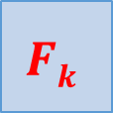





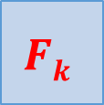




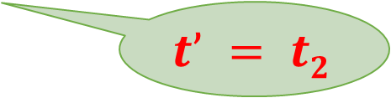

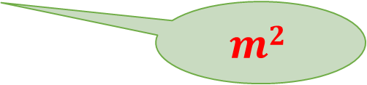
$$t1=Tagk(m1)$$
$$t2=Tagk(m2)$$
the adversary
chooses:
$$Fk$$
$$Fk$$
$$m1$$
$$m2$$
$$t’=Tagk(m’)$$
$$t1$$
$$t’ = t2$$
$$Fk$$
$$Fk$$
now she can compute:
$$m2$$
$$m1$$
$$m2⊕t1$$
$$m’$$

Slide 34
©2018 by Stefan Dziembowski. Permission to make digital or hard copies of part or all of this material is currently granted without fee provided that copies are made only for personal or classroom use, are not distributed for profit or commercial advantage, and that new copies bear this notice and the full citation.

