Slide 1

Lecture 4b
Hash Functions I
Stefan Dziembowski
www.crypto.edu.pl/Dziembowski
University of Warsaw
24.10.18
version 1.0

Slide 2
Secure communication
 | encryption | authentication
private key | private key encryption | private key authentication
public key | public key encryption | signatures
1
2
3
4
we will discus this on the next lecture, but first, we talk about the hash functions

Slide 3
Plan
Introduction and definitions
Hash function design paradigms
  Merkle-Damgård transform
  Sponge construction

Slide 4


Hash functions
short $H(m)$
a hash function
$$H:{\left\{0,1\right\}}^{∗}→ \{0,1\}L$$
long $m$

Slide 5

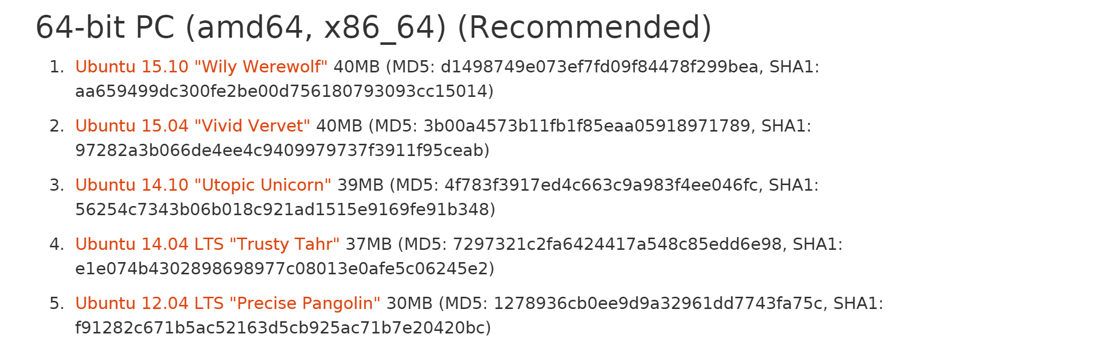

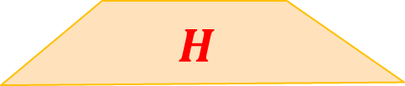

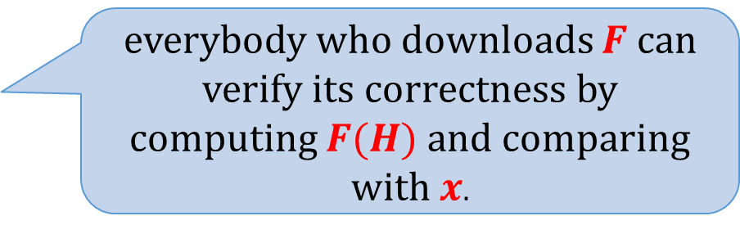
Example of an application: file fingerprinting
“fingerprint”
(publish this through a secure channel)
$$x= H(F)$$
$$H$$
everybody who downloads $F$ can verify its correctness by computing $F(H)$ and comparing with $x$.
large file $F$
Example
(ubuntu.com):

Slide 6
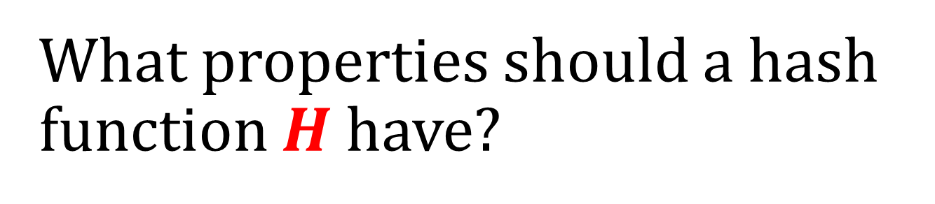
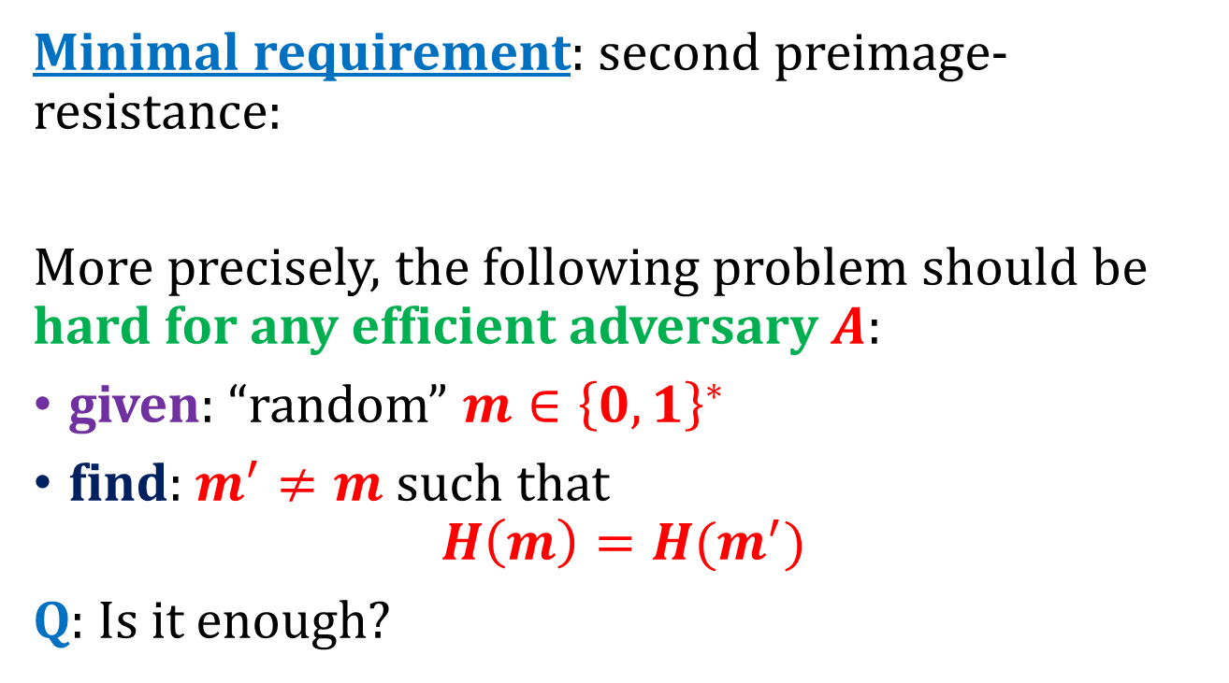
What properties should a hash function $H$have?
Minimal requirement: second preimage-resistance:
More precisely, the following problem should be hard for any efficient adversary $A$:
given: “random” $m∈{\left\{0,1\right\}}^{∗}$
find: $m^{′}≠m$such that
$$H\left(m\right)=H(m^{′})$$
Q: Is it enough?

Slide 7
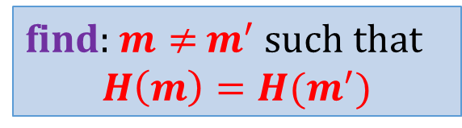
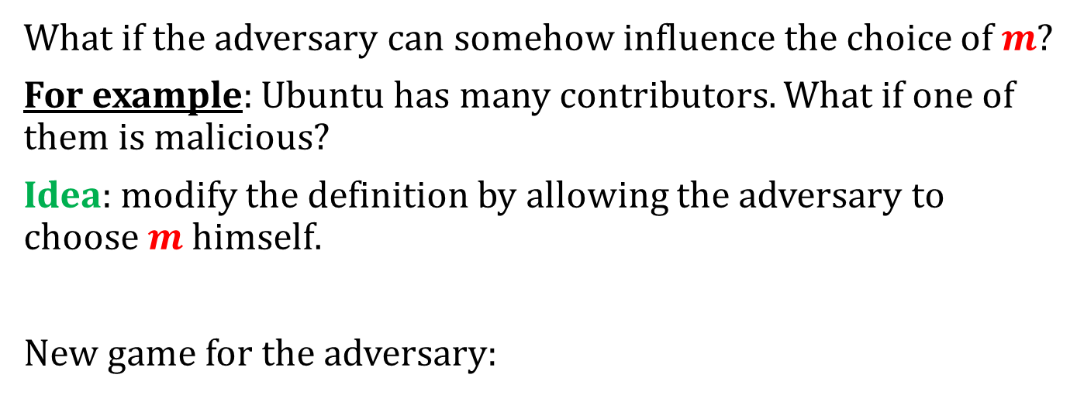
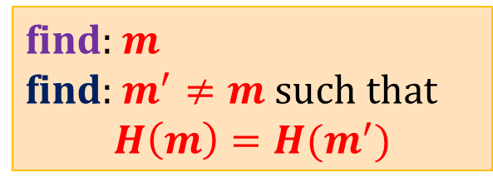

Second preimage resistance may be in many cases be too weak
What if the adversary can somehow influence the choice of $m$?
For example: Ubuntu has many contributors. What if one of them is malicious?
Idea: modify the definition by allowing the adversary to choose $m$ himself.
New game for the adversary:
if this problem is hard then a function is called
“collision-resistant”
find: $m$
find: $m^{′}≠m$ such that
$$H\left(m\right)=H(m^{′})$$
$$⇔$$
find: $m≠$ $m^{′}$ such that
$$H\left(m\right)=H(m^{′})$$

Slide 8

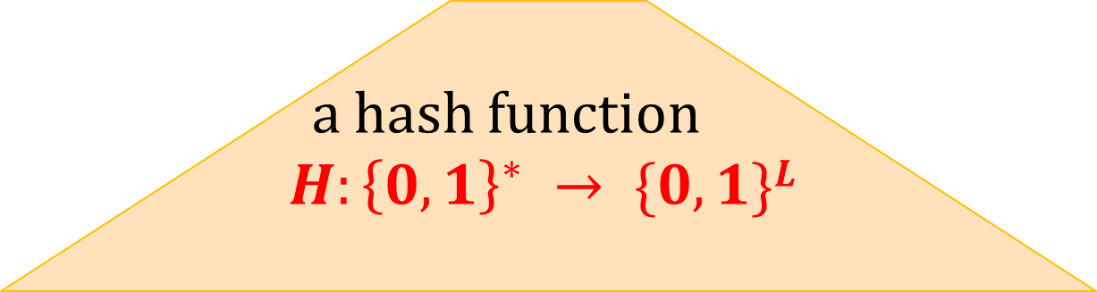

Collision-resistant hash functions
short $H(m)$
a hash function
$$H:{\left\{0,1\right\}}^{∗} → \{0,1\}L$$
long $m$
a “collision”
Requirement: it should be hard to find a pair $(m,m’)$such that
$$H(m)=H(m’)$$

Slide 9


Collisions always exist
domain
$$m$$
range
$$m’$$
Since the domain is larger than the range the collisions have to exist.

Slide 10
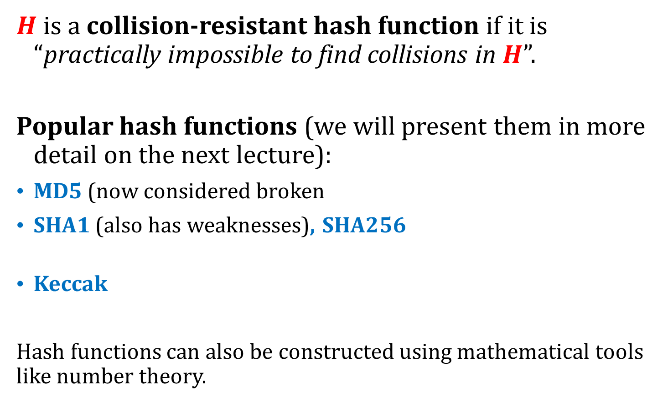
“Practical definition”
$H$ is a collision-resistant hash function if it is “practically impossible to find collisions in $H$”.
Popular hash functions (we will present them in more detail on the next lecture):
MD5 (now considered broken
SHA1 (also has weaknesses), SHA256
Keccak
Hash functions can also be constructed using mathematical tools like number theory.
based on the Merkle-Damgård transformation
based on the sponge construction

Slide 11
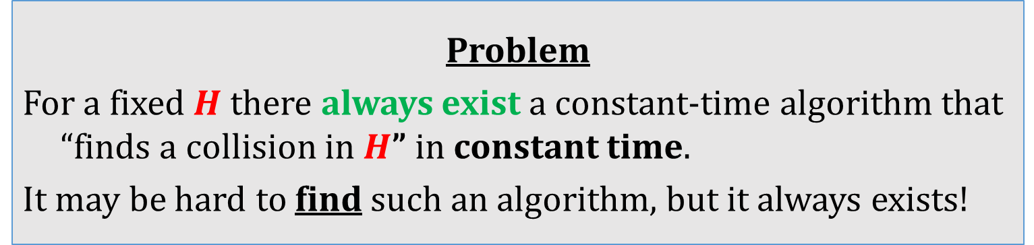
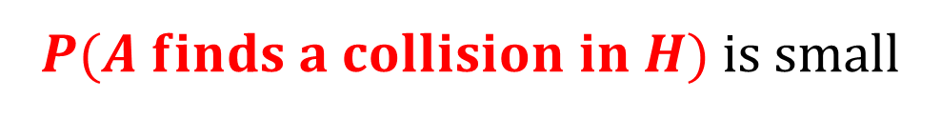


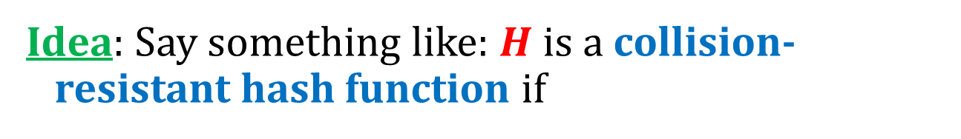
How to formally define “collision resitance”?
Idea: Say something like: $H$ is a collision-resistant hash function if
$$∀$$
$P(A finds a collision in H)$is small
efficient
adversary $A$
Problem
For a fixed $H$ there always exist a constant-time algorithm that “finds a collision in $H$” in constant time.
It may be hard to find such an algorithm, but it always exists!

Slide 12

Solution
When we prove theorems we will always consider
families of hash functions
indexed by a key $s$:
$${\left\{H^{s}\right\}}_{s∈keys }$$

Slide 13




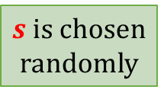


informal description:
“knows $H$”
a protocol
$$H$$
$$H$$
$$H$$
formal model:
$s$ is chosen
randomly
a protocol
$$s$$
$$Hs$$
$$Hs$$
$$Hs$$

Slide 14
informal description:
“knows $H$”
a protocol
$$H$$
$$H$$
H
$$H$$
real-life implementation (example):
“knows SHA1”
a protocol
SHA1
SHA1
SHA1

Slide 15
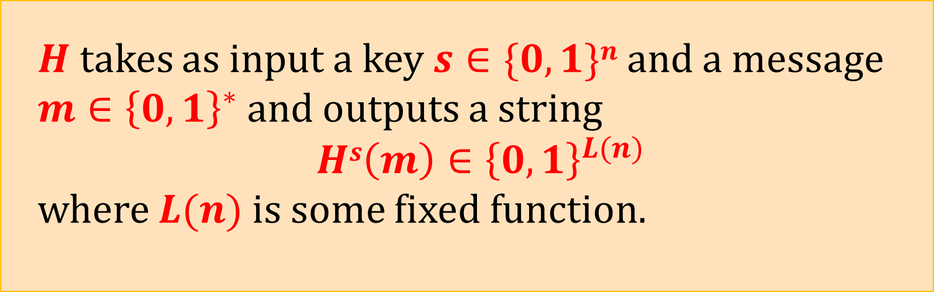

Hash functions – the functional definition
A hash function is a probabilistic polynomial-time algorithm $H$ such that:
$H$ takes as input a key $s∈\{0,1\}n$and a message
$m∈{\left\{0,1\right\}}^{∗}$and outputs a string
$$Hs\left(m\right)∈{\left\{0,1\right\}}^{L(n)}$$
where $L(n)$is some fixed function.

Slide 16


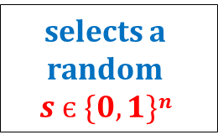

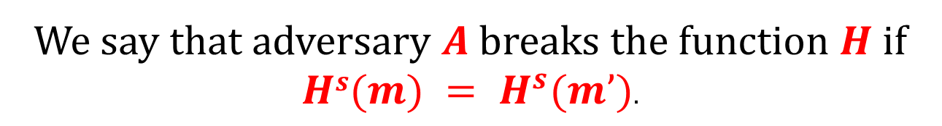
Hash functions – the security definition [1/2]
$$1n$$
selects a random
$$s є \{0,1\}n$$
$$s$$
outputs $(m,m’)$
We say that adversary $A$breaks the function $H$ if $Hs(m) = H^{s}(m’)$.

Slide 17


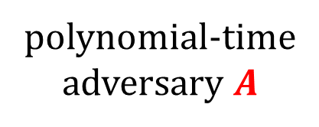

Hash functions – the security definition [2/2]
$H$ is a collision-resistant hash function if
$$∀$$
$P(A breaks H)$is negligible
polynomial-time
adversary $A$

Slide 18
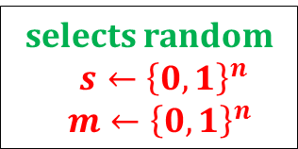





A weaker requirement: pre-image resistance
Intuitively: “it’s hard to find a pre-image of $H^{s}$”
Main difference:
$$1n$$
selects random
$s←{\left\{0,1\right\}}^{n}$
$m←{\left\{0,1\right\}}^{n}$
$$s,H^{s}(m)$$
outputs $m^{′}$
We say that adversary A breaks the function $H$ if
$$H^{s}\left(m\right)=H^{s}(m^{′})$$

Slide 19

Yet another requirement: second pre-image resistance
Intuitively: “it’s hard to find a second pre-image of $H^{s}$”
$$1^{n}$$
selects random
$s←{\left\{0,1\right\}}^{n}$
$m←{\left\{0,1\right\}}^{n}$
$$s,m$$
outputs $m^{′}$
We say that adversary A breaks the function $H$ if $m^{′}≠m$ and $H^{s}\left(m\right)=H^{s}(m^{′})$

Slide 20

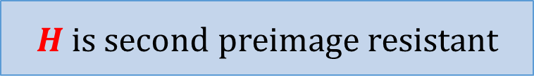

Fact
The following implications hold:
$H$ is collision resistant
$H$ is second preimage resistant
$H$ is pre-image resistant

Slide 21
Do collision-resilient hash functions belong to minicrypt?
collision-resilient hash functions exist
?
easy exercise
open problem
one-way functions
exist
[D. Simon: Finding Collisions on a One-Way Street: Can Secure Hash Functions Be Based on General Assumptions? 1998]:
there is no “black-box reduction”.

Slide 22
Plan
Introduction and definitions
Hash function design paradigms
  Merkle-Damgård transform
  Sponge construction

Slide 23
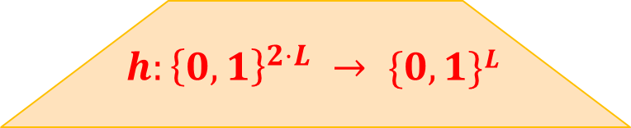




A common method for constructing hash functions
Construct a “fixed-input-length” collision-resistant hash function
Call it: a collision-resistant compression function.
Use it to construct a hash function.
$$L$$
$$h(m)$$
$$h:{\left\{0,1\right\}}^{2⋅L} → \{0,1\}L$$
$$m$$
$$2·L$$

Slide 24











An idea
pad with zeroes
if needed
$$t$$
$$m$$
$$0000$$
$$m1$$
$$m2$$
. . .
$$mB$$
$$mi∈\{0,1\}L$$
. . .
$$IV$$
$$h$$
$$h$$
$$h$$
$$H(m)$$
can be arbitrary
This doesn’t work...

Slide 25









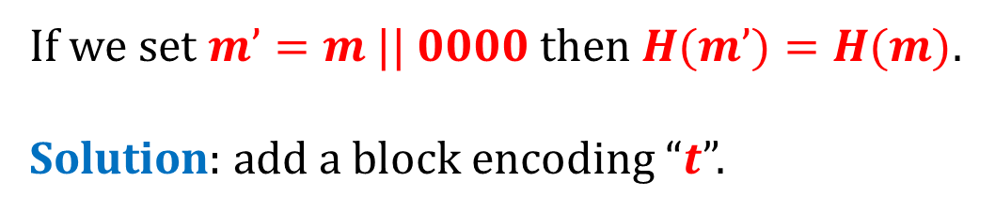

Why is it wrong?
$$t$$
$$m$$
$$0000$$
$$m1$$
$$m2$$
. . .
$$mB$$
If we set $m’=m || 0000$then $H(m’)=H(m)$.
Solution: add a block encoding “$t$”.
$$t$$
$$m’$$
$$0000$$
$$m_{1}^{′}$$
$$m_{2}^{′}$$
. . .
$$m_{B}^{′}$$
$$m_{B+1}^{′}=t$$

Slide 26














Merkle-Damgård transform
given $h :\{0,1\}2L → \{0,1\}L$
we construct $H:{\left\{0,1\right\}}^{∗}→\{0,1\}L$
doesn’t need to be know in advance
(nice!)
$$t$$
$$m$$
$$0000$$
$$m1$$
$$m2$$
$$mB$$
$$m_{B+1}=t$$
$$mi∈\{0,1\} L$$
. . .
$$IV$$
$$h$$
$$h$$
$$h$$
$$h$$
$$H(m)$$

Slide 27
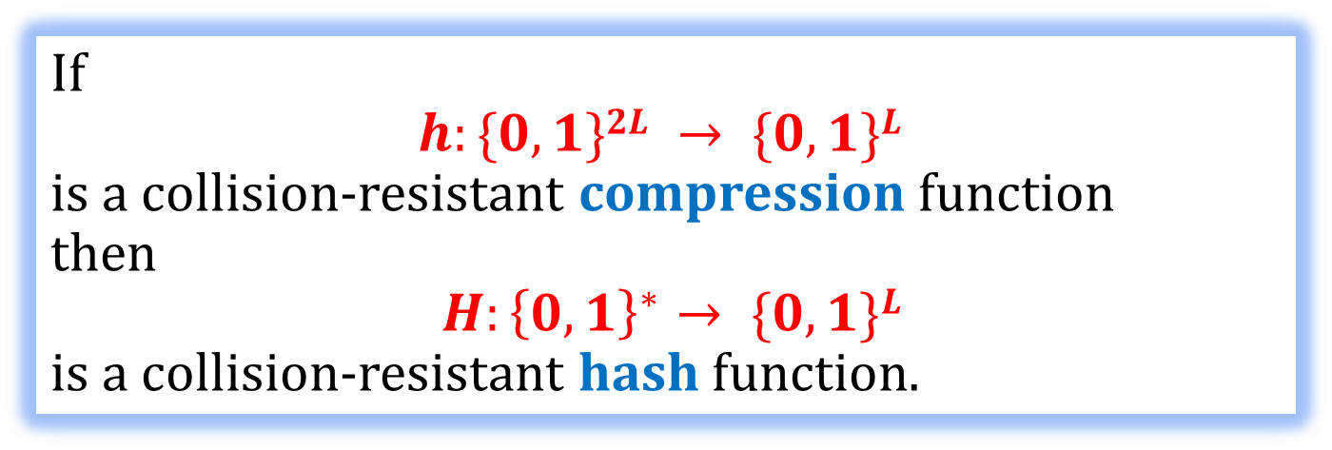
This construction is secure
We would like to prove the following:
Theorem
If
$$h:\{0,1\}2L → \{0,1\}L$$
is a collision-resistant compression function
then
$H:{\left\{0,1\right\}}^{∗}→ \{0,1\}L$
is a collision-resistant hash function.
But wait….
It doesn’t make sense…

Slide 28
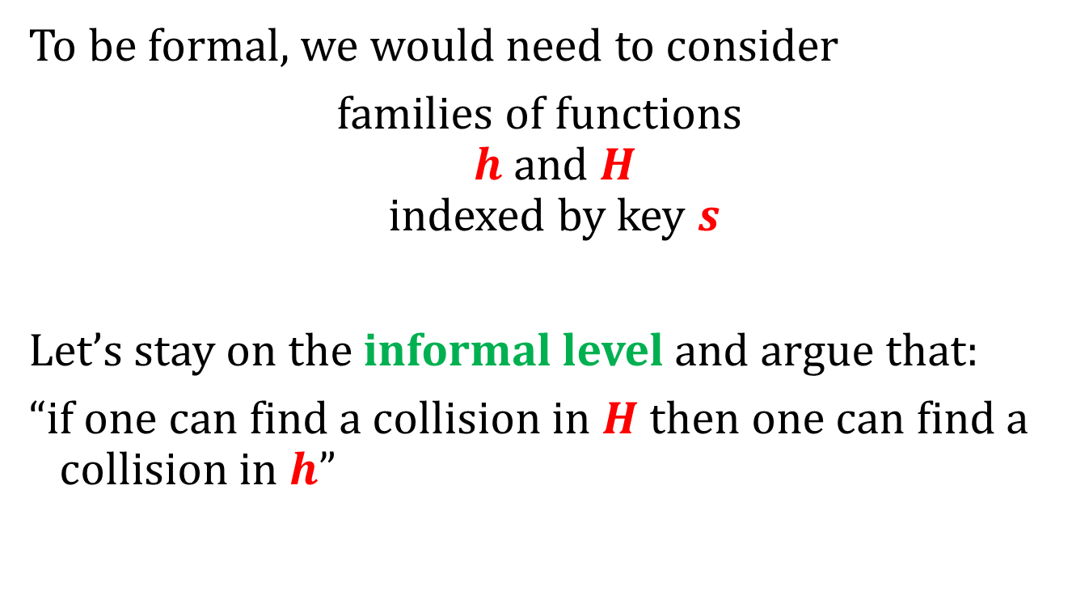
What to do?
To be formal, we would need to consider
families of functions
$h$ and $H$
indexed by key $s$
Let’s stay on the informal level and argue that:
“if one can find a collision in $H$then one can find a collision in $h$”

Slide 29

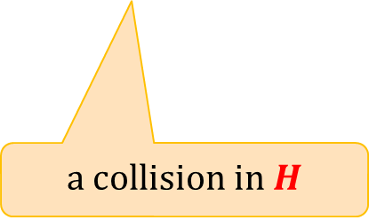



$a$ breaks $h$
$$(m,m’)$$
$A$ breaks $H$
a collision in $H$
outputs a collision $(x,y)$in $h$

Slide 30


How to compute a collision $(x,y)$in $h$ from a collision $(m,m’)$in $H$?
We consider two cases:
$|m| = |m’|$
$|m| ≠ |m’|$

Slide 31












Case 1: $|m|=|m’|$
$$t$$
$$m$$
$$0000$$
$$m1$$
$$m2$$
$$mB$$
$$m_{B+1}=t$$
$$t$$
$$m’$$
$$0000$$
$$m_{1}^{′}$$
$$m_{2}^{′}$$
$$m_{B}^{′}$$
$$m_{B+1}^{′}=t$$

Slide 32







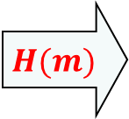





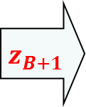


$$|m|=|m’|$$
Some notation:
$$m$$
$$0000$$
$$m1$$
$$m2$$
$$mB$$
$$m_{B+1}=t$$
. . .
$$IV$$
$$h$$
$$h$$
$$h$$
$$h$$
$$z1$$
$$z2$$
$$z3$$
$$zB$$
$$z_{B+1}$$
$$H(m)$$

Slide 33







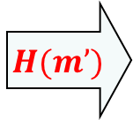





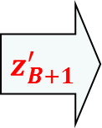

$$|m|=|m’|$$
For $m’$:
$$m’$$
$$0000$$
$$m_{1}^{′}$$
$$m_{2}^{′}$$
$$m_{B}^{′}$$
$$m_{B+1}^{′}=t$$
. . .
$$IV$$
$$h$$
$$h$$
$$h$$
$$h$$
$$z_{1}^{′}$$
$$z_{2}^{′}$$
$$z_{3}^{′}$$
$$z_{B}^{′}$$
$$z_{B+1}^{′}$$
$$H(m’)$$

Slide 34






















$$z_{B+2}=H(m)$$
equal
$$z_{B+2}^{′}=H(m^{′})$$
$$m_{B+1}$$
$$z_{B+1}$$
$$m_{B+1}^{′}$$
$$z_{B+1}^{′}$$
$$m_{B}$$
$$zB$$
$$m_{B}^{′}$$
$$z_{B}^{′}$$
$$. . .$$
$$. . .$$
$$z3$$
$$z_{3}^{′}$$
$$m2$$
$$z2$$
not equal
$$m_{2}^{′}$$
$$z_{2}^{′}$$
$$m1$$
$$z_{1}=IV$$
$$m_{1}^{′}$$
$$z_{1}^{′}=IV$$

Slide 35
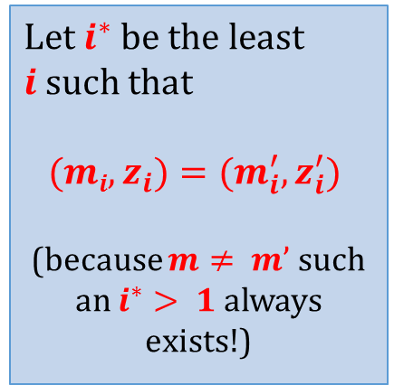
$$z_{B+2}=H(m)$$
equal
$$z_{B+2}^{′}=H(m^{′})$$
$$m_{B+1}$$
$$z_{B+1}$$
$$m_{B+1}^{′}$$
$$z_{B+1}^{′}$$
Let $i^{∗}$be the least $i$such that
$$(mi,z_{i})=(m_{i}^{′},z_{i}^{′})$$
(because $m≠ m’$such an $i^{∗}> 1$always exists!)
$$m_{B}$$
$$zB$$
$$m_{B}^{′}$$
$$z_{B}^{′}$$
$$. . .$$
$$. . .$$
$$z3$$
$$z_{3}^{′}$$
$$m2$$
$$z2$$
$$m_{2}^{′}$$
$$z_{2}^{′}$$
$$m1$$
$$z_{1}=IV$$
$$m_{1}^{′}$$
$$z_{1}^{′}=IV$$

Slide 36








So, we have found a collision!
$$z_{i^{∗}}$$
equal
$$z_{i^{∗}}^{′}$$
$$h$$
$$h$$
$$m_{i^{∗}−1}$$
$$z_{i^{∗}−1}$$
not equal
$$m_{i^{∗}−1}^{′}$$
$$z_{i^{∗}−1}^{′}$$

Slide 37







Case 2: $|m|≠|m’|$
$$H(m)$$
equal
$$H(m’)$$
$$m_{B+1}$$
$$z_{B+1}$$
$$m_{B^{′}+1}^{′}$$
$$z_{B^{′}+1}^{′}$$
. . .
. . .
the last block encodes
the length on the message
so these values
cannot be equal!
So, again we have found a collision!

Slide 38
Plan
Introduction and definitions
Hash function design paradigms
  Merkle-Damgård transform
  Sponge construction

Slide 39












Sponge construction (used in Keccak)
main parameters:
$c$ – “capacity”
$r$ – “rate”
$b≔c+r$ – “state width”
main ingredient:
a function $f:{\left\{0,1\right\}}^{r+c}→{\left\{0,1\right\}}^{r+c}$
first step: input processing:
$$r$$
$$f$$
$$c$$
pad if needed with $10^{∗}1$
$$m$$
1$00…01$
divide $m$ as:
$$p_{0}$$
$$p_{1}$$
$$p_{ℓ}$$
$$r$$
$$r$$
$$r$$

Slide 40





















Second step
truncate if needed
note: “unlimited” length
“output”
$$…$$
$$…$$
$$p_{0}$$
$$p_{1}$$
$$p_{ℓ}$$
$$z_{0}$$
$$z_{1}$$
$$f$$
$$f$$
$$f$$
$$f$$
$$f$$
$$r$$
$$⊕$$
$$⊕$$
$$⊕$$
$$(0,…,0)$$
$$…$$
$$…$$
$$c$$
$$(0,…,0)$$
“absorbing”
“squeezing”

Slide 41
©2018 by Stefan Dziembowski. Permission to make digital or hard copies of part or all of this material is currently granted without fee provided that copies are made only for personal or classroom use, are not distributed for profit or commercial advantage, and that new copies bear this notice and the full citation.

